Slide 1
Число 19

Slide 2
Продолжи числовой ряд
Вставь пропущенные числа
10, 11, …, …, 14 ,…, …, 17.
10, 11, 12, 13, 14, 15, 16, 17.
20, 19, …, …, 16, 15, …, 13.
20, 19, 18, 17, 16, 15, 14, 13.

Slide 3
Давайте посчитаем
12 + 5
18 – 6
16 - 5
12 + 3
17 – 4
13 + 5
18 – 4
12 + 4
18
12
15
13
17
16
11
14

Slide 4
10 +8 =10
16-6 =18
17-5 =4
14-10 =12
16-4
=8
18-10
=12

Slide 5
+
12 5= 17
13 2= 15
+
-
-
17 3= 14
19 2= 17
+
10 9= 19
+
16 2= 18
+
16 3 =19
12 3 =15
+
+
11 5 =16
11 7 =18
+
-
13 3 =10
-
18 3 =15

Slide 6
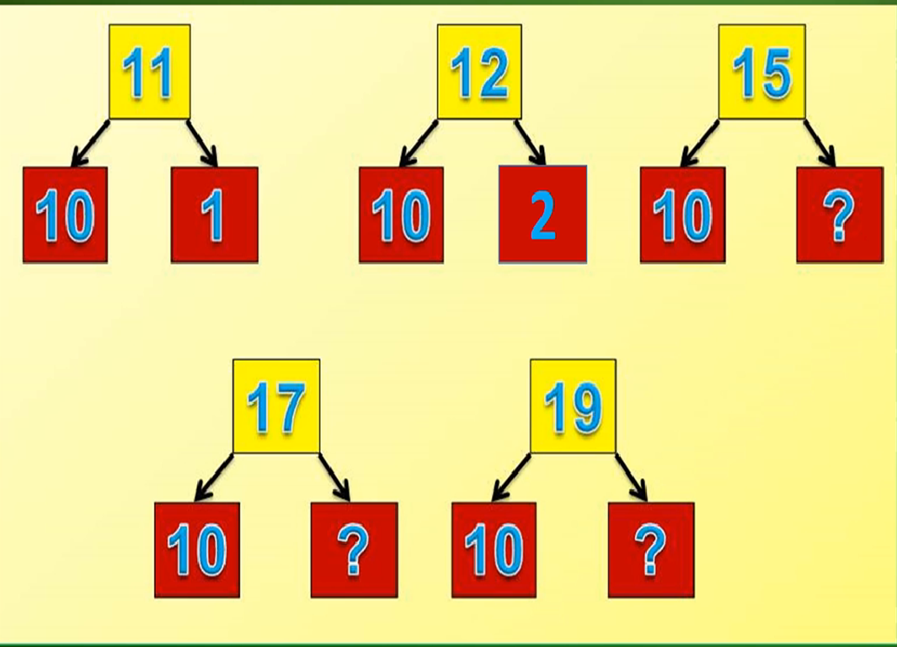
10
1
10
2
10
5
10
7
10
9

Slide 7
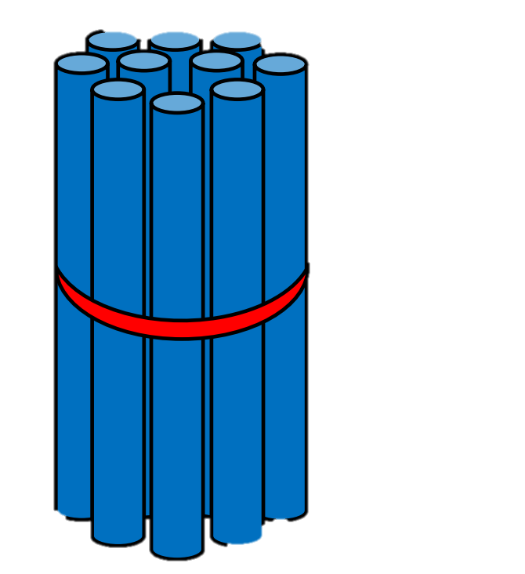
10 + 9 = 19

Slide 8
19 - 9 = 10

Slide 9
19 - 10 = 9

Slide 11
=9
=13
=13
=10
=10
=18
=19
=12
=19
=19
=17
=0
14
17
1
>
=
<
19
13
14
>
<
<

Slide 12
3 + 1 = 4(ч)

Slide 13
5 + 3 = 8(д.)
5 + 3 = 8(д.)

Slide 15
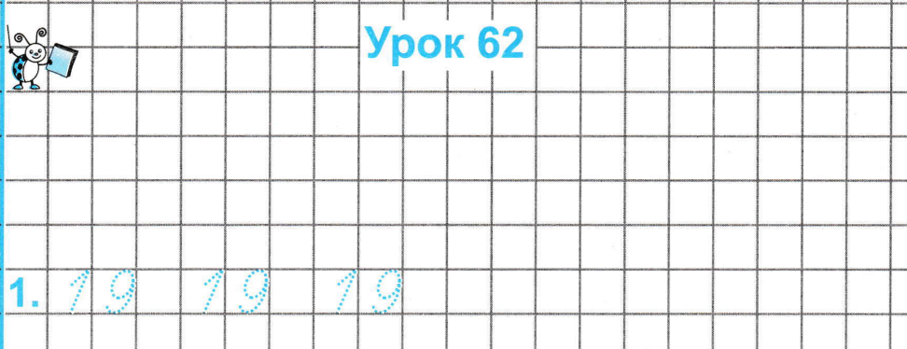
1 8 - 8= 1 0
1 0 +5= 1 5
1 2 - 10 = 2
1 7 - 10 = 7

Slide 16
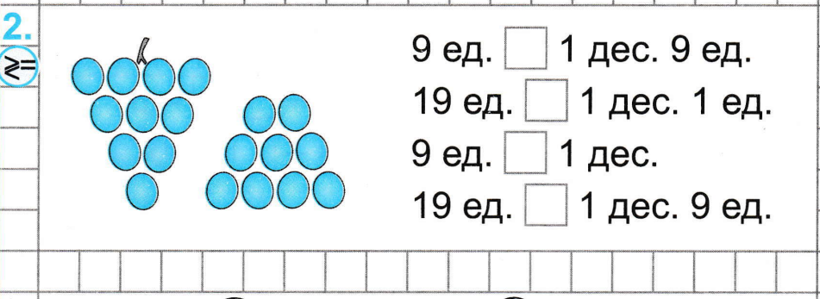
<
>
<
=

Slide 17
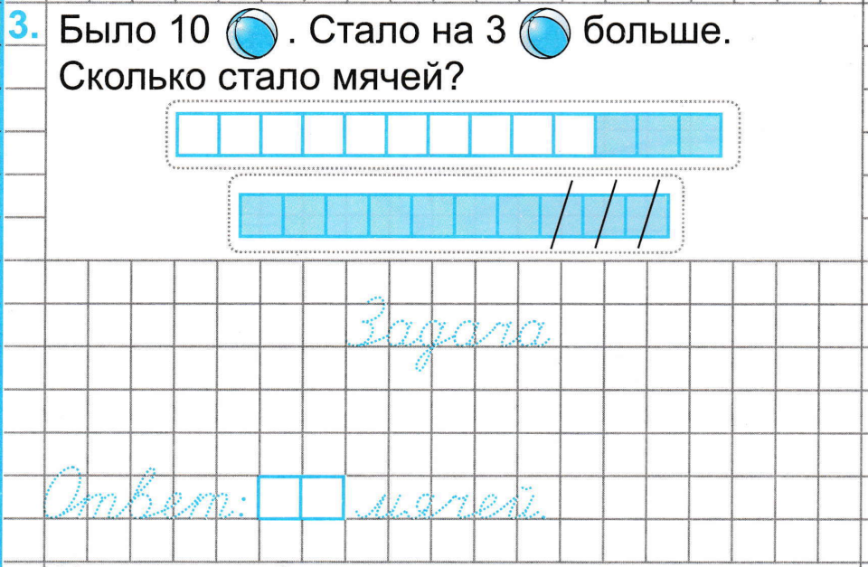
1 0 + 3= 1 3(м.)
1 3

