Slide 1
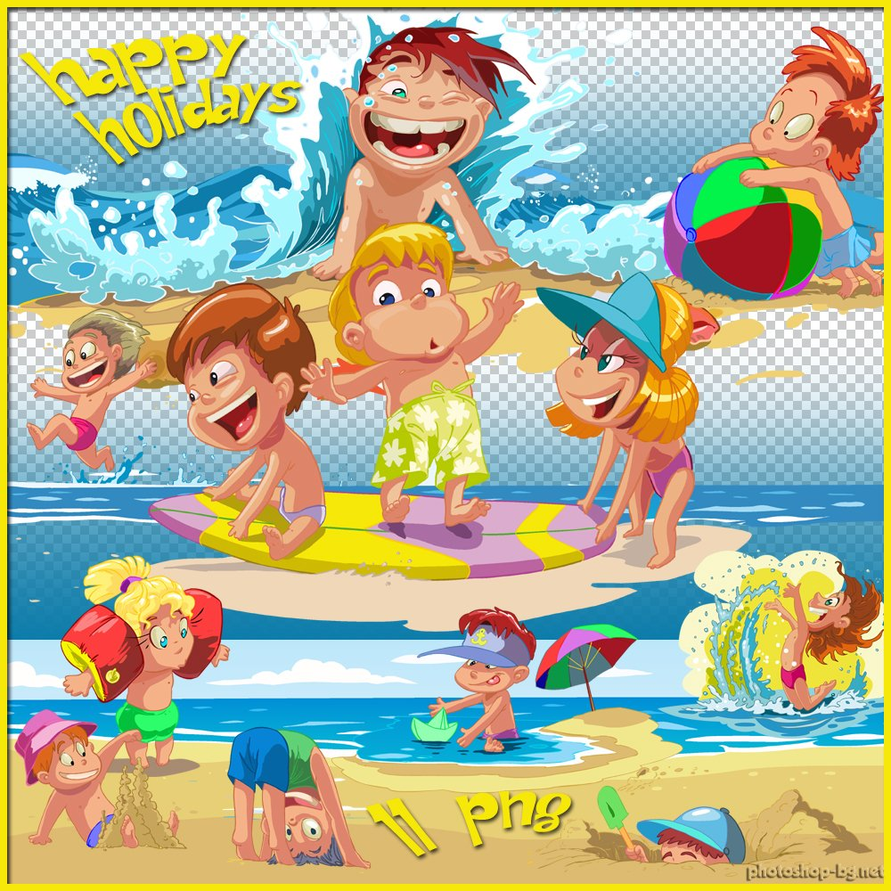
My holidays

Slide 3
It’s sunny.

Slide 4
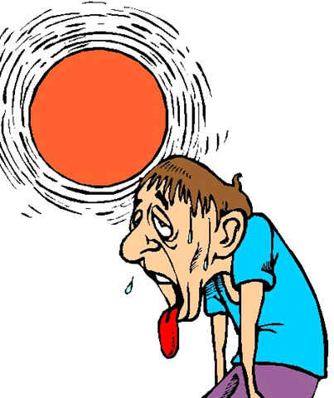

Slide 5
It’s hot.

Slide 6
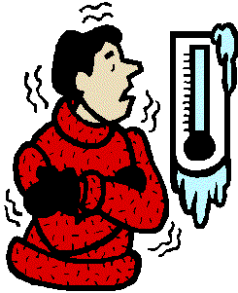

Slide 7
It’s cold.

Slide 8
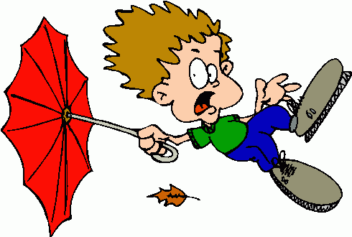

Slide 9
It’s windy.

Slide 10
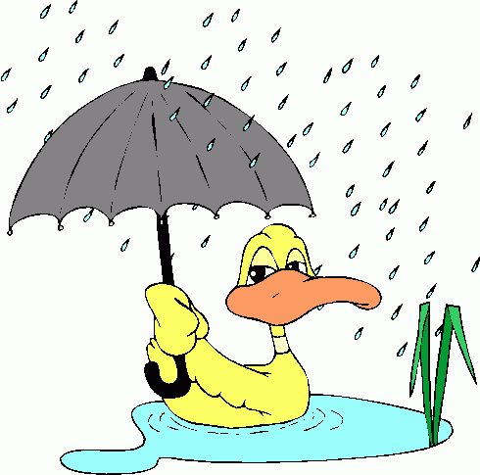

Slide 11
It’s raining.

Slide 13
An island

Slide 14
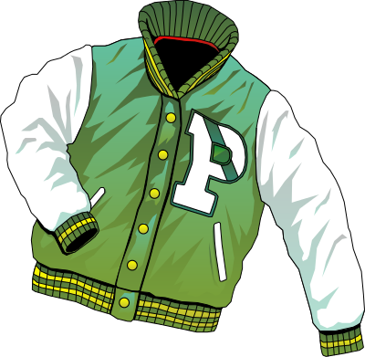

Slide 15
A jacket

Slide 16
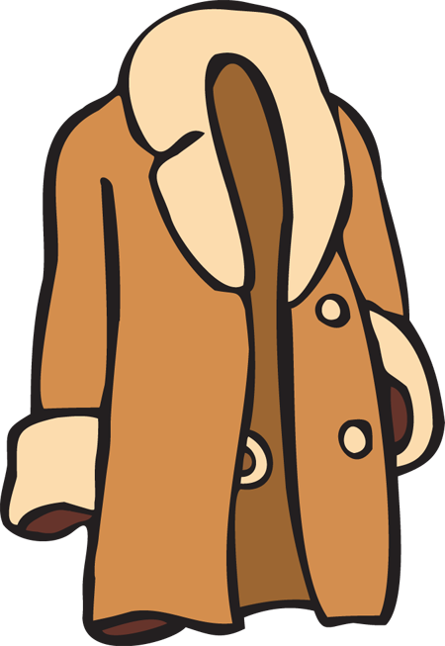

Slide 17
A coat

Slide 18
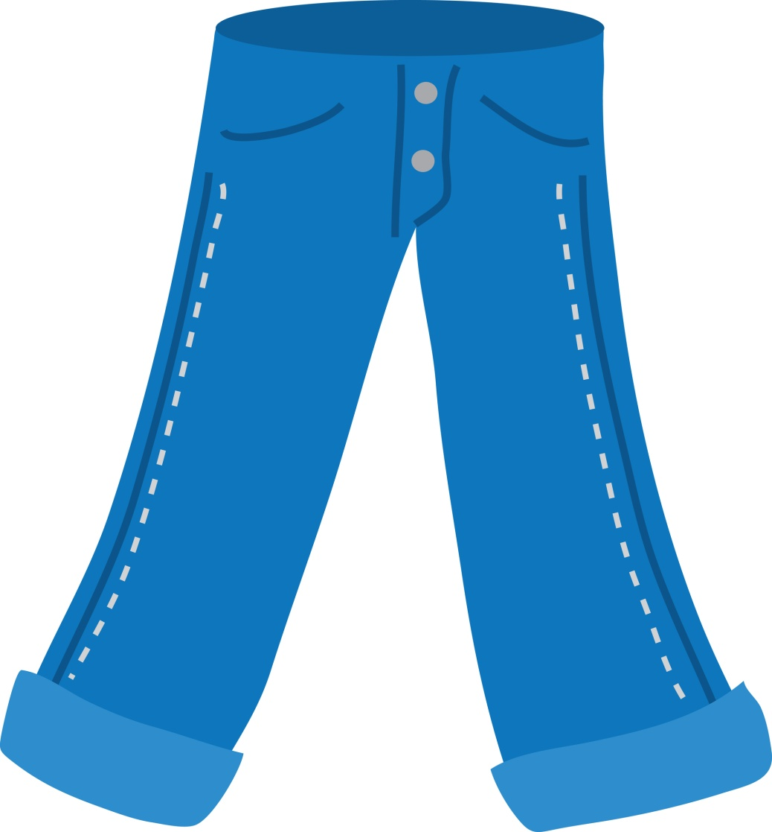

Slide 19
jeans

Slide 20
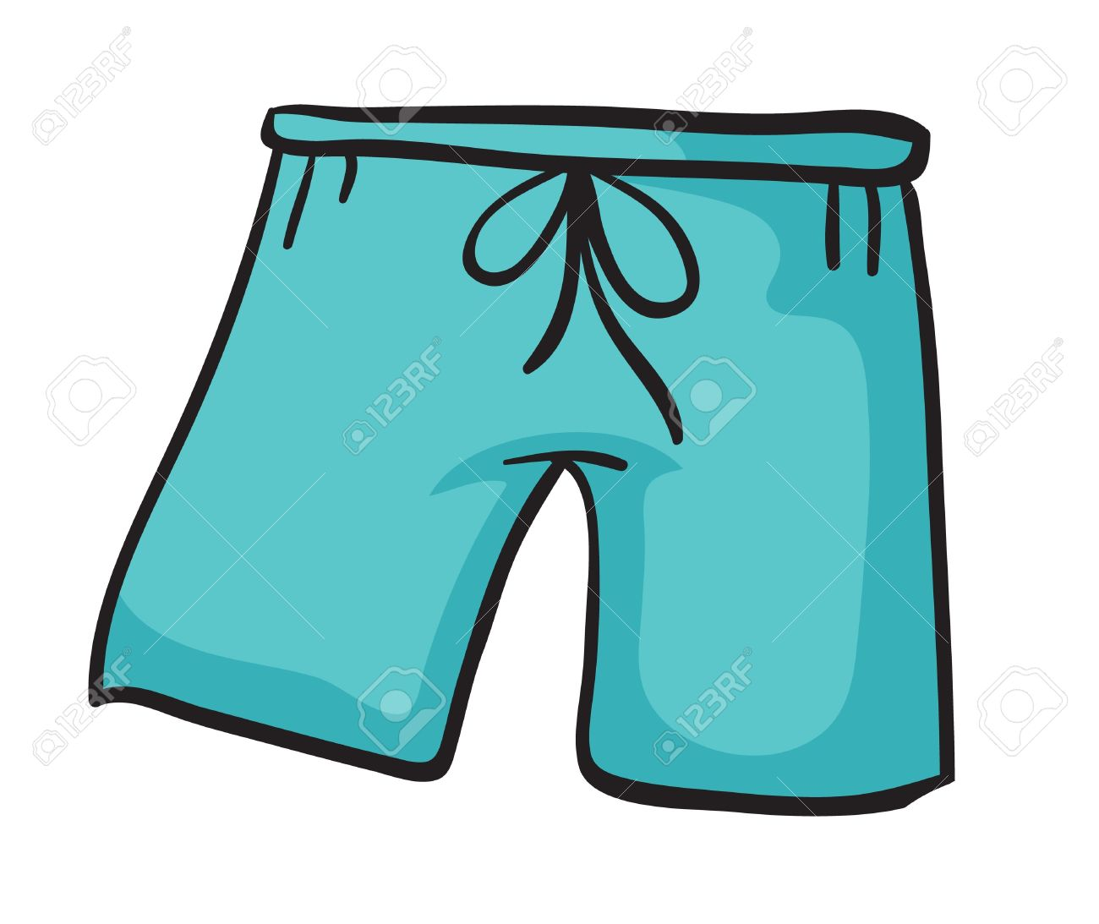

Slide 21
shorts

Slide 23
a hat

Slide 25
a cap

Slide 26
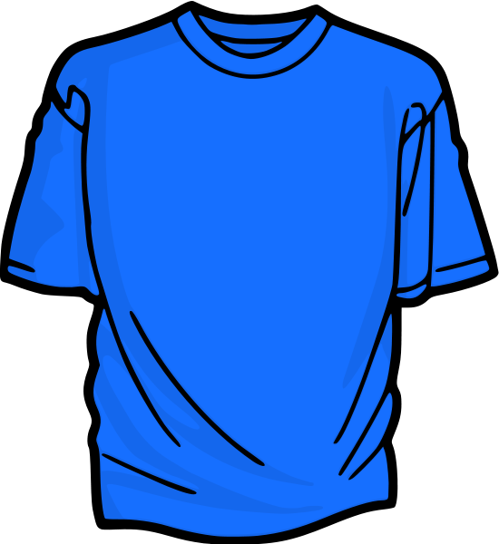

Slide 27
a T-shirt

Slide 28
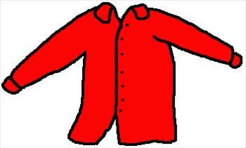

Slide 29
a shirt

Slide 30
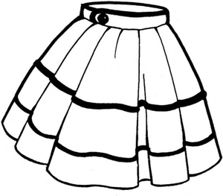

Slide 31
a skirt

Slide 32
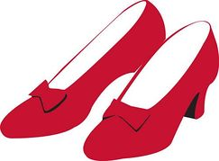

Slide 33
shoes

Slide 34
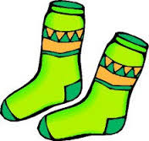

Slide 35
socks

Slide 36
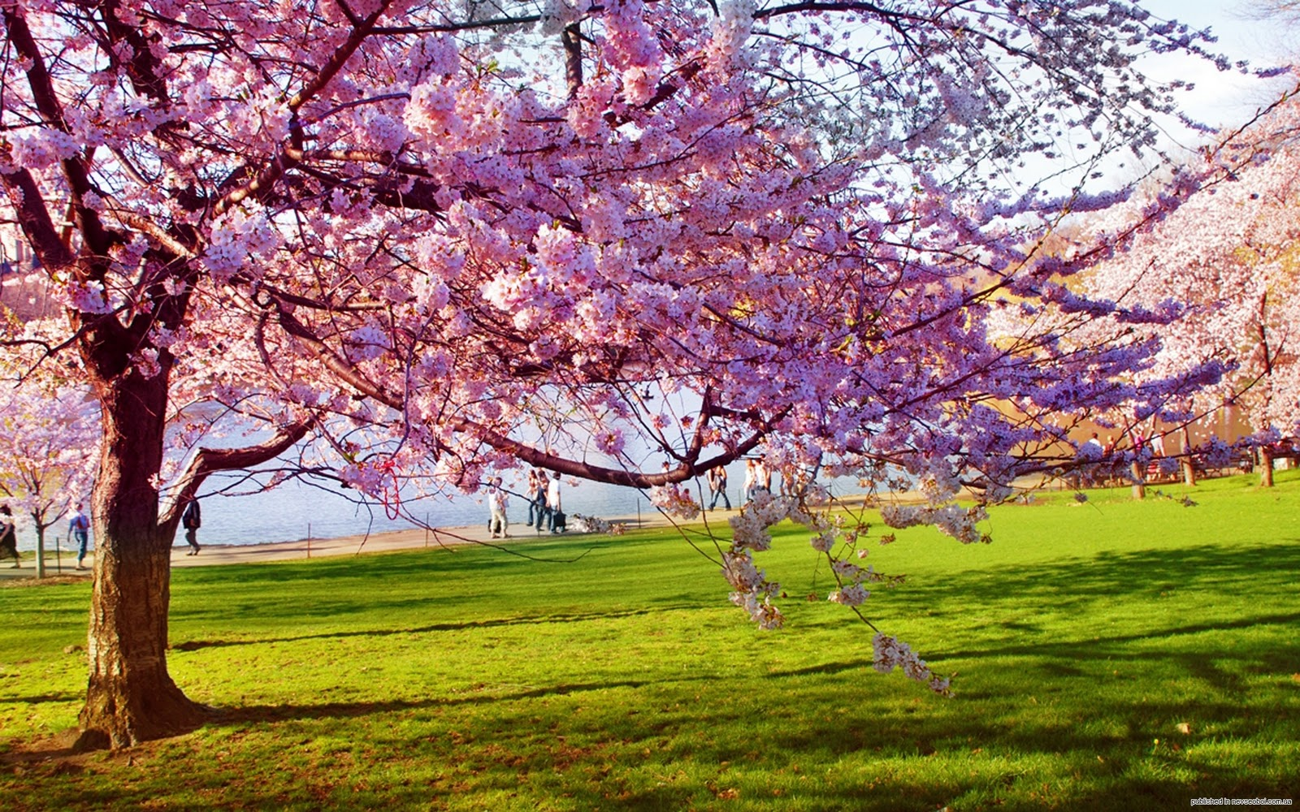

Slide 37
It’s spring.

Slide 38
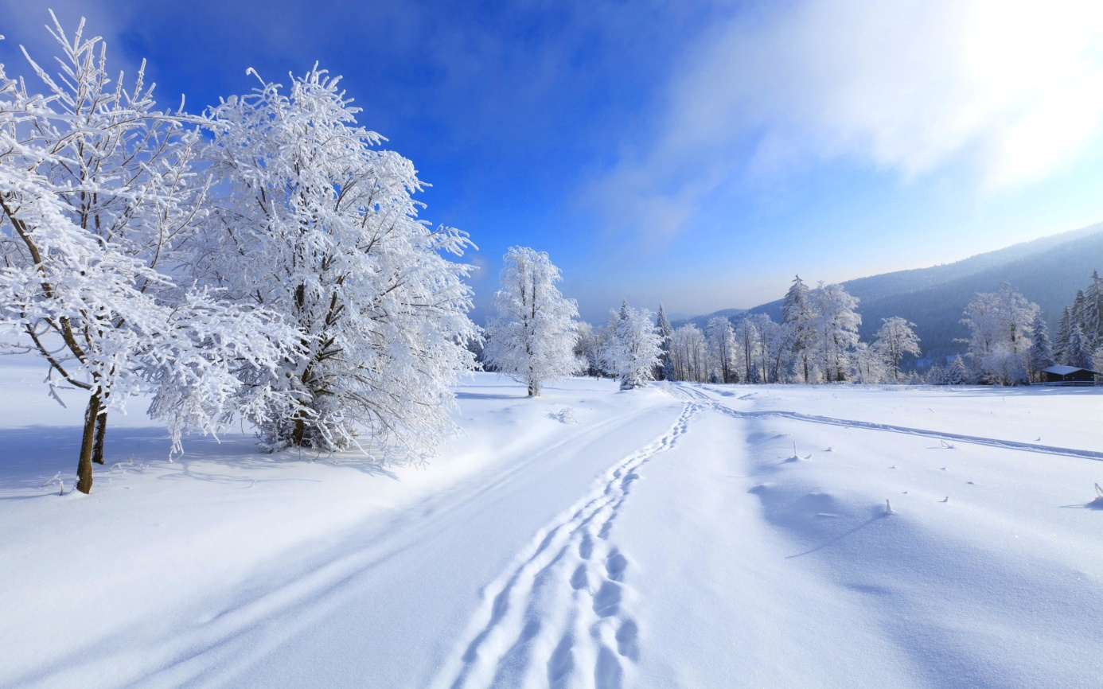

Slide 39
It’s winter.

Slide 41
It’s summer.

Slide 42
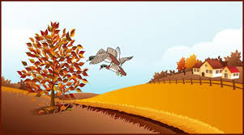

Slide 43
It’s autumn.

Slide 44
What’s the weather like?
It’s ……..

Slide 45
What’s the weather like?
It’s ……..

Slide 46
What’s the weather like?
It’s ……..

Slide 47
What’s the weather like?
It’s ……..

Slide 48
What’s the weather like?
It’s ……..

Slide 49
Answer the questions:
My favourite season is …………..
It‘s ……………….
I’m wearing my…..(я ношу)

Slide 50
her, bird, skirt, T-shirt; a skirt – skirts, a T-shirt – T-shirts; a blue skirt, a white T-shirt. Girls wear skirts. Boys wear T-shirts.

Slide 51
bee, read, jeans; dark blue jeans, my jeans, his jeans.

Slide 52
win, wind, windy; a hot wind, a windy day, the wind and the sun. It’s so hot!

Slide 53
blue, shoe, a shoe – shoes; red shoes, summer shoes; his shoes. Put on your shoes.

Slide 54
pot, sock, a sock – socks; his black socks. Take off your socks.

Slide 55
boat, cold; a cold day, cold weather. It’s so cold today!

Slide 56
kite, bike, island [ˈaɪlənd]; an island – islands, a big island, a small island.

Slide 57
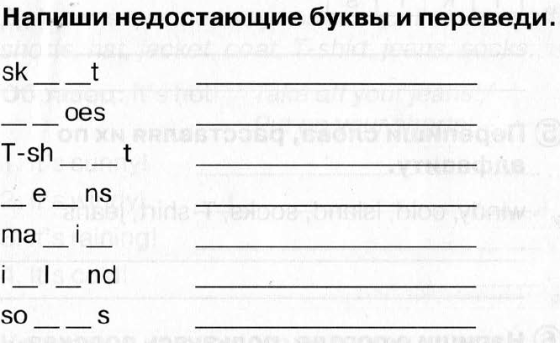

Slide 58
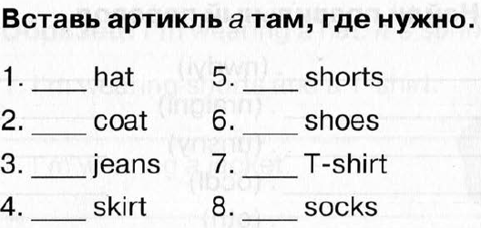

Slide 59
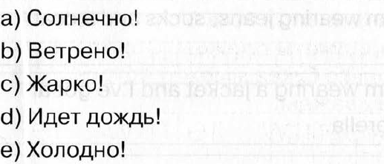
Translate from Russian into English:

