Slide 1
English loanwords in Russian language
This presentation was done by Bydanov Egor, 10a,
Guliver Maxim,10a, Kurochkina Maria, 6б

Slide 3
The subject of our research work is to study the problem of borrowing the words in the modern Russian language.
The objects of our research are the anglicisms functioning in the local press and in teenagers’ speech.
The purpose of our work is to find information about borrowing words which occurred in Russian language from English and make an analysis of the problem of loanwords .

Slide 4
The hypothesis
English borrowings have an impact on the cultural life and language behavior of young people, the use of anglicisms in the press, in many cases impractical because it complicates the perception of the text, prevents an understanding of its essence.

Slide 5
The relevance of this research and scientific novelty
The study of using loan words is very important for many reasons. We study anglicisms not only for the sake of anglicisms themselves. They give us an opportunity to gain a deeper insight into our own language.
We study various sources containing anglicisms and their impact on young people of a single school.

Slide 6
The practical importance
Possibility of using the results of the research work at lessons of Russian and English, and also at further research of foreign loans.

Slide 7
The research tasks are
to present historical review of the problem of borrowing
to find different types of anglicisms and suggest the appropriate reasons for borrowings
to hold an experiment and answer the question: “What types of anglicisms are most popular today in Russian press?”
to hold an experiment and answer the question: “What types of anglicisms are used more often by teenagers?”
to find out positive and negative aspects of borrowing from English into Russian language.

Slide 8
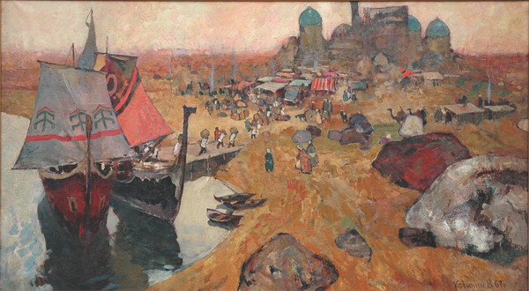
Borrowings from English into Russian language

Slide 9
The reasons for using anglicisms.
historical contacts between people of different nationalities;
the lack of corresponding concepts in the language. For example, these are words “Scanner”, “Touchpad”, “Laptop”.
the necessity to name new objects and facts (like taxi, robot);
the language fashion, it is international language, and it is no wonder that it becomes popular both in East European countries and countries of Asia and Near East;

Slide 10
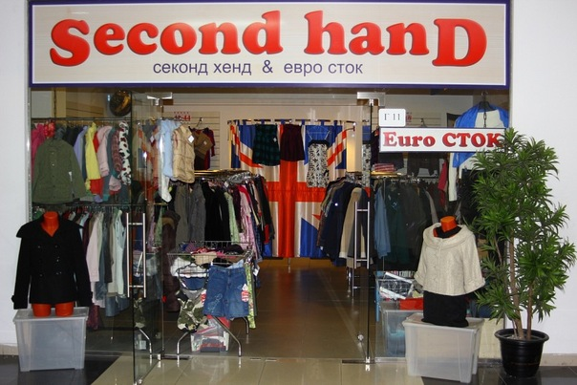
The reasons for using anglicisms.

Slide 11
The types of anglicisms
Phonetic borrowing
“Hybrids”
Direct loans
Exotic words
Emotional expressions
Compounds
Foreign words
Loanshift

Slide 12
The impact of borrowed words on Russian language
The process of word-stock formation is very long-drawn-out and complicated. It is also closely connected with the history of a nation. Russian vocabulary in its modern state did not appear at once.
Interesting fact: almost all words on letter “Ф” in Russian were borrowed.

Slide 13
We found 48 words and divided them into four groups: work and politics, culture, sports and science.
Politics Work. | Culture | Sport | Science
Meeting (митинг) | Supermarket (супермаркет) | Football (футбол) | Computer (компьютер)
Hypothec(ипотека) | Project (проект) | Sport (спорт) | Business (бизнес)
Notebook(ноутбук) | Design (дизайн) | Start (старт) | Internet (Интернет)
Leader (лидер) | Interview (интервью) | Volleyball (волейбол) | Interactive (интерактивный)
Oligarch (олигарх) | Volunteer (волонтер) | Basketball (баскетбол) | Resident (резидент)
Candidate (кандидат) | Nomination (номинация) | Record-holder (рекордсмен) | Cottage (коттедж)
Innovation (инновация) | Problem (проблема) | Match (матч) | Hacker (хакер)
Visit (визит) | Marathon (марафон) | Tournament (турнир) | Marketer (маркетолог)
Rating (рейтинг) | Presentation (презентация) | Sportsman (спортсмен) | Programmer (программист)
Presidium (президиум) | College (колледж) | Champion (чемпион) | Marketing (маркетинг)
Alternative (альтернатива) | Site (сайт) | Championship (чемпионат) | Credit (кредит)
Online (он-лайн) | Activist (активист) | Finish (финиш) | Virtual (виртуальный)

Slide 18
The survey
Anglicisms | Do you know what it means?
DJ
Marketing
Investor
Volunteer
Comfort
Online
Modernization
Primaries
Distributor

Slide 19
Positive and negative aspects of borrowing from English into Russian language
Positive aspects
The opportunity to communicate with people from other counties
The possibility to learn more about other cultures;
The chance to develop your language skills
Negative aspects
The possibility of losing the values of our native language
The possibility to forget your native culture in pursuit of foreign values
Sounding absurd and being misunderstood as a result of wrong use of foreign words.

Slide 20
Positive and negative aspects of borrowing from English into Russian language

Slide 22
Conclusion
According to the results of our research we can say that students use anglicisms not so often as it considered to be.
We have found that some students don't like to use anglicisms. They prefer to use Russian words.
According to the results obtained during our research work we can conclude that almost 50 per cent of students understand the people who use anglicisms and it approves our hypothesis.
The purpose of the research work has been achieved.

Slide 24
Thank you for your attention!

