Slide 1
Cardinal numbers

Slide 2
Cardinal numbers are numbers that tell you "how
Many (with countable nouns)." They express an amount.
We use cardinal numbers to count people or things.
They indicate a quantity of people or objects.
e.g. I bought two bananas at the store.
How many bananas did I buy at the store?

Slide 3
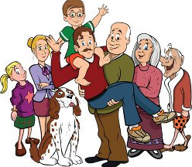
There are seven people in my family.
How many people are there in my family?

Slide 4
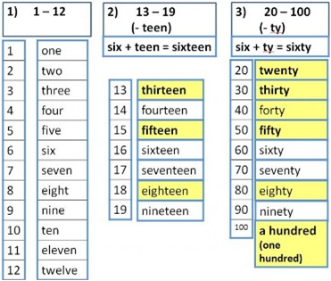
Look at the table and remember

Slide 5
Read and Remember!
When writing a compound number(any number made up of two words) we use a hyphen between each word.
25 twenty-five
36 thirty –six
123 one hundred (and) twenty – three
Write the following numbers in words:
24 122 245

Slide 6
Let’s count !
How fast can you count to 50?
1 2 3 4 5 …………………………..50

Slide 7
Let’s count !
How fast can you count down from 50 to 1 ?
50 1

Slide 8
Answer the questions
How old are you?
How many students are there in your class?
How many girls are there in your class?
How many boys are there in your class?
How many people are there in your family?

Slide 9
Let’s read the dialogue and act out it!
Woman: Excuse me. Where’s the English class, please?
Receptionist: English 1 or English 2?
Woman: Oh, English 1
Receptionist: English 1 is in Room 59.
Woman: Room 59. Where’s that, please?
Receptionist: It’s on the fifth floor.
Woman: Thank you.

Slide 10
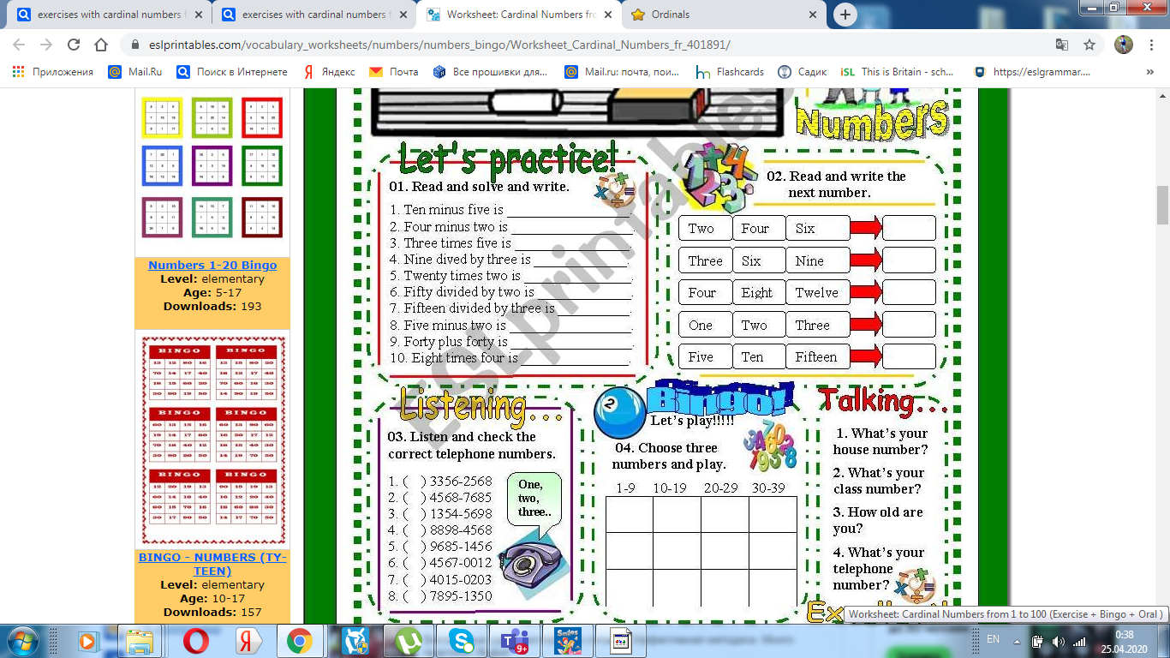
Read and say the next number
Eight
Twelve
Sixteen
Four
Twenty

Slide 11
Mathematical symbols
Plus (+) 5 + 5=10
Minus (-) 10 - 8 = 2
Times (*) 2*2= 4
Divided by (:) 12 : 6 = 2
is (=)

Slide 12
Are you good at Maths?
Ten minus five is
Three times five is
Nine divided by three is
Fifteen divided by three is
Five minus two is
Forty plus forty is
Eight times four is
Five
Fifteen
Three
Five
Three
Eighty
Thirty-two

Slide 13
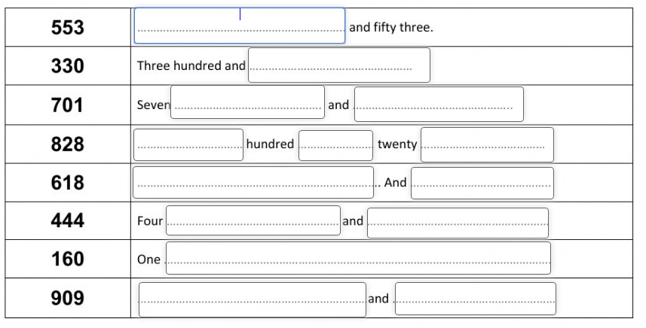
Complete the numbers with the missing words

