Slide 1
Road safety
Саломатова Наталья Виталиевна
МОУ СОШ №24
Копейского городского округа

Slide 2
Pedestrian
Parking zone
Traffic lights
Road safety
Pavement
Traffic sign
Zebra crossing
Yellow lines
Traffic warden

Slide 3
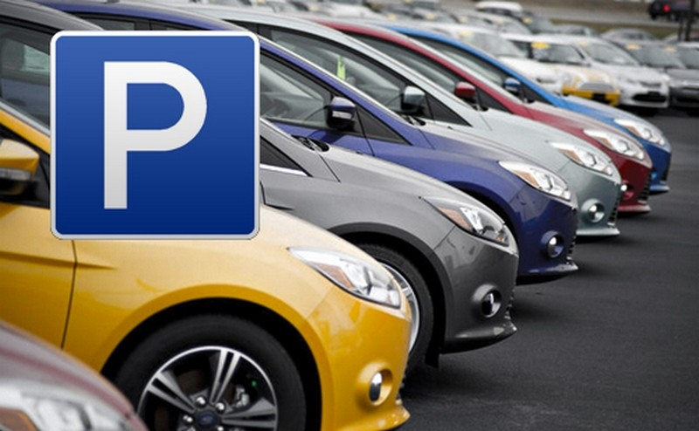
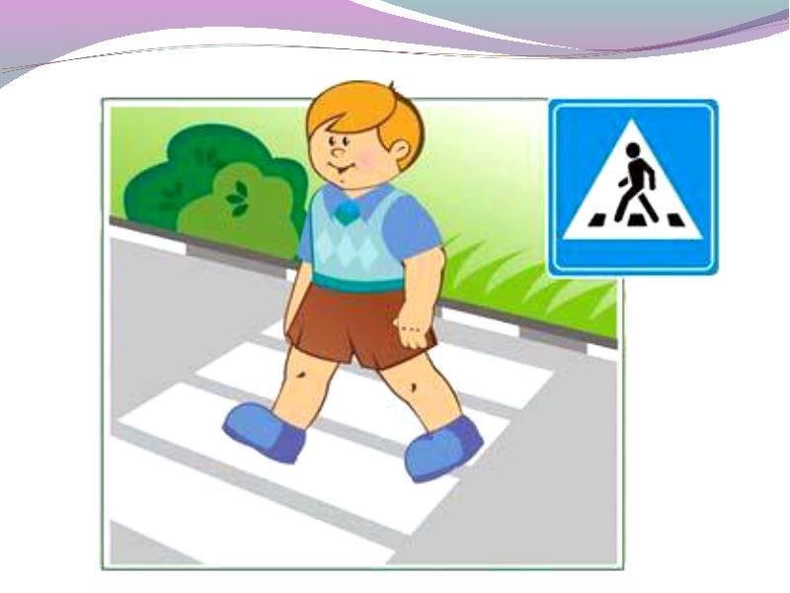
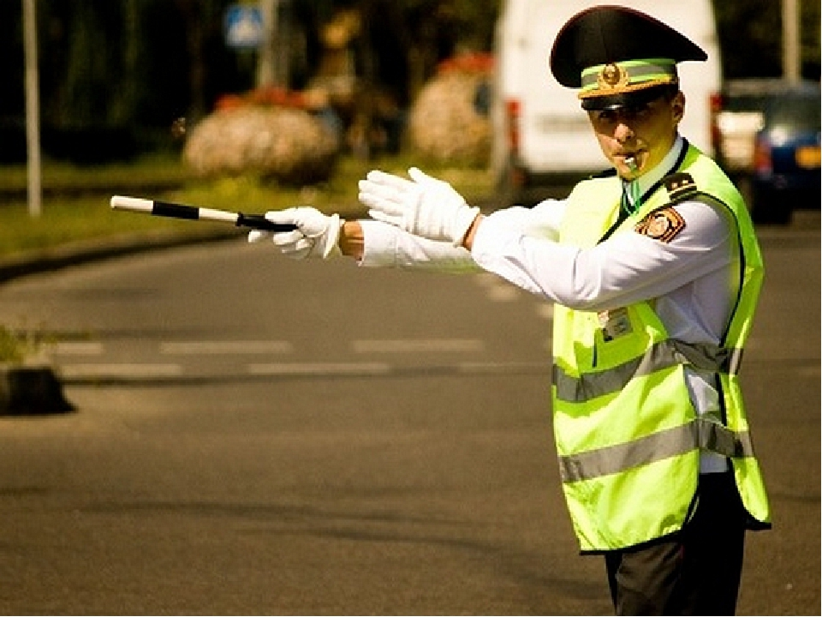
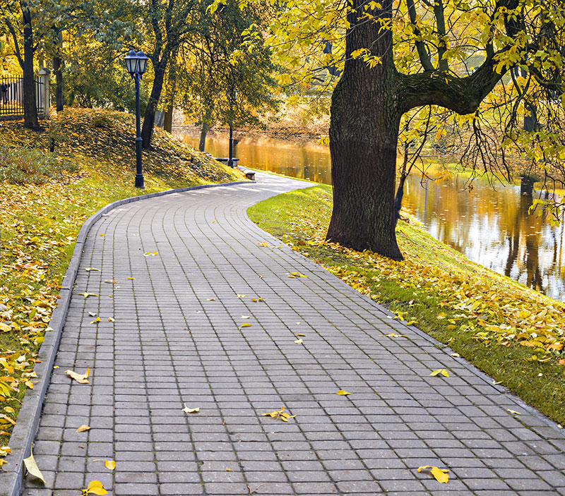

Slide 4
The imperative
WEAR YOUR SEAT BEALTS!
DON’T TALK TO THE DRIVER!

Slide 5
When in the street, look both ways before crossing. Don’t…
When in the car,
When on the bus,

Slide 6
BICYCLE
BUS
CAR

Slide 7
FILL IN BY, ON, IN
… FOOT
…CAR/BUS/TRAIN/PLANE/BIKE
…A BUS
…THE 8 O’CLOCK TRAIN

