Slide 1
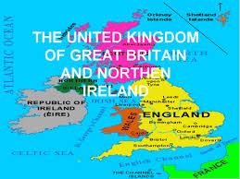
Презентация к уроку Culture Corner 4 УМК Spotlight для 8 класса “ English Traditional Costumes”.
Выполнила Петрова Т.Н., учитель английского языка СОШ №5 г. Петрозаводска.

Slide 2
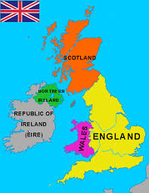
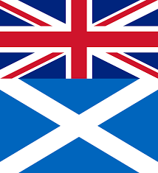
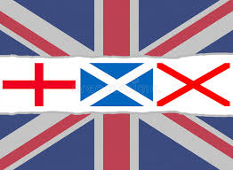
The countries of the UK.
What parts does the UK consist of?
The UK consists of England, Scotland,
Wales and Northern Ireland.
What cities are the capitals of these parts?
(London, Cardiff, Edinburgh and Dublin are
the capitals of these parts.)

Slide 3
Vocabulary, Culture Corner 4.
Apron, check, cloak,
distinctive, embroidery,
Fringed, kilt, pad, pin,
pleat, secure, specific,
shawl, tartan, waist.

Slide 4
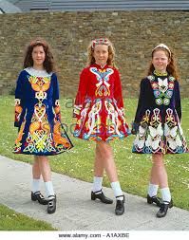
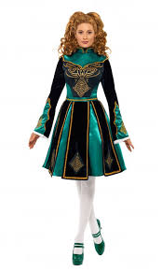
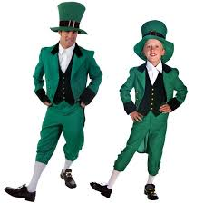
Traditional Costumes in the UK. SB, p.6, ex.2.
What do female dancers usually wear?
What are the patterns on their clothes
based on?

Slide 5
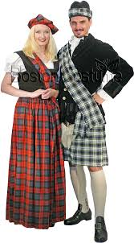
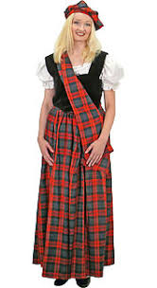
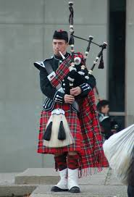
The Scottish Kilt.
What is the best known costume in the UK?
What were kilts?
What other parts were included
in the costume?
Is the kilt still worn today?

Slide 6
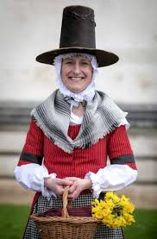
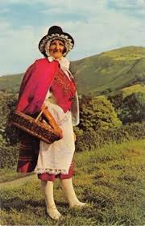
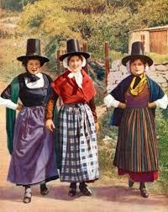
The Welsh traditional costume.
What parts were included in the costume?
How was the shawl worn?
What did ladies carry?

Slide 7
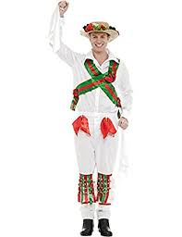
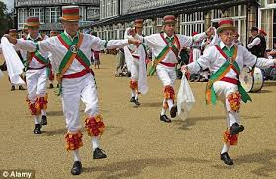
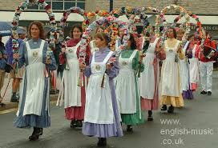
The costume for Morris dancing.
When are Morris dances performed?
What do the dancers wear?
What are their hats decorated with?

Slide 8
Tell about costumes in the UK.
A. In Ireland female dancers wear ….. The patterns ……
B. The best known ….. Kilts were ….. Each clan …… The kilt is still…..
C. Welsh women in the past …. A shawl …. The outfit ……
D. Morris dances are performed …… The dancers wear ….. Their hats are decorated ……

