Slide 1
Theme: Favourite things

Slide 2
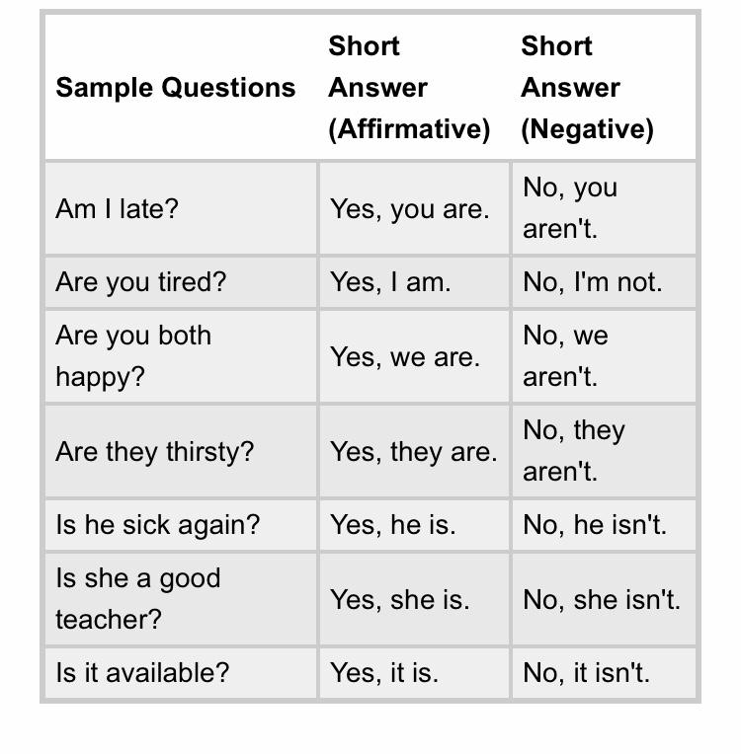
Grammar

Slide 3
New words
Food | [fuːd] | еда
Colour | [ˈkʌlə(r)] | цвет
Game | [ɡeɪm] | игра
Animal | [ˈænɪml] | животное
Sport | [spɔːt] | спорт
Singer | [ˈsɪŋə(r)] | певец(певица)
TV programme | [ˌtiː ˈviː] [ˈprəʊɡræm] | телепрограмма
Team | [tiːm] | команда
Film | [fɪlm] | фильм, кино
Film star | [fɪlm] [stɑː(r)] | кино звезда

Slide 4
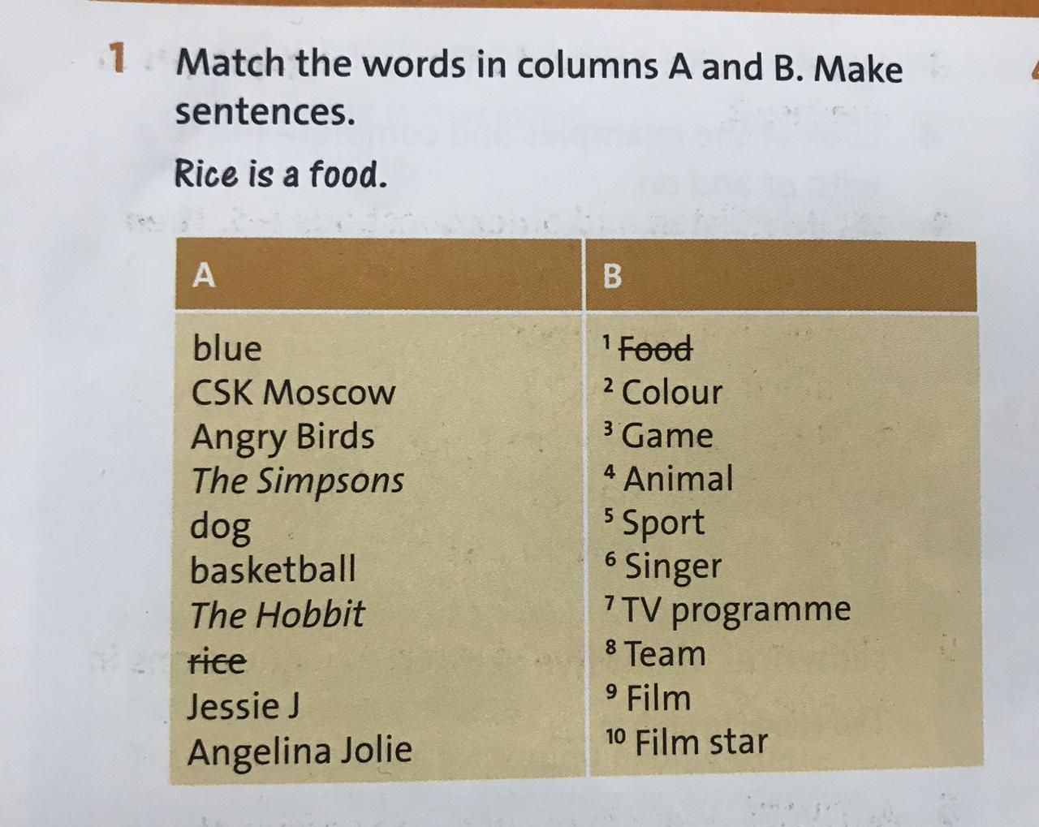
Student’s book p:16 Example: Angry Birds is a game Jessie J is a singer

Slide 5
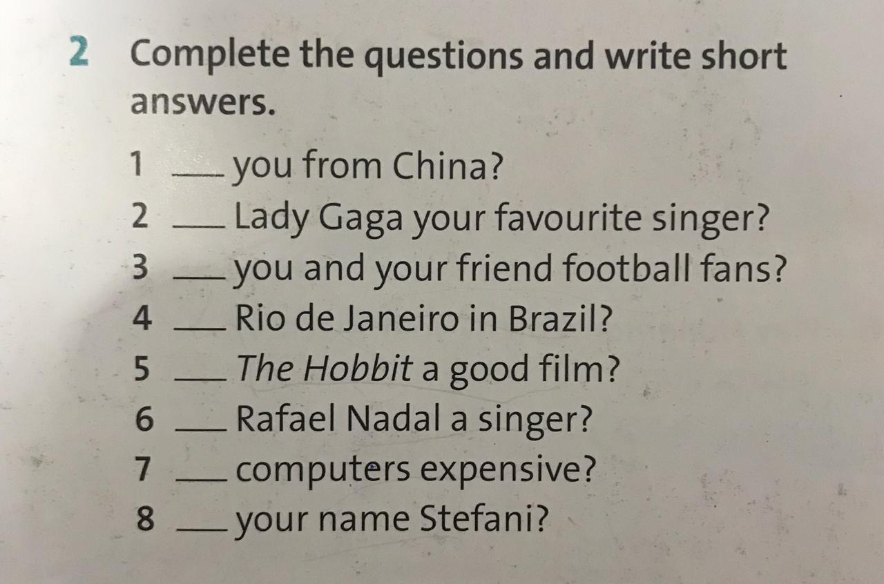
Student’s book p: 17 Example: 1) Are you from China? Yes, I am / No, I am not

Slide 6
Homework: Workbook Ex:2 (p:12) Talking about and write the rules for sport

