Slide 1
Module 3. Great Minds.
Revision.

Slide 2
I. Choose the science.
1. …… studies the structure of substance.
2. …….is the science about living things.
3. … is the study of political power.
4. …. is the scientific studies of societies.
5. …. is the activity of organizing the work
6. …. is the study of the way money or goods
are produced and used
A. Management B. Physics C. Sociology
D. Politics. E. Biology. F. Economics.

Slide 3
II. Matching.
1. Marie Curie …. | a. a famous English naturalist.
2. Charles Darwin was … | b. a German-born physicist.
3. Aristotle was …. | c. a chemist and an inventor.
4. Albert Einstein was … | d. studied radioactive elements.
5. Dmitry Mendeleev was …. | e. proved that the solar system was centered on the sun.
6. Nicolas Copernicus …. | f. a Greek philosopher.

Slide 4
III. Choose the name of the scientist. Which scientist ……
1. …. invented the telephone?
2. …discovered radio waves?
3. … introduced the law of gravitation?
4. … invented a lighting conductor?
5. …. was an inventor of the light bulb?
6. … discovered electromagnetic induction?
A). H. Hertz B)M. Faraday. C) B. Franklin
D). A. Bell E). Thomas Edison F) I. Newton

Slide 5
IV. Choose the word.
1.Mike works Monday to Friday, 9 to 5. It’s a …… job.
2. Tony loves about working as a …… without sitting in the office every day.
3. My brother works hard because he has to meet tough …..
4. Does your farther often work …….?
5. She works as a …… to a general manager of a computer company.
6. My brother had been working hard before he got a …… .
deadlines, full-time, pay rise, overtime, freelancer,
personal assistant

Slide 6
V. Find the preposition.
1. A famous foreign singer will bring …... a new album next month.
2. As both her parents died, her aunt brought her …. .
3. The sales at the auction brought …. a large amounts to charity.
4. She passed out and the doctor had to bring her ….. .
5. Looking this film brings ….. so many happy moments.
in, out, up, back, round.

Slide 7
VI. Grammar.
1.Mark … (fix) the car the whole morning.
2. We …. (cook) everything by the time Father got home.
3. Ben was so tired yesterday. He … (prepare) for a Math exam all day.
4. Jane left the house as soon as it … (stop) snowing.
Past Perfect – had III,-ed
Past Perfect Continuous – had been …ing

Slide 8
VII. Choose the preposition.
1. I believe Sam will have a brilliant career by/in law.
2. Mary was under/in charge of presenting our science project to the class yesterday.
3. Abraham Lincoln began his political career at/in the young age of twenty three.
4. I don’t think Evelyn can work well under/ in pressure .
5. Charles is leaving in/at the beginning of the month.

Slide 9
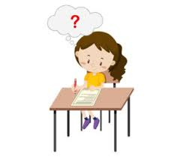
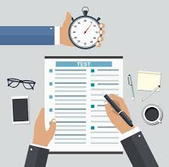
Thank you for attention.

