Slide 1
WELCOME TO OUR LESSON!

Slide 2
Organisation moment
SUBJECT
SCHOOL
ON DUTY
WEATHER
DATE DAY
SEASON TEACHER

Slide 3
LET’S PLAY A GAME MY VOCABULARY MEMORY
School subject
It’s white and sweet
FRUIT
FAMILY
Bird

Slide 4
NEW LESSON THEME: HOMES

Slide 5
LET’S DIVIDE INTO GROUPS ТОПҚА БӨЛІНУ

Slide 7
New words Жаңа сөздермен жұмыс English in Mind 2.lnk
A block of flats
A detached house
A semi-detached house
A caravan
A cottage
A terraced house
A housing estate
A bungalow
A chimney
A garden
A garage
A gate
A fence
A TV aerial
Stairs

Slide 9
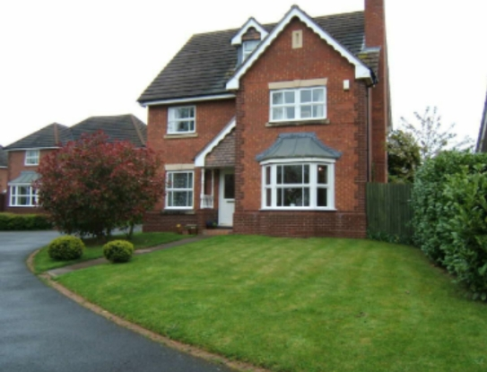

Slide 10
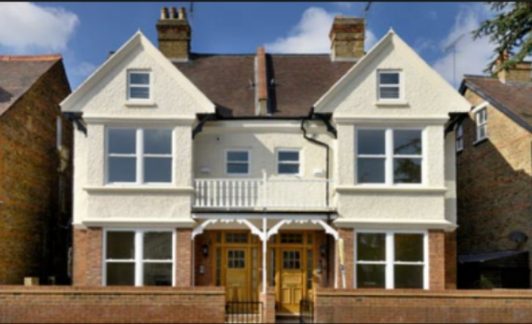

Slide 11
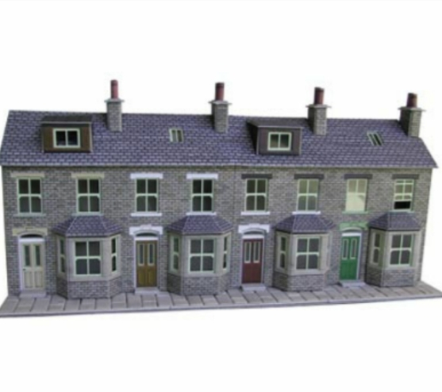

Slide 12
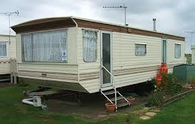

Slide 13
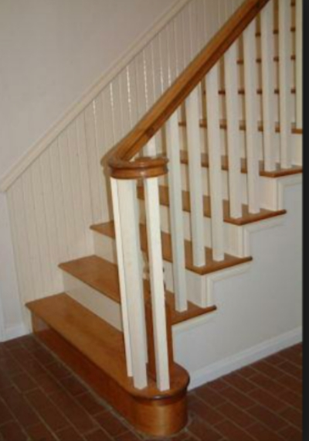

Slide 14
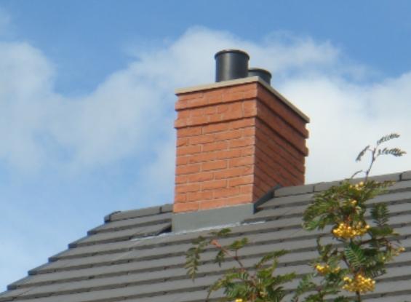

Slide 15
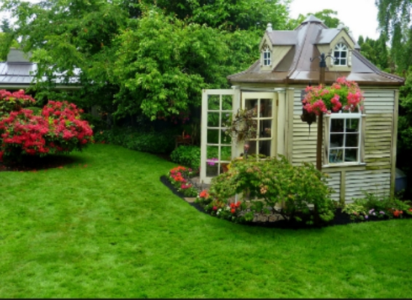

Slide 16
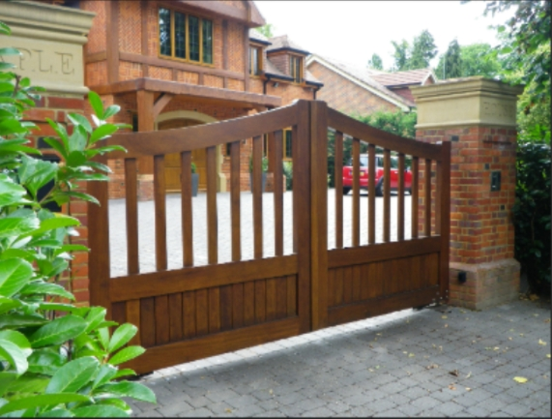

Slide 17
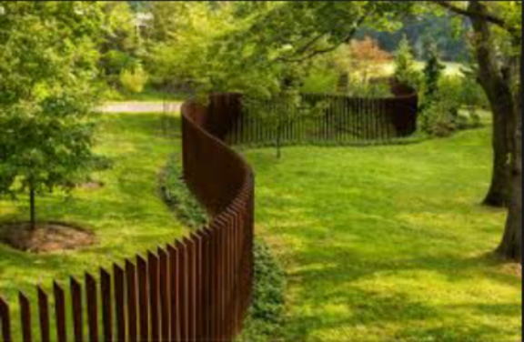
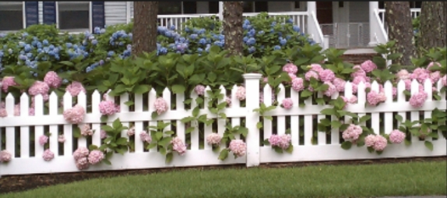

Slide 18
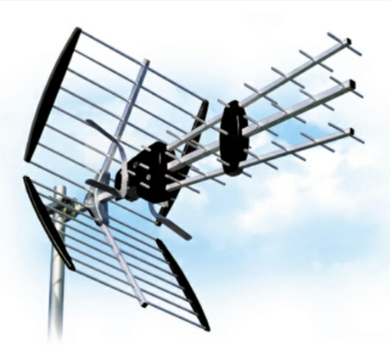

Slide 19
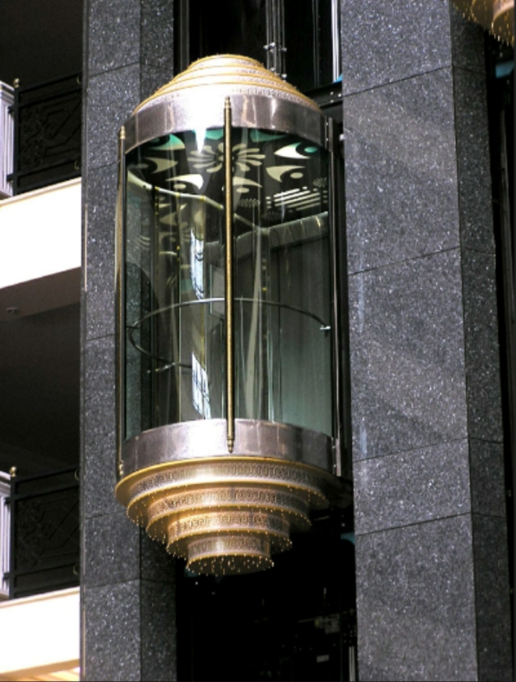

Slide 20
Let’s work with the Student’s book book In which picture can you see these things? Exercise 4 b page 62 English in Mind 2.lnk
A chimney a garden
A garage a gate
A fence a TV aerial

Slide 21
Listen and click on the correct pictures exercise homes 1 English in Mind 2.lnk Complete the sentences. The first letter of each missing word is given exercise homes 2 English in Mind 2.lnk

Slide 22
GRAMMAR Too many,too much,enough

Slide 29
GRAMMAR Too many,too much,enough Complete the chart with these words
mistakes money noise people places problems rain time traffic tourists
Too many | Too much

Slide 35
GRAMMAR Task 3 Too many,too much,enough
Page 61 exercise 2c,d,

Slide 36
HOMETASK EXERCISE 2 F,9 PAGE 61
Көпір.mp4
WRITE A SHORT ESSAY USING TOO MANY AND TOO MUCH

Slide 37
REFLECTION
I learnt….
I liked…
It was easy….
It was difficult….
I want to know….

