Slide 1
Intellectual game
Teacher:
Nurlybayeva A.M

Slide 2
The Scrabble game is based on its own game. Designed for grades 7-8
Lesson topic "Scrabble"
Lesson type: Activation of the studied regional material.

Slide 3
Tasks:
Promote the enhancement of the cognitive interests of schoolchildren.
Ensure the systematization and assimilation of students' knowledge.
Promote the formation of the ability to work in a group.

Slide 4
During the classes.
The guys are divided into two teams.
First tour.
The "Own game" in English is offered. A table is displayed on the electronic board (see Appendix # 1).
The teams take turns choosing a category and a cost. If not answered, the other team has the right to answer.

Slide 5
Second round
The children are invited to read the text without errors. Remove 10 points for each mistake. The maximum number of points is 500.
Round three.
Practical application of knowledge. For a while, the guys solve a crossword puzzle. Each correct word gets 100 points.

Slide 6
Summarizing.
The results are summed up by the jury, in the role of which both children and invited teachers can act.

Slide 7
The capital of | 100 | 200 | 300 | 400 | 500
The official language of | 100 | 200 | 300 | 400 | 500
Agree or disagree | 100 | 200 | 300 | 400 | 500
Translate from English into Russian | 100 | 200 | 300 | 400 | 500
Translate from Russian into English | 100 | 200 | 300 | 400 | 500

Slide 8
Read without mistakes
T1: Great Britain is situated on the British Isles. It is washed by the Atlantic Ocean, the Irish Sea and the North Sea. The population is over 59 million people. English is the official language, but some people speak Scottish, Welsh and Irish. The capital of the UK is London. Great Britain is famous for its universities: Cambridge and Oxford.
T2: Canada is the second largest country in the world. It is washed by the Arctic Ocean, the Atlantic Ocean and the Pacific Ocean. The capital of Canada is Ottawa. In Canada there are people of many nationalities. There are two official languages in this country: English and French.

Slide 9
T3: Australia is the biggest island and the smallest continent in the world. It is washed by the Indian and the Pacific Oceans. It is a large country, but its population is only 18 million people. The capital of Australia is Canberra. English is the official language in Australia. This country is famous for its native animals: the kangaroo, the koala, the dingo and the emu.
T4: New Zealand is a small and quiet country in the Pacific Ocean. It consists of two main islands and some smaller islands. The capital of New Zealand is Wellington. The population of this country is mixed. The official languages are English and Maori. New Zealand is famous for its products: butter, cheese and meat.
T5: The USA is situated in North America It is washed by the Atlantic and the Pacific Oceans. The official name of the country is the United States of America. The USA has the third largest population in the world. The capital of the USA is Washington. English is the official language, but Spanish is the second language in the USA.

Slide 10
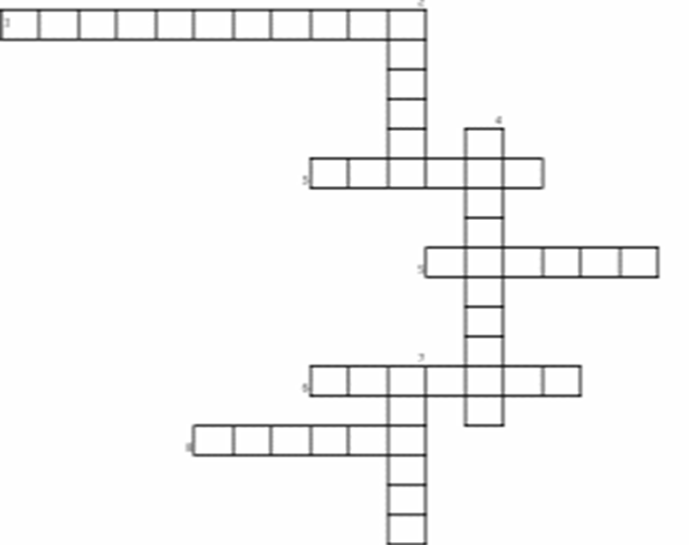

Slide 11
The UK of Great Britain and Nothern Ireland
What abbey plays the role of the Royal church?
These birds lives at the Tower.
What is the tower of London now?
In what place does the Queen live?
What is the most famous clock in Great Britain?
The first main island of The British Isles?
On what continent are the British Isles situated?
One of the fourth historical provinces of Ireland.

