Slide 1






Slide 2
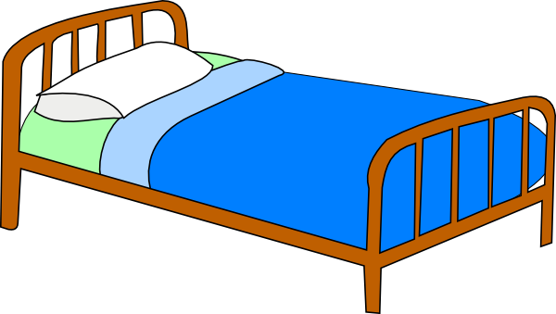


bed
sofa
desk

Slide 3

bed
chair
sofa

Slide 4
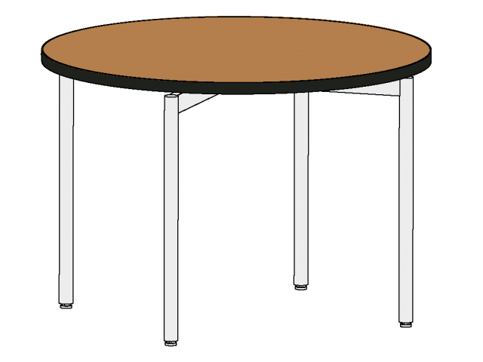
shelf
desk
table

Slide 5

sofa
armchair
chair

Slide 6
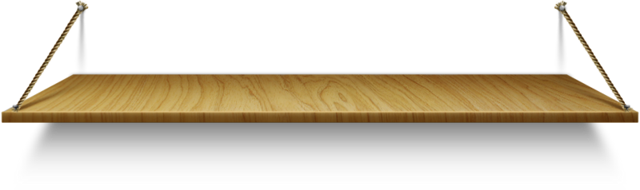
wardrobe
shelf
bookcase

Slide 7

carpet
desk
sofa

Slide 8
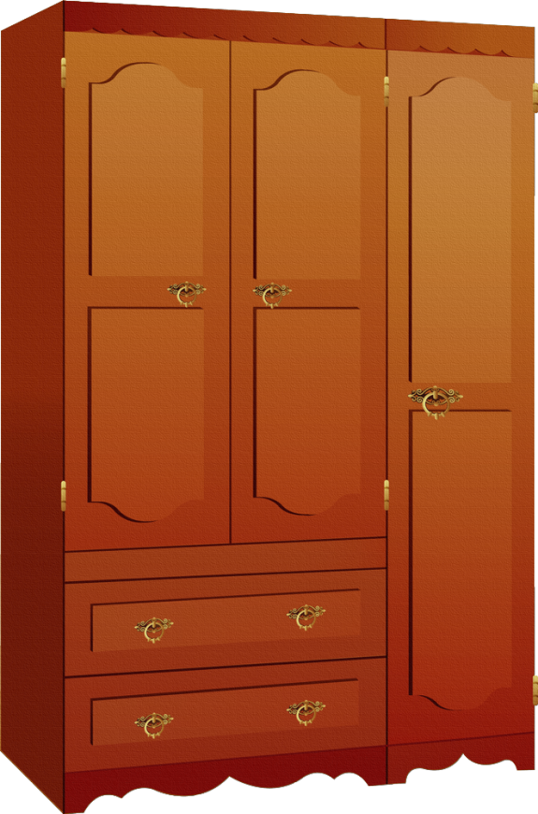
wardrobe
bookcase
carpet

Slide 9
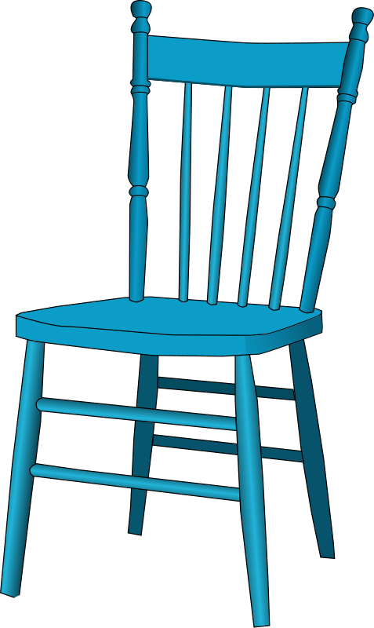
bed
chair
armchair

Slide 10
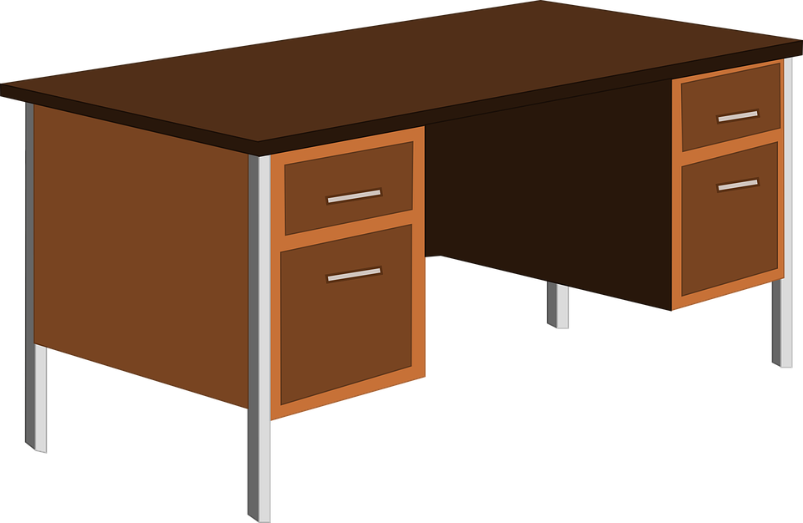
table
bed
desk

Slide 11

wardrobe
bookcase
shelf

Slide 12

mirror
shelf
lamp

Slide 13

mirror
wardrobe
shelf

Slide 14
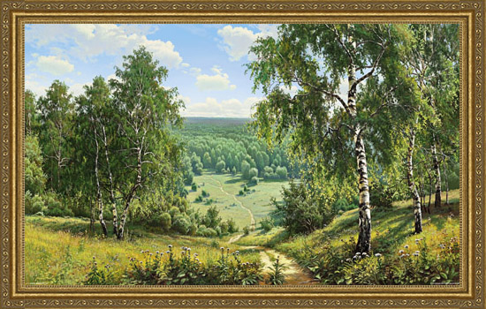

carpet
picture
shelf

Slide 15


http://www.clipartbest.com/cliparts/dc6/ezn/dc6eznyMi.png
http://vignette3.wikia.nocookie.net/clubpenguin/images/5/5a/788_furniture_icon.png/revision/latest?cb=20120727041525
http://vignette2.wikia.nocookie.net/clubpenguin/images/7/7a/Sofa.png/revision/latest?cb=20131201095923
http://mediatechnologies.com/images/sized/uploads/products/vector_float_round-640x0.png
http://fs181.www.ex.ua/show/30712169/30712169.png?800
http://lib.rus.ec/i/50/479950/i_045.png
http://cliparts.co/cliparts/8cx/ngB/8cxngB96i.png
http://dc528.4shared.com/img/uEX4vvSa/s7/136ffc05ad0/wardrobe__16_
https://pixabay.com/static/uploads/photo/2013/07/13/13/45/desk-161474_960_720.png
https://s-media-cache-ak0.pinimg.com/736x/d2/1f/b0/d21fb0b99f2ec3d526e1b3a619b8a166.jpg
http://kupikartin.ru/images/805.jpg
https://openclipart.org/image/2400px/svg_to_png/168561/lamp.png
http://swarzedzhome.pl/wp-content/uploads/2015/03/JOY_lustro-e1425286905265.png
http://www.minnesotaprodj.com/images/next-button-out.png
http://www.minnesotaprodj.com/images/back-button-out.png
http://weebeeworld.com/Images/red-close-button.png
http://mrnussbaum.com/draggable1/dd/images/go_button.png
http://images.clipartpanda.com/clipart-house-Anonymous_Small_House.png
http://nfepta.org/wp-content/uploads/2014/05/websiteslinks-icon.png
http://img-fotki.yandex.ru/get/5507/20573769.2/0_5f5bd_c0681961_L.jpg

