Slide 1
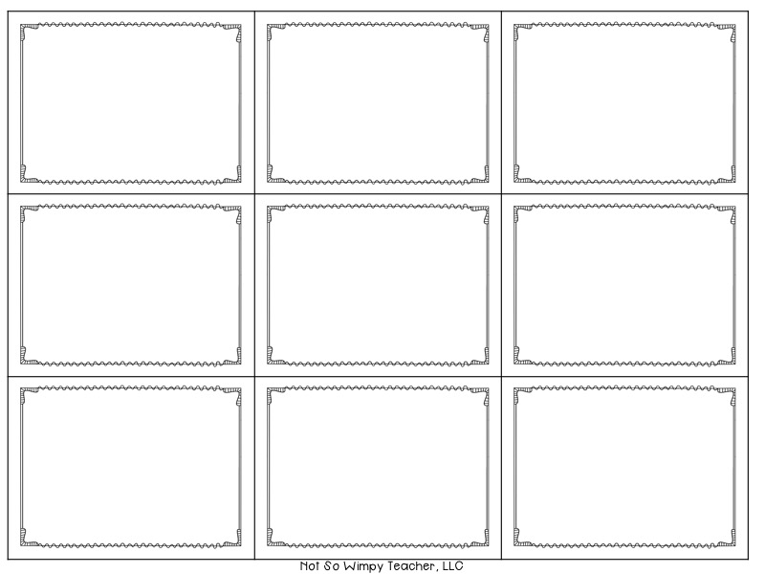
mummy
daddy
grandma
grandpa
brother
sister
children
family
friend

Slide 2
colour
blue
green
red
white
yellow
tree house
house
chair

Slide 3
table
radio
bed
garden
bedroom
kitchen
black
brown
in

Slide 4
living room
bathroom
bath
candles
party
happy
sad
one
two

Slide 5
three
four
five
six
seven
eight
nine
ten
burgers

Slide 6
sandwiches
chips
bananas
apples
chocolate
yummy
ice cream
cake
biscuit

Slide 7
chocolate cake
orange juice
pizza
milk
animal
fish
frog
bird
chimp

Slide 8
horse
swim
sing
run
jump
dance
climb
fly
boy

Slide 9
girl
clown
circus
magician
swing
funny
It’s sunny!
It’s raining!
It’s hot!

Slide 10
jacket
coat
shorts
It’s windy!
take off
put on
It’s cold!
island
socks

Slide 11
shoes
jeans
T-shirt
skirt
flowers
music
summer
winter
autumn

Slide 12
toy soldier
spring
toy
ballerina
pink
shelf
teddy bear
toy box
on

Slide 13
in
under
dark hair
eyes
ears
mouth
nose
fair hair
puppet

Slide 14
jack-in-the-box
big
small
dear
hello
city
town
country
weather

