Slide 1
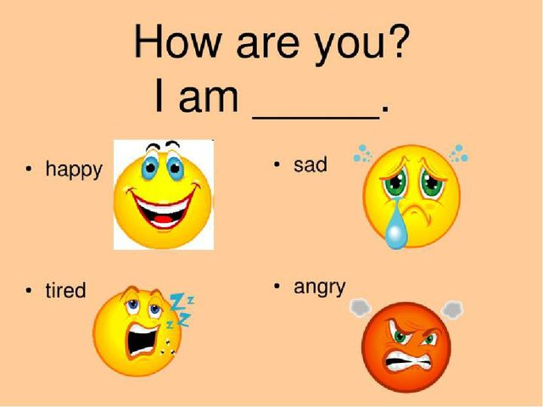

Slide 4
A computer magazine
Forward 4 (3-1)

Slide 5
computer
screen
keyboard

Slide 6
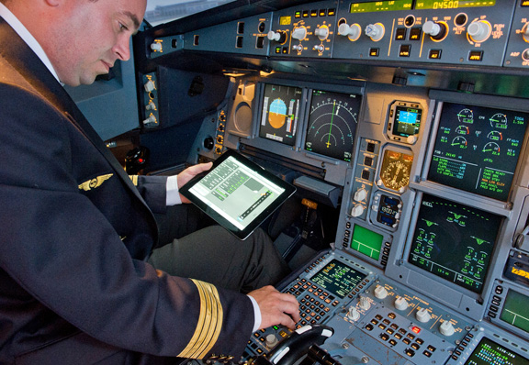
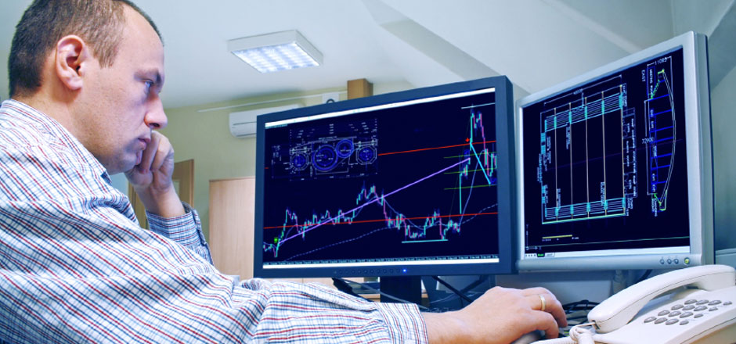
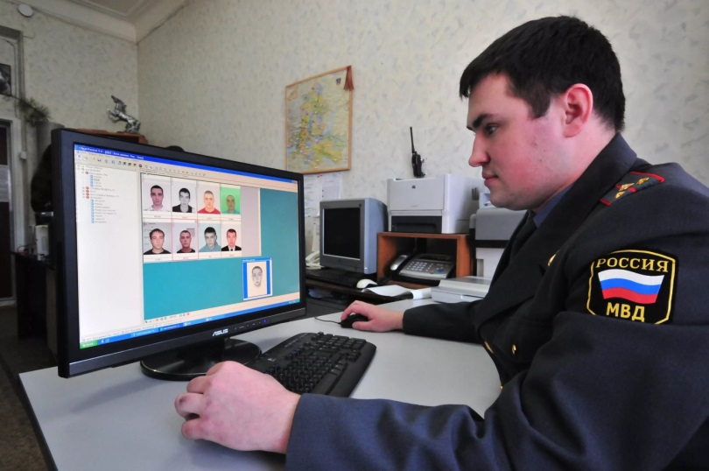
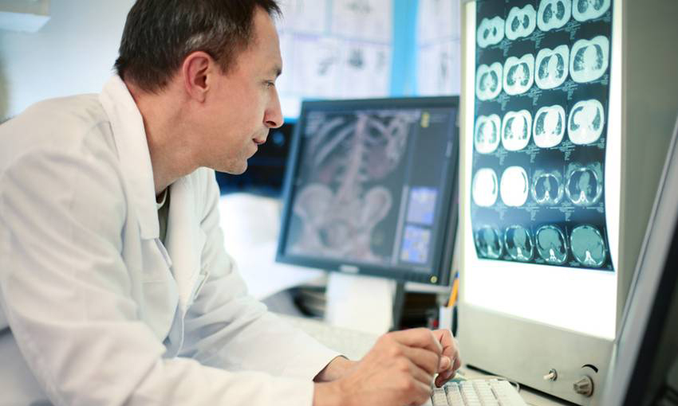
use a computer

Slide 7
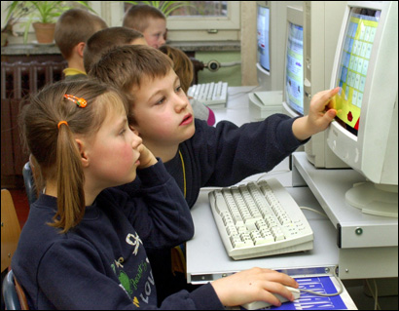
learn to use a computer

Slide 8
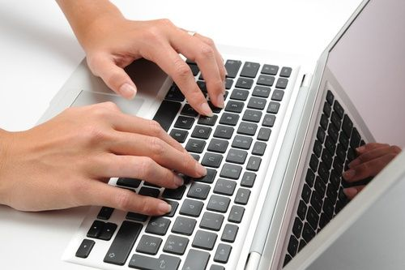
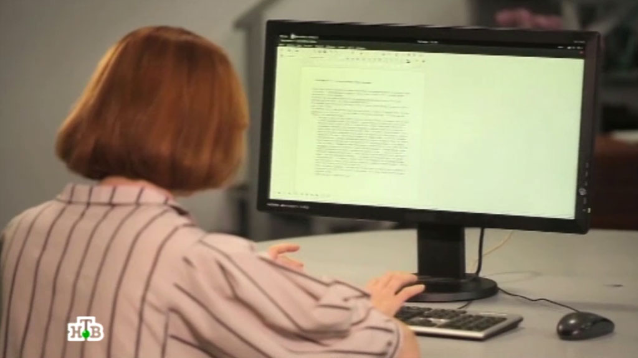
use a keyboard
look at the screen

Slide 9
Engineers
design things
(planes, ships, houses, cars)

Slide 10
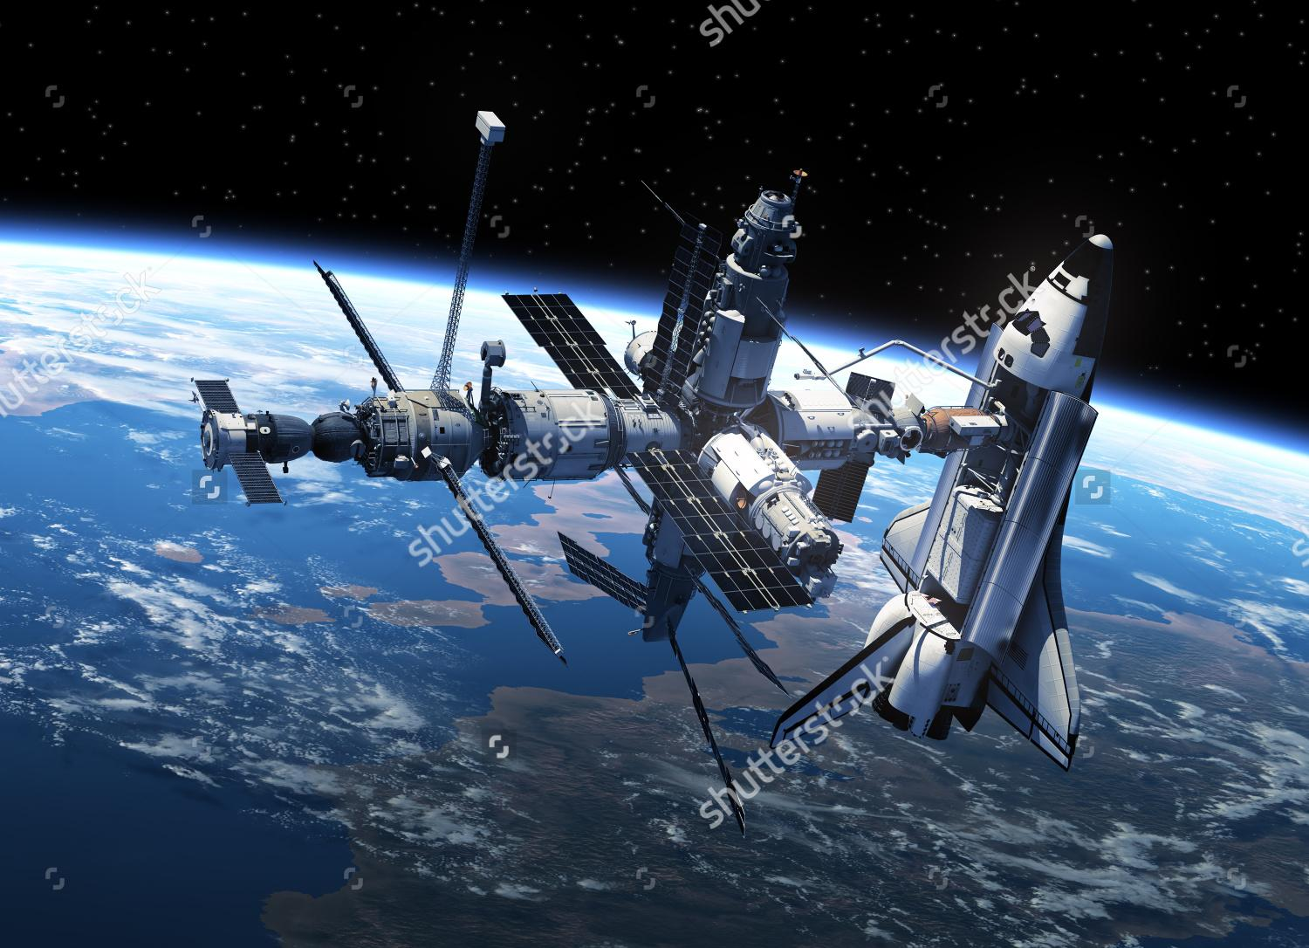
space shuttle

Slide 11
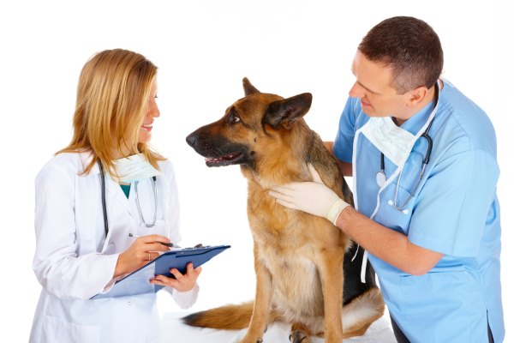
Vets
look after sick animals

Slide 12
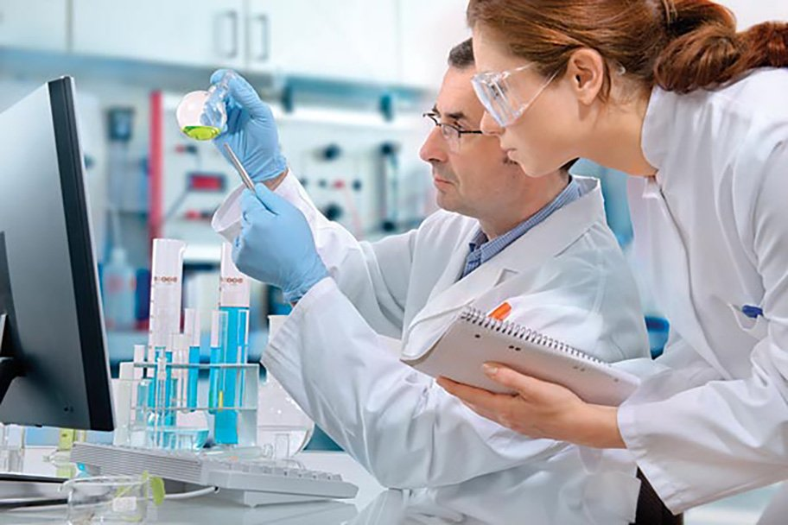
Scientists
work in laboratories

Slide 13
Detectives
catch criminals

Slide 14
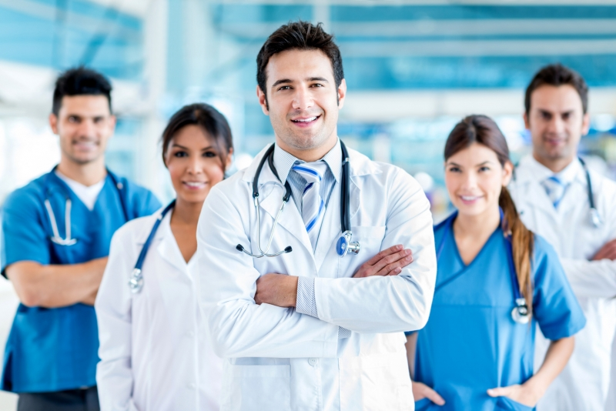
Doctors
look after sick people

Slide 15
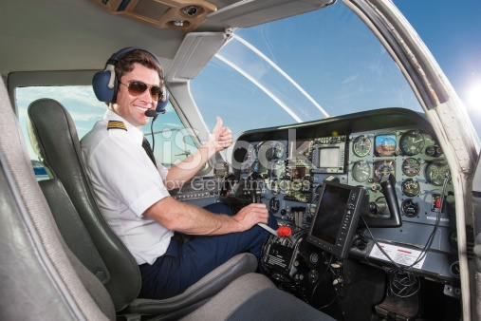
Pilots
fly planes

Slide 16
Chefs
cook wonderful food

Slide 17
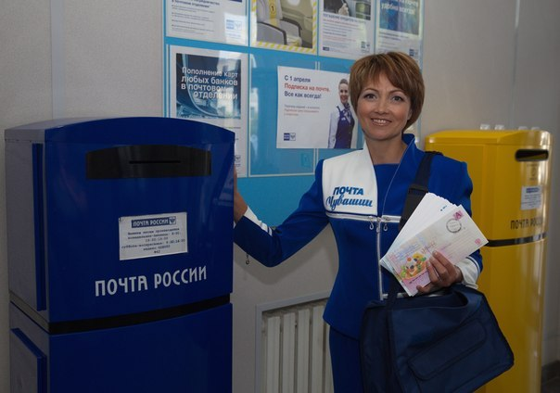
Postmen
deliver letters to people

Slide 18
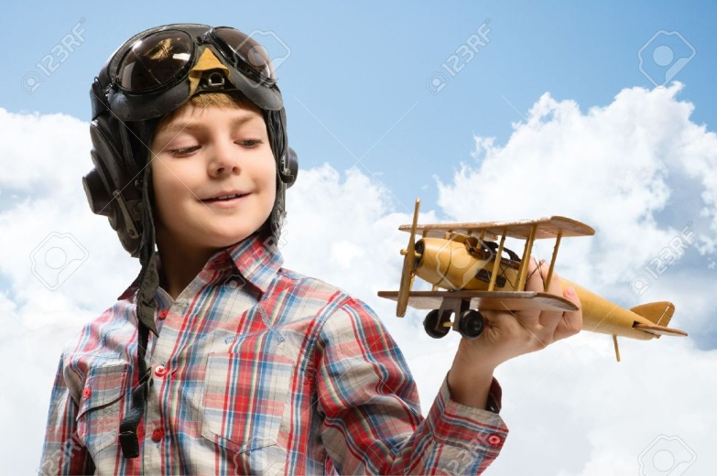
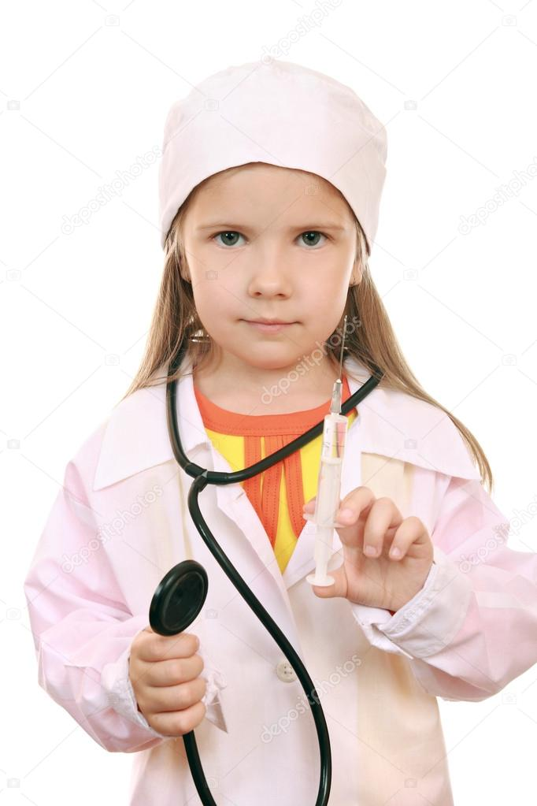
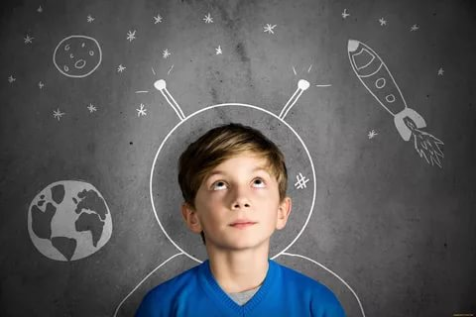
What do you want to be?
Ex.8
to go to the Moon

Slide 19
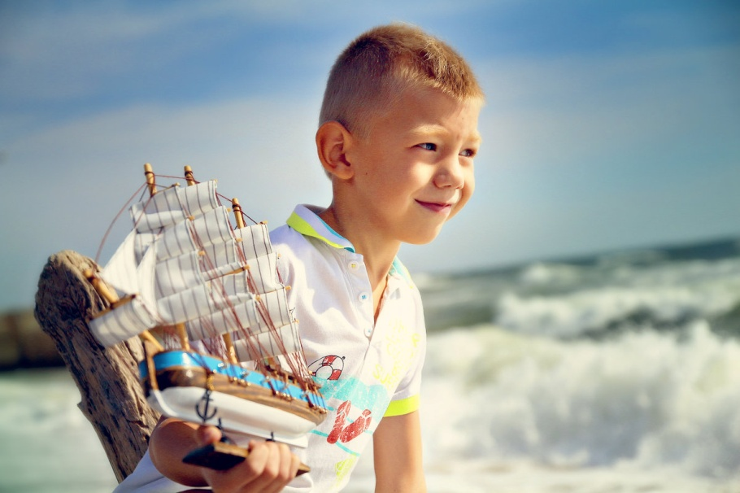
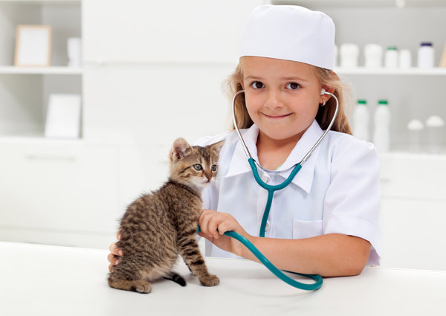
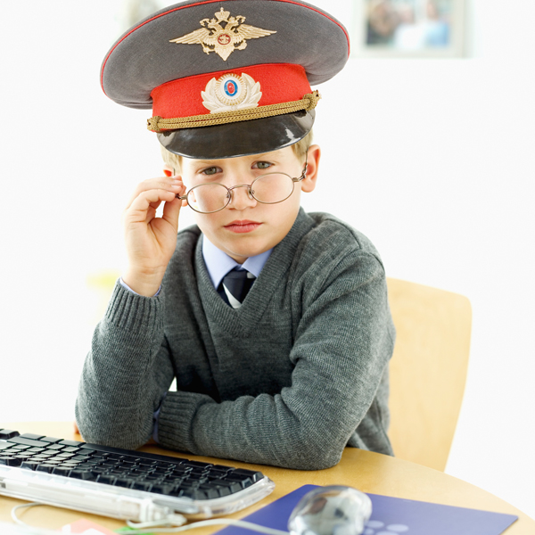
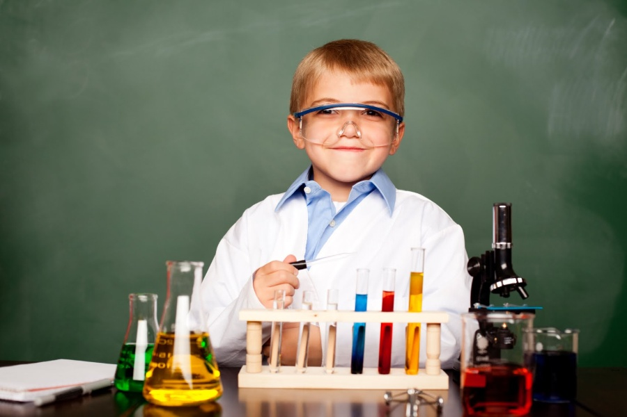

Slide 20
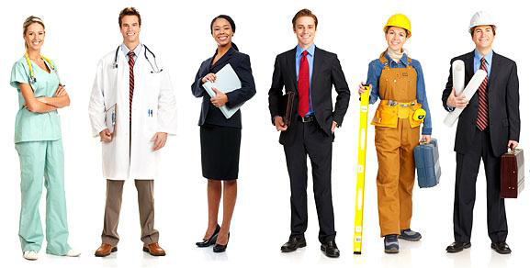
Who is this man?
Ex.13
What does he do?
What does a doctor do?
What does a doctor need?

Slide 21
Present Simple Настоящее простое
Описывает постоянные, регулярные, повторяющиеся действия
Обычные, привычные, повседневные действия и состояния
Слова-помощники (маркеры)
Always -всегда
Usually - обычно
Sometimes - иногда
Often - часто
Never –никогда
Every day, Sunday, weekend…

Slide 22
+ I, you, we, they go to school every day.
He, she, it goes to school every day.
I, you, we, they don’t go to school on weekend.
He, she, it doesn’t go to school on weekend.
? Do you, they go to school every day? Yes, I, we, they do. No, I, we, they don’t.
Does he, she, it go to school every day? Yes, he, she, it does. No, he, she, it doesn’t.

Slide 23
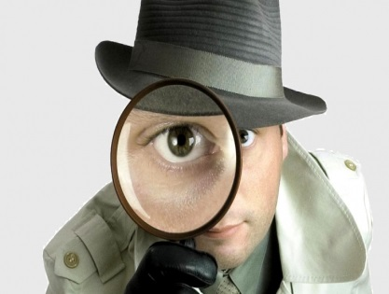
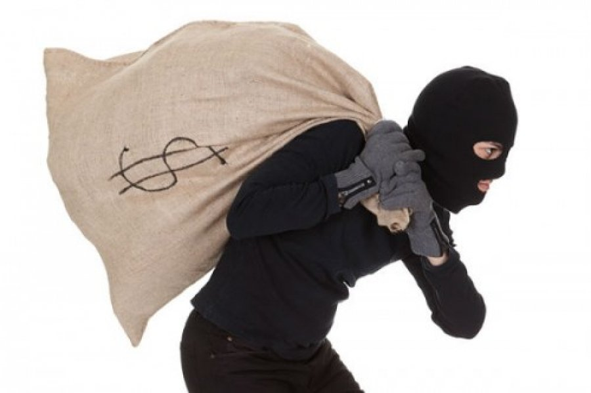
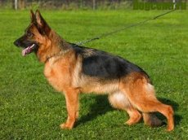
What does a detective do?
What does a detective need?
A detective catches criminals.
A detective needs a dog.

Slide 24
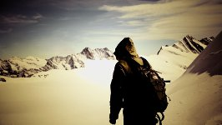
Fill in the gaps
Joseph Alexander is a famous _________.
His birthday is on January 10^{th.}
He comes from ________________ ______________________.
He’s got short ___________ hair and __________________ eyes.
^{He’s got __________________.}
^{He’s tall and thin.}
^{He likes to climb mountains.}

