Slide 1
SOS game
Answer the question and have a chance to win

Slide 2
Guess the word
The money that you pay for a journey.
fare

Slide 3
What is the opposite of
Legal
illegal

Slide 4
What is it?
pitch

Slide 5
Say three forms of the verbs beginning with..
The letter “b”.
Burst(burst)
Bite(bit, bitten)
Beat(beat, beaten)
Bear(bore, born)

Slide 6
Guess the word:
A ground for golf.
course

Slide 7
What is it?
stick

Slide 8
Guess the word:
Someone whose job is to make sure that players in a game obey the rules in tennis, baseball and cricket.
umpire

Slide 9
Translate:
encourage

Slide 10
What is the adjective of the word
Compete
competitive

Slide 11
What hobby is it?
knitting

Slide 12
Guess the word:
To be to late for smth.
miss

Slide 13
What is the opposite of the word?
Patient
impatient

Slide 14
Translate into Russian:
sibling

Slide 15
What is the opposite?
Honest
dishonest

Slide 16
What preposition should be used?
The discovery was made almost … accident.
by

Slide 17
Translate into Russian:
valuable

Slide 18
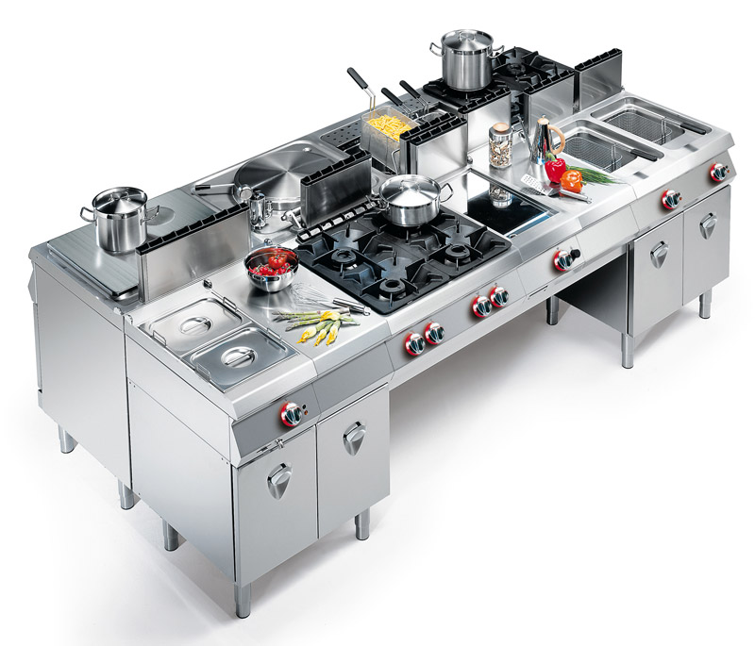
What is it?
equipment

Slide 19
What preposition should be used?
He was afraid … being caught by the police.
of

Slide 20
What preposition should be used?
I wasn’t keen … going there on my own.
on

Slide 21
Translate into Russian:
Have a narrow escape.

Slide 22
What preposition should be used?
She insisted … coming.
on

Slide 23
Translate:
Extended family

Slide 24
What preposition should be used?
Do you often go … school trips?
on

Slide 25
What preposition should be used?
That old man reminds me … my grandfather.
of

Slide 26
What preposition should be used?
Jane insisted … seeing the doctor immediately.
on

Slide 27
Say three nouns of the adjective:
Photographic
Photograph
Photography
photographer

Slide 28
What preposition should be used?
I blame myself … everything that happened.
for

Slide 29
What is the opposite of the word?
Fair
unfair

Slide 30
What preposition should be used?
Fortunately, we succeeded … rescuing all the passengers.
in

Slide 31
What preposition should be used?
The accused Jim … stealing three cars.
of

Slide 32
What is it?
rod

Slide 33
What preposition should be used?
I’ve been dealing … this problem all morning.
with

Slide 34
What’s the difference between
Be used to
Used to

Slide 35
What’s the difference between
PRESENT PERFECT and PAST SIMPLE

Slide 36
What’s the difference between
PRESENT PERFECT and PAST SIMPLE?

Slide 37
What’s the difference between
Used to
would

Slide 38
What hobby is it?
sewing

Slide 39
Say three forms of the verb
Sew -
Sewed- sewn

Slide 40
Say three irregular verbs beginning
With the letter “h”.

