Slide 1
LYMPHATIC SYSTEM

Slide 2
YOU WELL
DESCRIBE THE LYMPHATIC SYSTEM AND THE RELATIONSHIP BEETWEEN THE BLOOD AND TISSUE FLUID AND LYMPH.

Slide 3
Terminology
Edema---- ісіну ---- отек
Absorption---- сіңіру --- абсорбция
Lymph------ лимфа ---- лимфа
Valve------ қақпақша ----- клапан
Backflow------- кері ағын---- обратное течение
Lymph nodes------- лимфа түйіндері --- лимфа түйіндері
Tonsil-------- көмегей безі------ мандалина
Homeostasis-------- гомеостаз----- гомеостаз
Thymus-------- тимус----- тимус

Slide 4
Key terms
Lymph--- the fluid that circulates through lymphatic system.
Lymphatic system--- network of tissues and organs that help
The body to get rid of toxins, waste and other unwanted materls.
. Tissue fluid---- fluid between cells.

Slide 5
Look at the video
1.What do we see from this video?
2.?
3.?
4.?
5.?

Slide 6
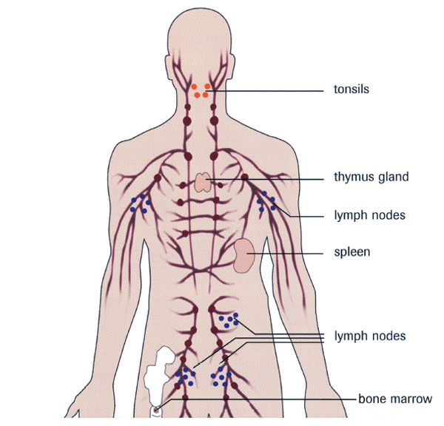

Slide 7
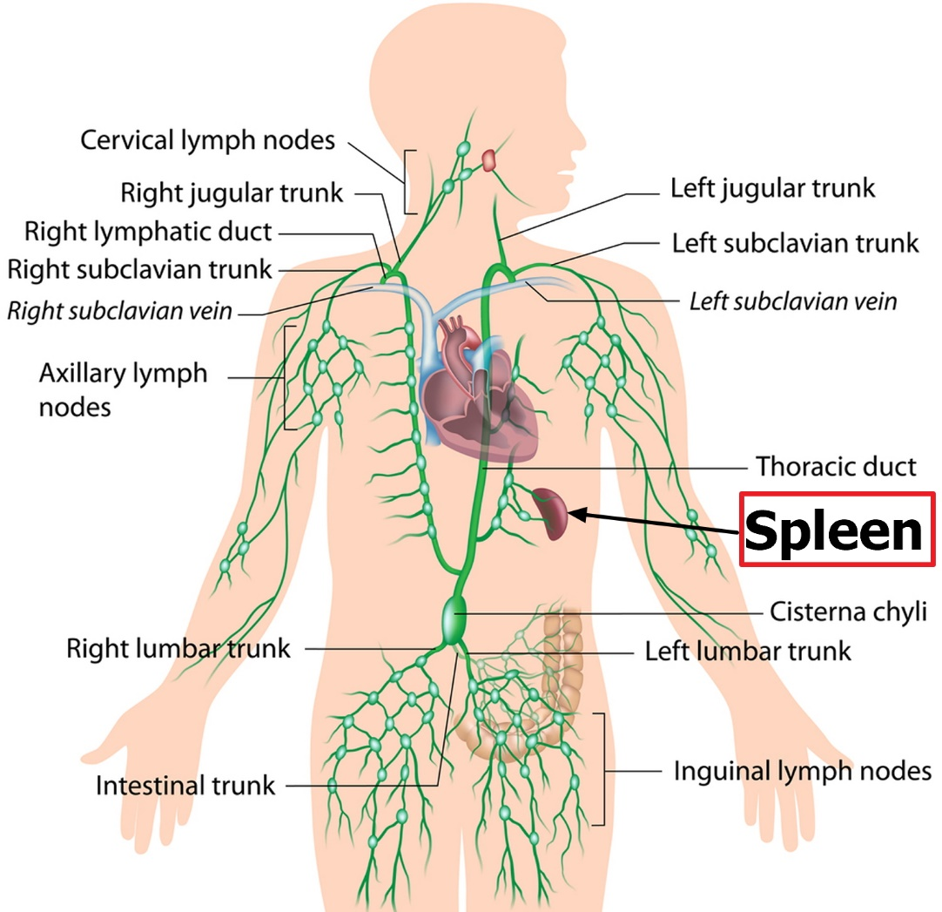

Slide 8
Activity True and False
1. The lymphatic system has 3 main function. T/F
2.There are 360 lympha nodes in human. T/F
3.Lympha- white yellow liquid. T/F
4.lympha nodes are located along the blood vessell pathway. T/F
5.The shape of lymph nodes is round,oval,bean T/F

Slide 9
Lymphatic system /domino/
Work in pairs Complete the table
Anagram | Correct word | Translation
damee | edema | Ісіну
mlphy | lymph | Лимфа
eavlv | valve | Қақпақша
nisotl | tonsil | Көмегей безі
klcabwof backflow кері ағын

Slide 10
Questions
1.What is the function of lymph ?
2.What is the difference between blood and lymph?
3.Which are cells present in the lymphatic system?

