Slide 1
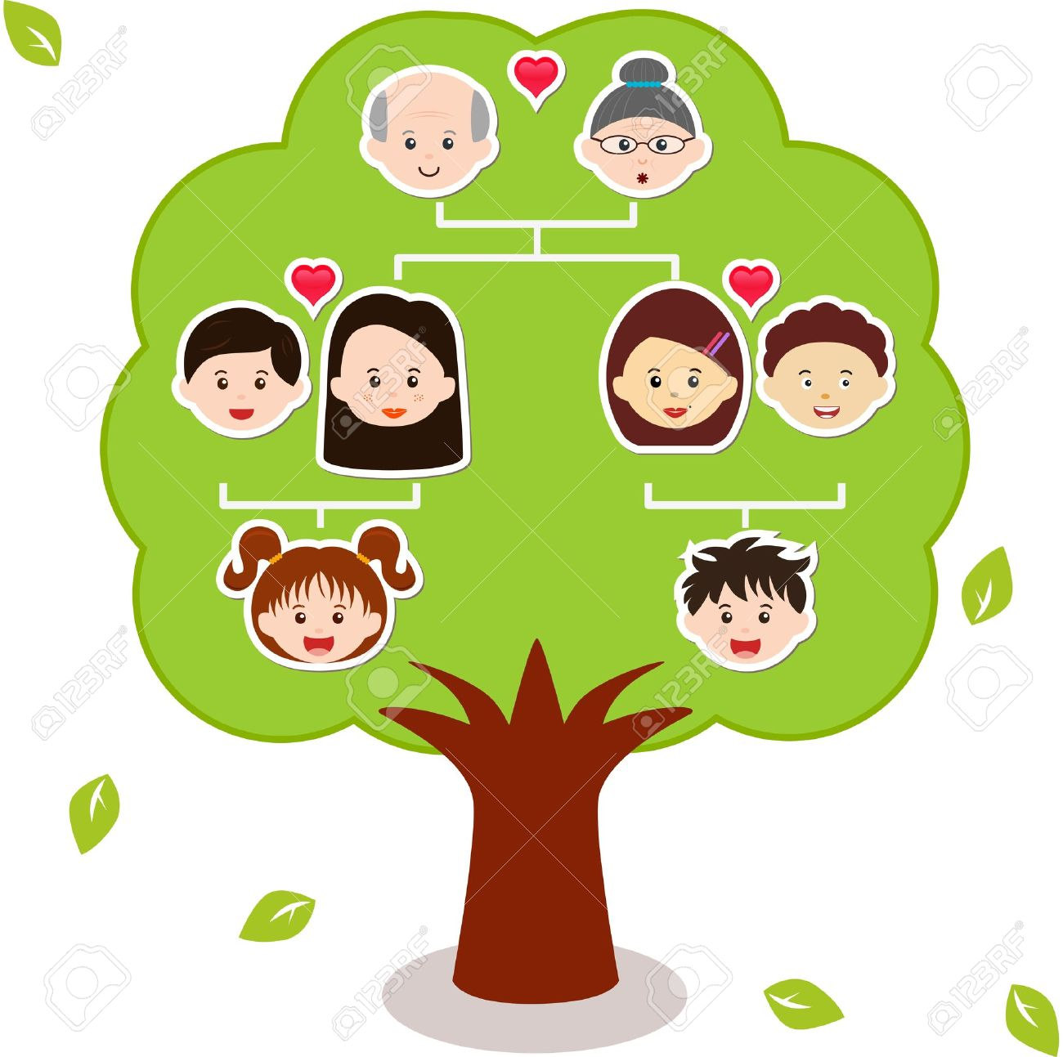
Family tree

Slide 2
Grandfather |ˈɡran(d)fɑːðə|

Slide 3
Grandmother |ˈɡran(d)mʌðə|

Slide 4
Grandparents |ˈɡrændˌperənts|

Slide 5
Mother |ˈmʌðə|

Slide 6
Father |ˈfɑːðə|

Slide 7
Parents |ˈpeərənts| родители
wife |waɪf| жена
husband |ˈhʌzbənd| муж

Slide 8
Twins |twɪnz| близнецы, двойняшки

Slide 9
Sisters |ˈsɪstəz|

Slide 10
Brothers |ˈbrʌðəz|

Slide 11
Uncle |ˈʌŋk(ə)l| дядя aunt |ɑːnt| тетя

Slide 12
Thanks for your attention!

