Slide 1
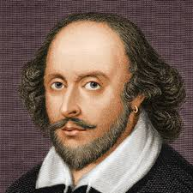
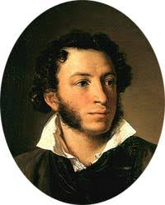
Module 2. Books and Authors.
Vocabulary and Grammar.
Автор - Петрова Т.Н., учитель англ. языка СОШ №5 г. Петрозаводска.

Slide 2
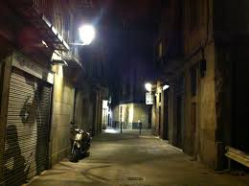
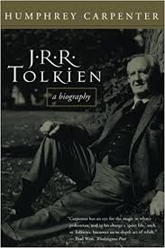
Drama, suspense story, biography, adventure.
A thrilling story when you don’t know
what happens next.
A serious play for the theatre, TV or radio.
A story about the life of a famous person
written by somebody else.
An exciting story with a character
who does dangerous things.

Slide 3
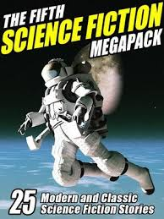
Mystery, humorous story, science fiction story.
A story that takes place in space or in the future.
A story that makes everybody laugh.
A story about a crime or an unusual event.

Slide 4
Grammar. Past Simple.
+ (ed, II) - (didn’t I)
? (Did …I? Wh..did … I?)
Write-wrote, catch-caught, find-found,
meet-met, be – was, were,
create-created, travel-traveled.

Slide 5
Open the brackets.
Jack London (be) a famous American writer.
Tom (meet) his friend at a bookshop.
They (find) initials on the walls of a cave.
Mark Twain (create) a famous character, Tom Sawyer.
Tolstoy (write) a great novel “War and Peace”.

Slide 6
Open the brackets.
We (find) a novel we needed in the library.
Sherlock Holmes (catch) a lot of terrible criminals.
Where …. Conan Doyle (study)?
….. Miss Marple (live) in Scotland?
How …. Captain Nemo (travel) ?

Slide 7
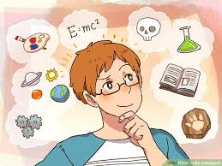
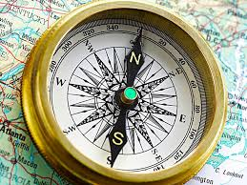
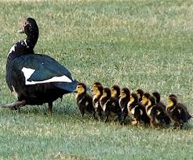
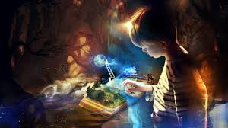
Intelligent, compass, solve, several, imagination, famous.
1.Agatha Christie was a …. English writer.
2. People use a …. to find a way back.
3. Tom is the best pupil in the class. He is
very ………
4. There were ….. books on the shelf.
5. What can people do to …. ecological
problems?
6. Talented authors have a vivid…..

Slide 8
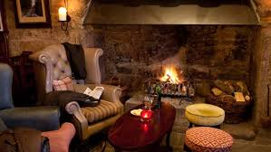
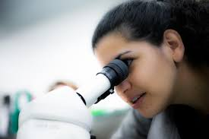
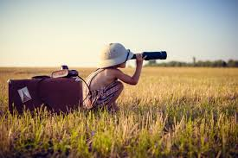
Hide, initials, cozy, glance, explore.
We found the …. on the walls of the cave.
The children like to ….. in the garden.
Jane’s flat is comfortable and ……
At first …… the object looked strange.
Polly ….. the forest very attentively.

Slide 9
Write down the words.
Intelligent – умный, imagination - воображение, several – несколько, solve - решить, hide – прятаться, cozy - уютный, glance – взгляд, explore - исследовать.
Write-wrote (писать-писал), catch-caught (поймать-поймал), find – found (найти-нашел), meet-met (встретить-встретил), be-was, were (быть - был, были).

Slide 10
Thank you for attention.

