Slide 1
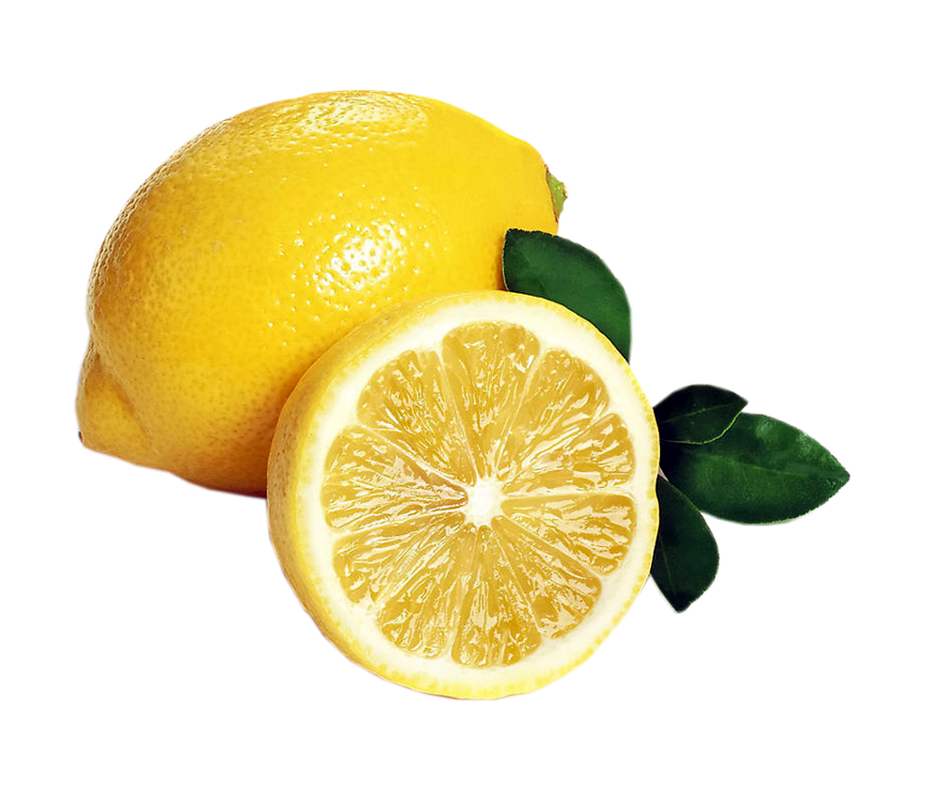
lemon

Slide 2
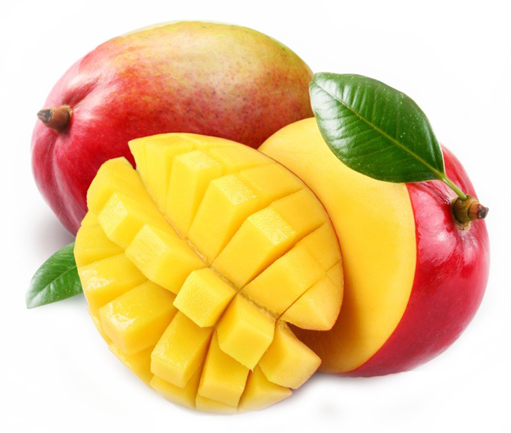
mango

Slide 3
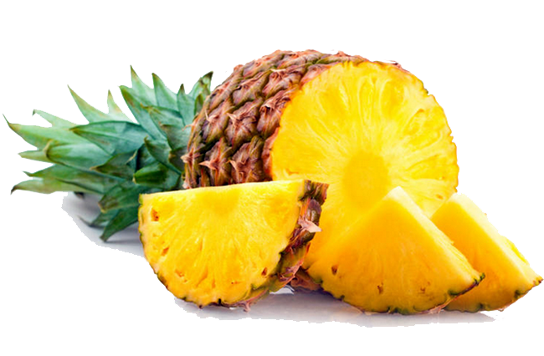
pineapple

Slide 4
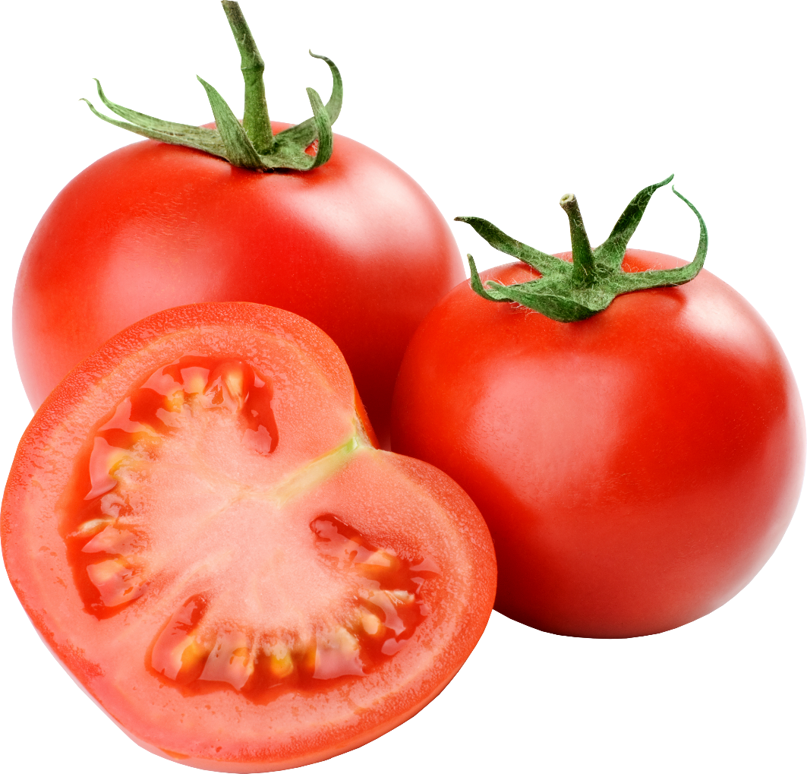
tomato

Slide 5
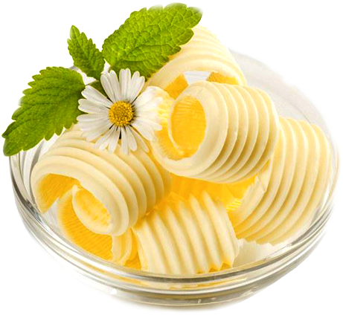
butter

Slide 6
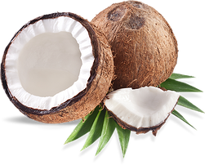
coconut

Slide 7
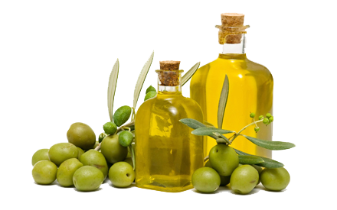
olive oil

Slide 8
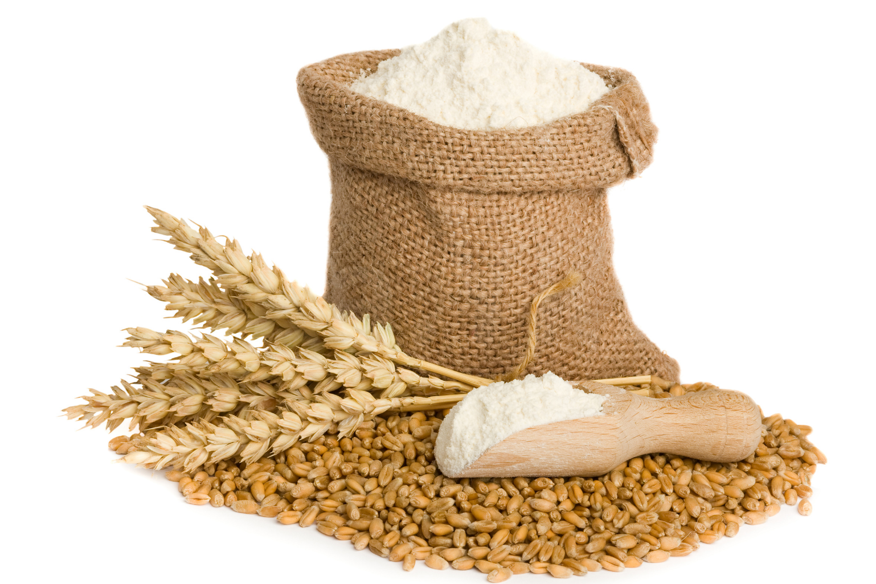
flour

Slide 9
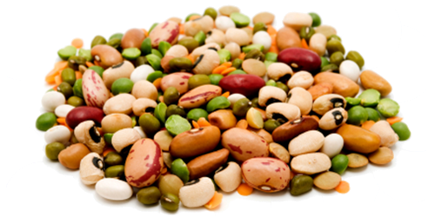
beans

Slide 10
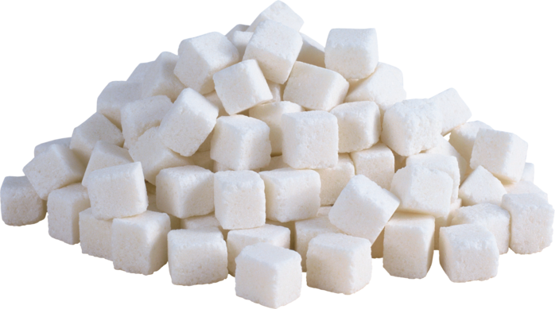
sugar

Slide 11
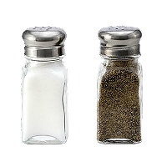
salt and pepper

Slide 12
Many, much,
a lot of

Slide 13
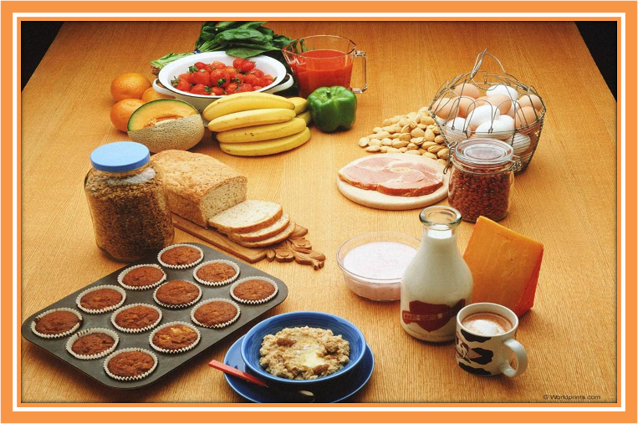
Countable and uncountable nouns
Исчисляемые и неисчисляемые существительные

Slide 14
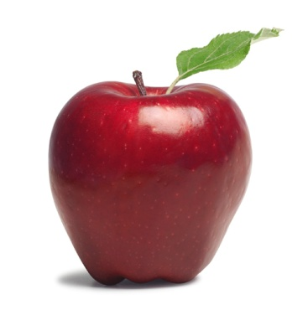
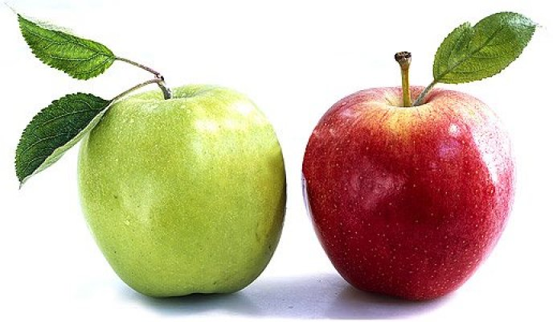
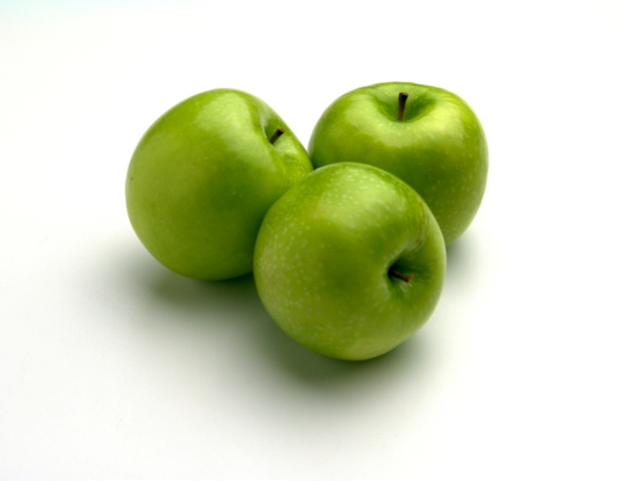
Countable nouns
One apple
Two apples
Three apples

Slide 15
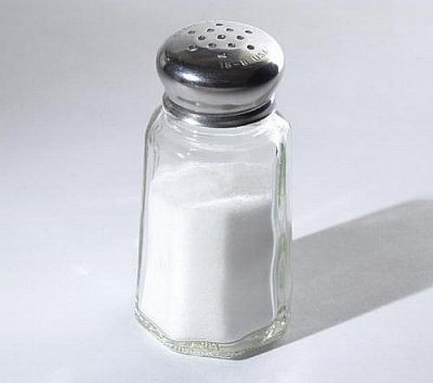
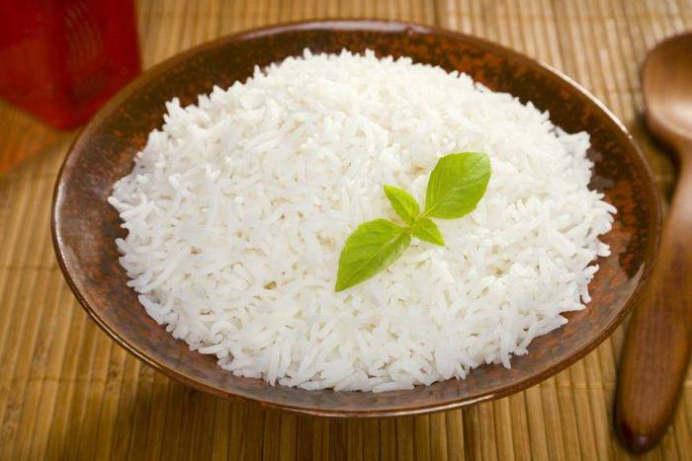
Uncountable nouns
Salt
Rice

Slide 16
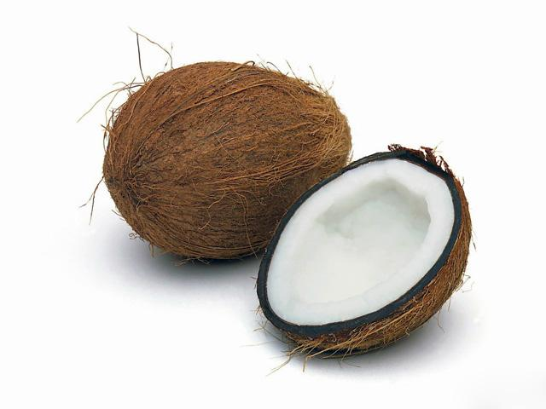
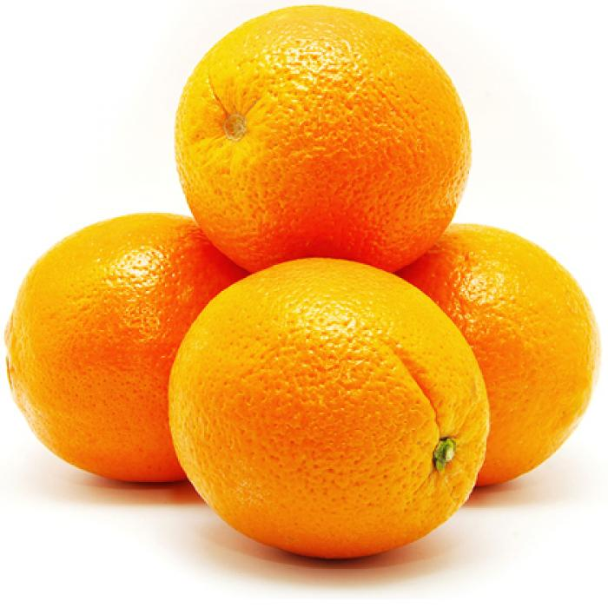
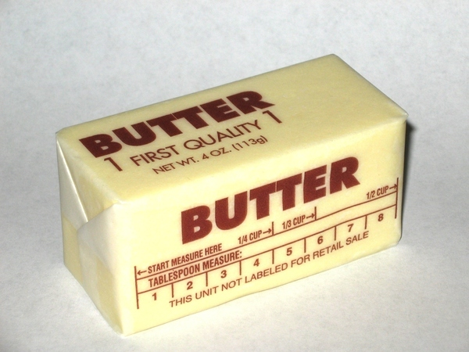
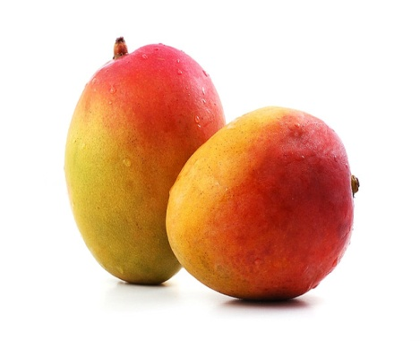
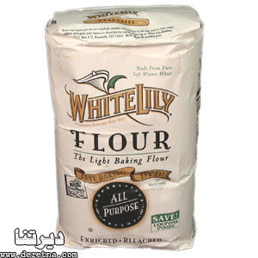
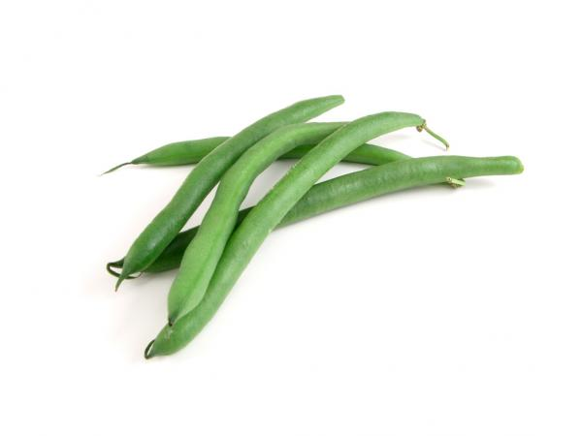
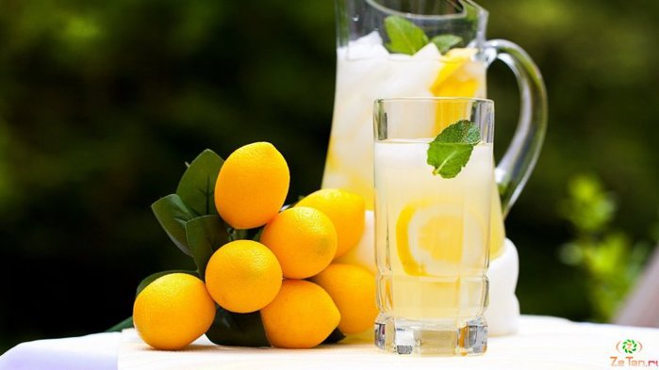
What products can we count?
С
U
С
С
С
U
U

Slide 17
Many (много)
используется с исчисляемыми существительными в вопросительных и отрицательных предложениях
There aren’t many apples in the fridge.
В холодильнике не много яблок.
Are there many apples in the fridge?
В холодильнике много яблок?

Slide 18
Much (много)
используется с неисчисляемыми существительными в вопросительных и отрицательных предложениях
There isn’t much salt in the salad.
В салате не много соли.
Is there much salt in the salad?
В салате много соли?

Slide 19
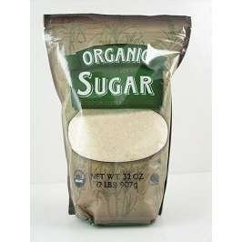
A lot of (много)
используется в утвердительных предложениях.
There is a lot of sugar in the tea.
В чае много сахара.

Slide 20
Много | A lot of | Many (исчисл.) | Much (неисчисл.)
+ | There is a lot of sugar in the tea. I have got a lot of bananas.
? |  | How many apples are there in the fridge? | How much salt is there in the salad?
- |  | There aren’t many apples in the fridge. | There isn’t much salt in the salad.

Slide 21
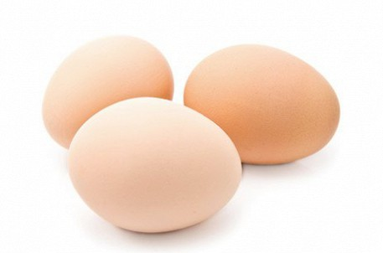
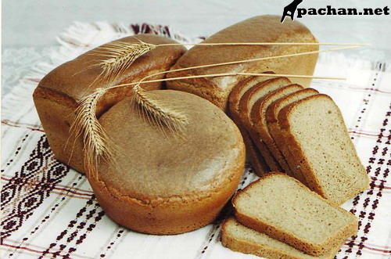
How many eggs are there?
Сколько яиц ?
- Not many
- A lot
How much bread is there?
Сколько хлеба?
- Not much
- A lot

Slide 22
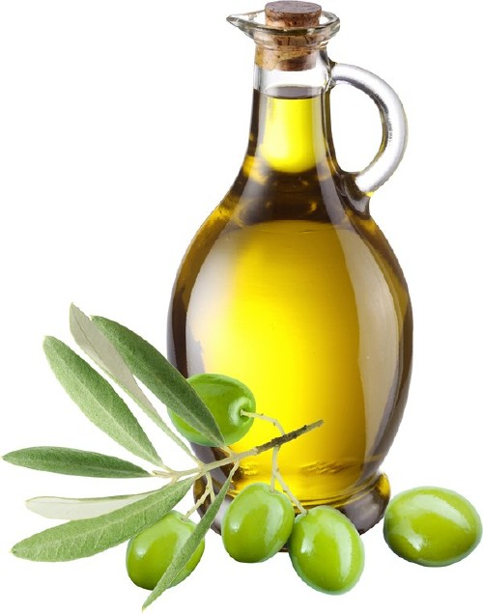
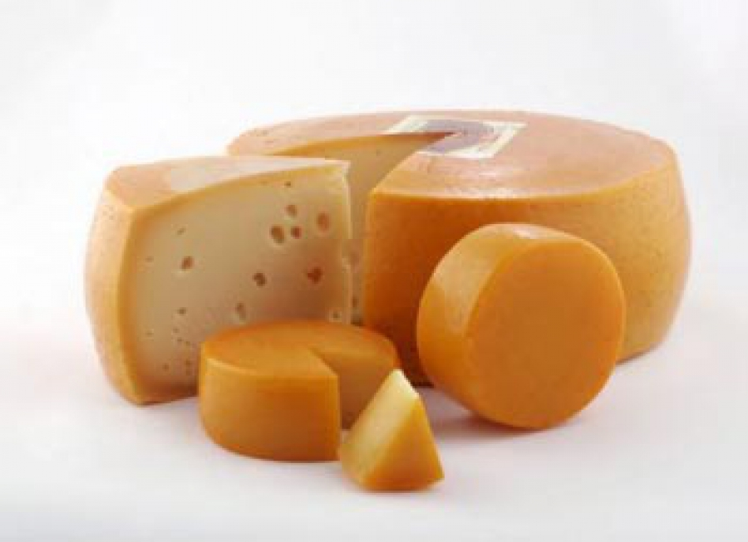
How much
……olive oil is there?
- Not much
- A lot
How much
…….cheese is there ?
- Not much
- A lot

Slide 23
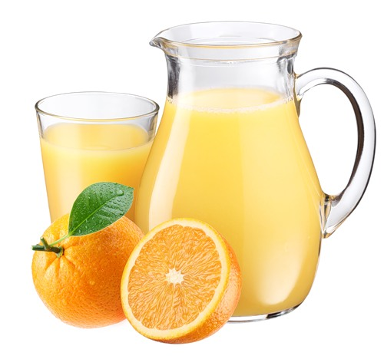
How much
……..orange juice is there ?
- Not much
- A lot
How many
……..potatoes are there?
- Not many
- A lot

Slide 24
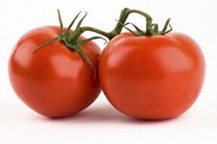
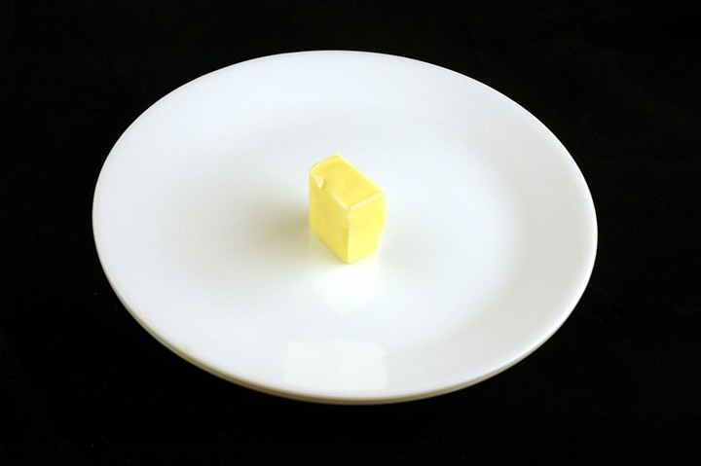
How many
……..tomatoes are there ?
- Not many
- A lot
How much
……butter is there ?
- Not much
- A lot

Slide 25
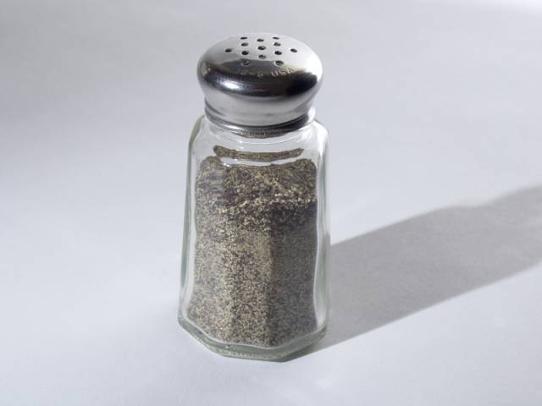
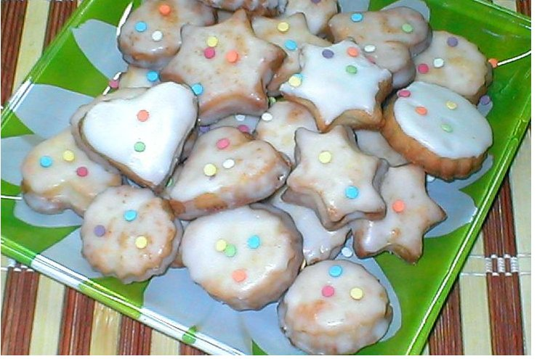
How much
…….pepper is there?
- Not much
- A lot
How many
…..biscuits are there ?
- Not many
- A lot

Slide 26
Try to complete the following sentences. Use How much /How many
1……..oranges are there in the bag?
2……..butter is there in the fridge?
3……..bread is there on the table?
4……..eggs are there in the box?
5……..potatoes are there in the cupboard?

Slide 27
Look, read and write Yes/No
There is a lot of olive oil.
There are a lot of biscuits.
There is a lot of butter.
There is a lot of cheese.
There are a lot of tomatoes.

Slide 28
