Slide 1
My favorite food
Моя любимая еда

Slide 2
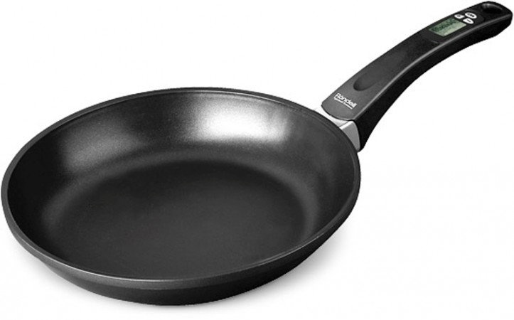
Five fat sausages Sitting in the pan. Five fat sausages Sitting in the pan. Sizzle! Sizzle! Sizzle! One goes BANG! Four fat sausages sitting in a pan.
Look and listen.

Slide 3
Four fat sausages sitting in a pan. Four fat sausages sitting in a pan. Sizzle, sizzle, sizzle… One goes "Bang!” Three fat sausages sitting in a pan.

Slide 4
Three fat sausages sitting in a pan. Three fat sausages sitting in a pan. Sizzle, sizzle, sizzle… One goes "Bang!” Two fat sausages sitting in a pan.

Slide 5
Two fat sausages sitting in a pan. Two fat sausages sitting in a pan. Sizzle, sizzle, sizzle… One goes "Bang!” One fat sausage sitting in a pan.

Slide 6
One fat sausage sitting in a pan. One fat sausage sitting in a pan. Sizzle, sizzle, sizzle… One goes "Bang!”

Slide 7
No one sausage sitting in a pan.

Slide 8
1 — гамбургеры 2 — бананы 3 - жареный картофель 4 — шоколад 5 — торт 6 — яйца 7 — печенье a)bananas b)burgers c)cake d)chips e)chocolate f)eggs g)biscuits
Read, match and write down, please.

Slide 9
I like... I don’t like....

Slide 10
Candles on a chocolate cake!
[tʃ] или [k]

Slide 11
Hurry! Hurry! – Поспеши! Поспеши! Today – сегодня Just for me – только для меня With – с too – тоже there’s lots - здесь есть много to eat – поесть For me and you – для меня и тебя To make a wish – загадать желание

