Slide 1
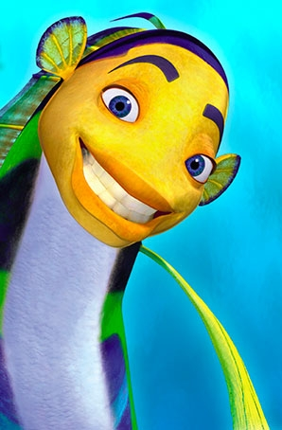
A Contest Lesson
Sea Animals

Slide 2
Learn to read the words and give the stress
Are you a student?
How are you?
Can you swim?
What’s this?
Are you six?
Do you like school?
Where did you stay?
Is your name John?
What for?
Where’s Mary?
How’ s Lizzy?
Is it a pen?
Do you live in Kentau?
How’s your friend?
Who is Anna?
Is your teacher nice?
Are you a doctor?
How long?

Slide 3
Look at the correct answers
How are you?
What’s this?
Where did you stay?
What for?
Where’s Mary?
How’ s Lizzy?
How’s your friend?
Who is Anna?
How long?
Are you a student?
Can you swim?
Are you six?
Do you like school?
Is it a pen?
Do you live in Kentau?
Is your teacher nice?
Are you a doctor?
Is your name John?

Slide 4
Read and translate the names of animals
a turtle
a shark
a clownfish
a sea lion
a starfish
a whale
a seal
a jellyfish
an orca
a seahorse
a dolphin
an octopus

Slide 5
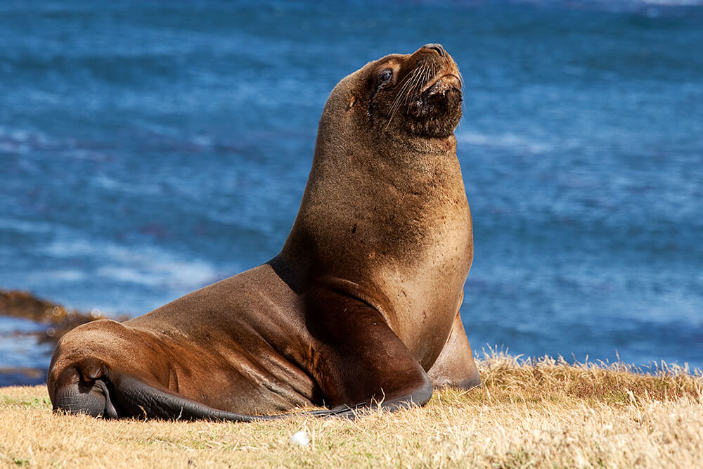
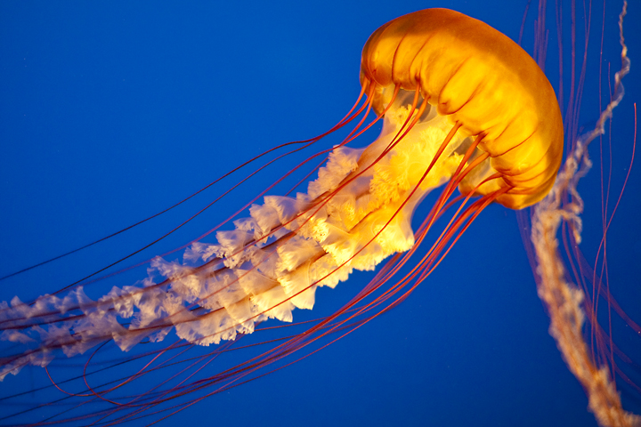
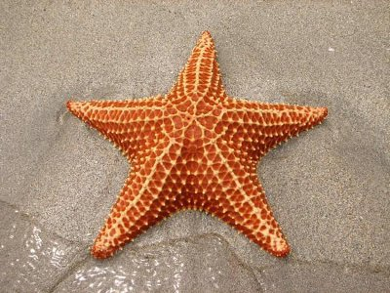
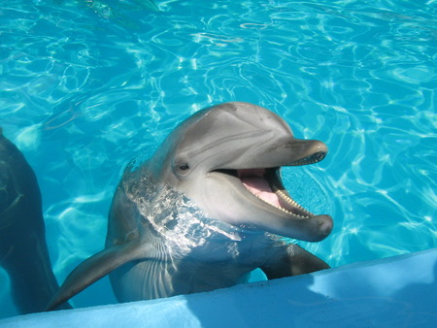
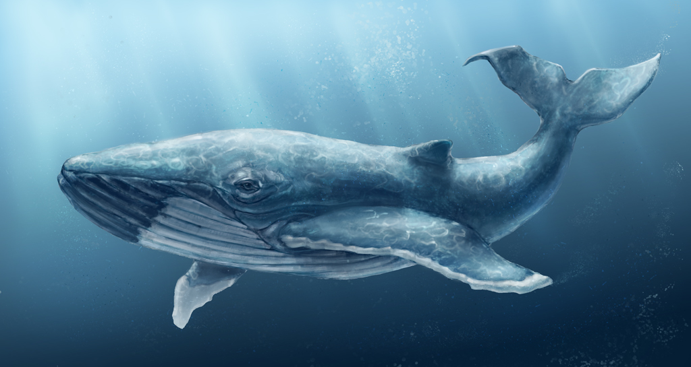
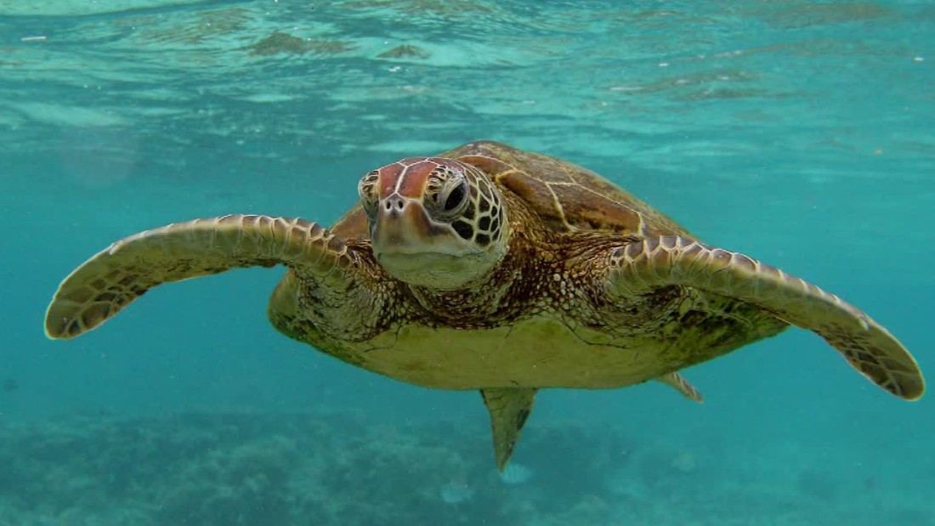
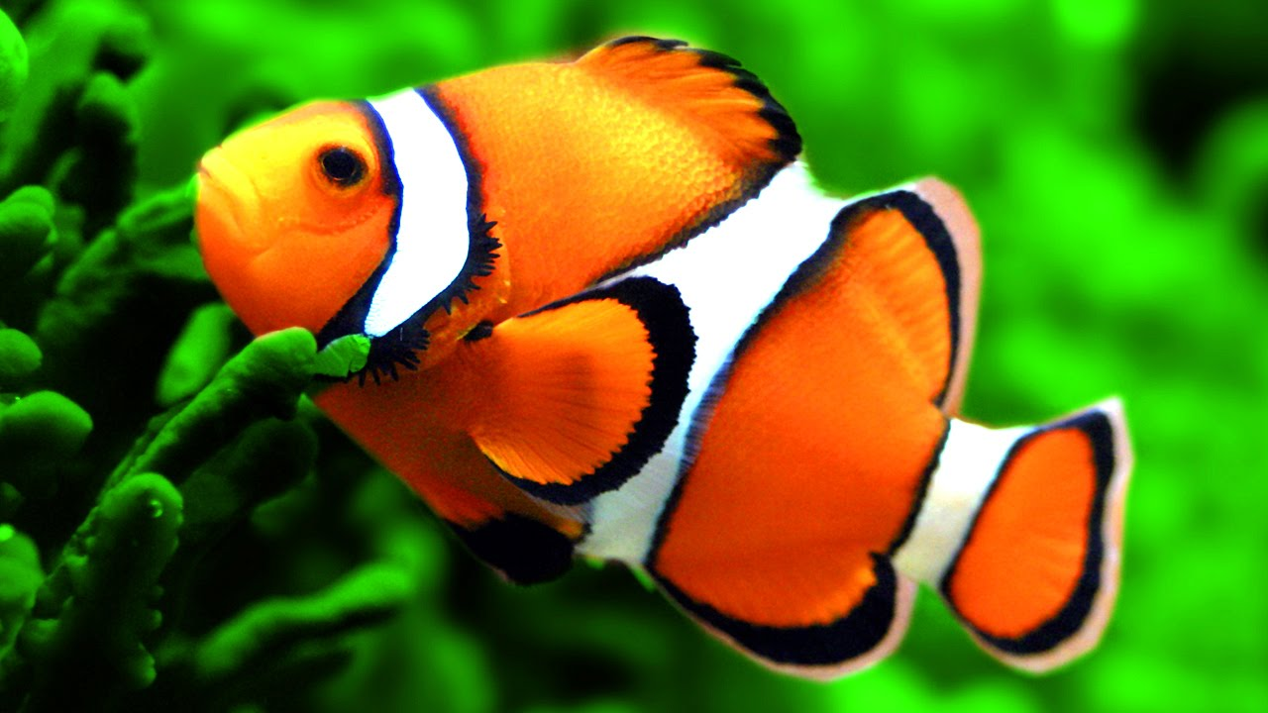
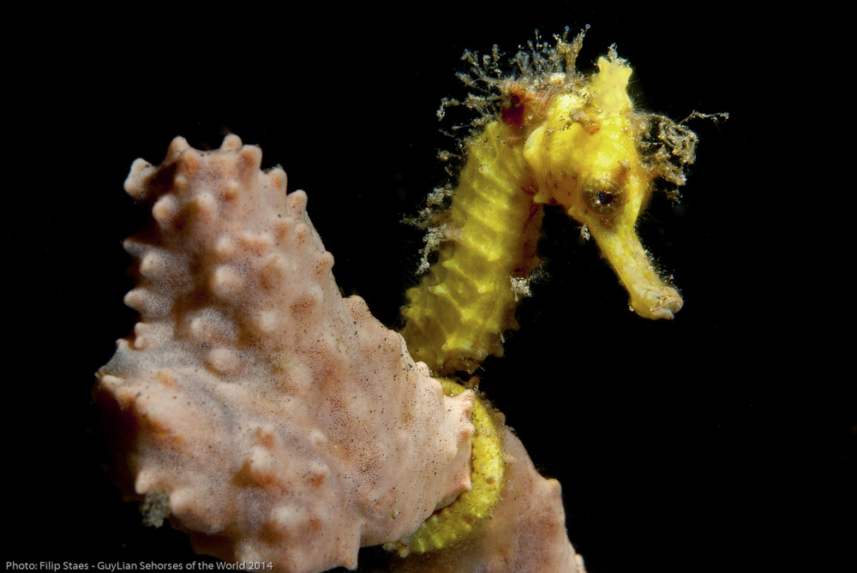
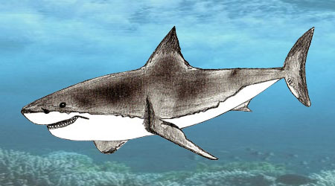
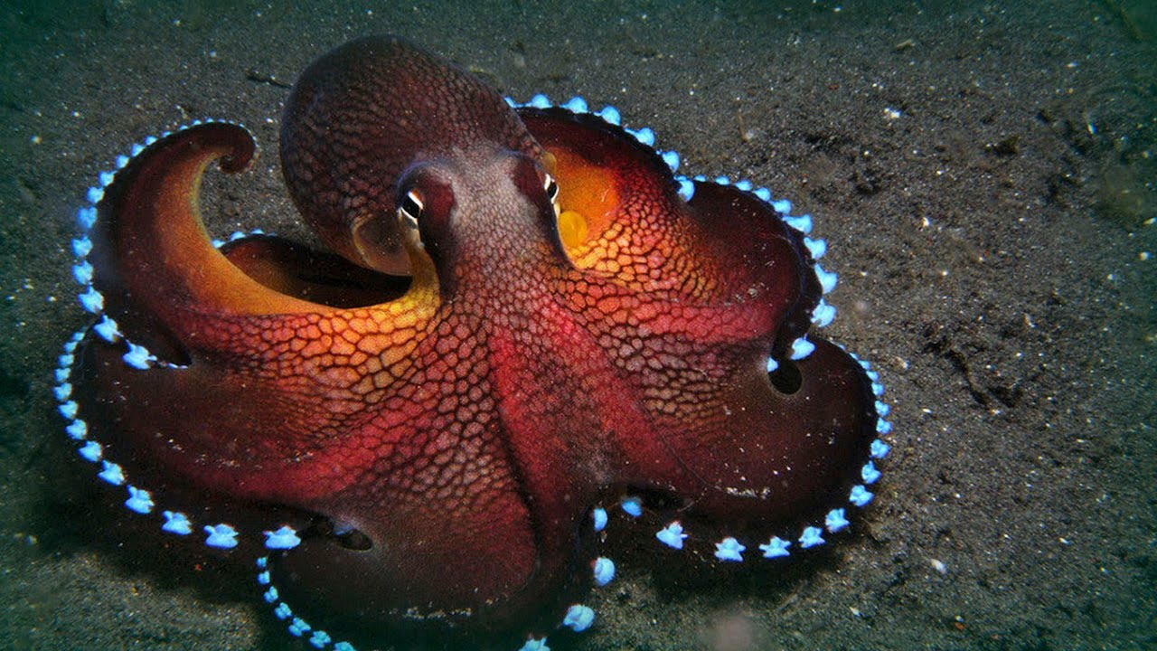
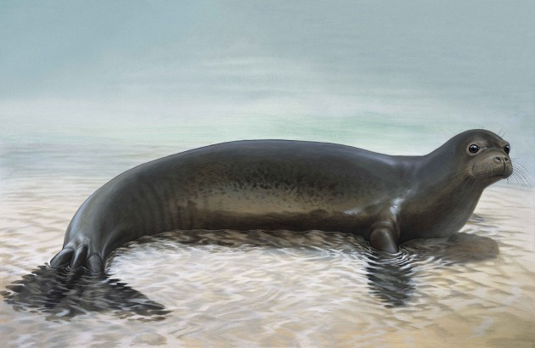
sea animals

Slide 6
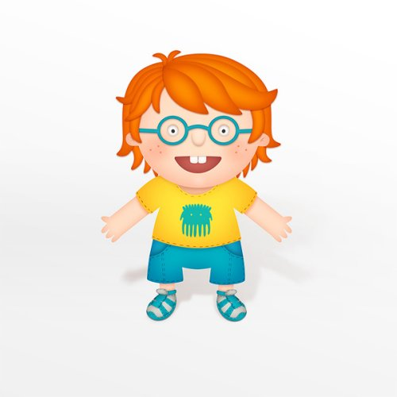
Study the pictures and choose the correct variant

Slide 7
What animal is it?
a) a seal b) a turtle c) a whale

Slide 8
What animal is it?
a) an orca b) a shark c) a dolphin

Slide 9
What animal is it?
a) an octopus b) a seahorse c) a jellyfish

Slide 10
What animal is it?
a) a sea lion b) a starfish c) a seal

Slide 11
What animal is it?
a) a seahorse b) a turtle c) a whale

Slide 12
What animal is it?
a) a clownfish b) an orca c) a jellyfish

Slide 13
What animal is it?
a) a shark b) a clownfish c) a seal

Slide 14
What animal is it?
a) an orca b) a shark c) a starfish

Slide 15
What animal is it?
a) a whale b) a jellyfish c) a sea lion

Slide 16
What animal is it?
a) a starfish b) a shark c) a seahorse

Slide 17
What animal is it?
a) a whale b) a jellyfish c) a dolphin

Slide 18
What animal is it?
a) a turtle b) a starfish c) an orca

Slide 19
Read and translate the Text
There are many animals in the world that live in water. We call them sea animals. They are different. They can be tiny or huge, friendly or dangerous, beautiful or ugly. Look, this is a seahorse and this is a jellyfish. This is a whale and that is a shark. These are dolphins and these are clownfish. They can be smart and funny. They have sharp teeth, flippers, tails. They can swim very well and fast. They all live in deep water.
New words: tiny- крошечный, huge- огромный, ugly- уродливый, smart- умный, teeth- зубы, flippers- плавники, deep- глубокий, sharp- острый, purple- сиреневый, grey- серый, orange- оранжевый, different- разный

Slide 20
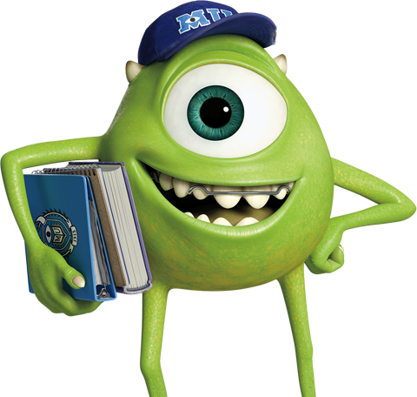
Look at the pictures and find the right animal. Write the name of animal

Slide 21
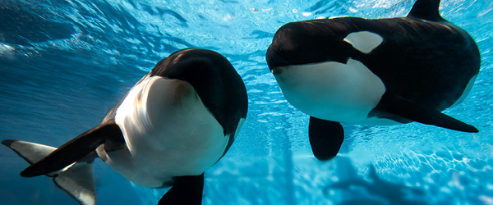
This sea animal is big and brown. It lives in the sea water. It has sharp teeth. It can work in the circus. It likes little fish.

Slide 22
It is a huge animal. It is black and white. It lives in the seas and oceans. It eats big and small fish. It is very smart. It can live 70 years.

Slide 23
It looks like a star. It can be red, green, purple or grey. It usually has five arms. It lives in the sea but it can not swim. It walks.

Slide 24
This fish is very beautiful. It is small and smart. It is orange and white. It lives deep in the sea. It likes to eat grass.

Slide 25
This animal is big. It has a lot of sharp teeth. It is very dangerous. It lives in the sea. It can swim very well. It can eat sea animals and people.

Slide 26
This is a sea animal. It is the biggest animal in the sea. It has big wings and tail. It lives in the deep water. It likes tiny fish.

Slide 27
This is a sea animal. It lives in the sea and ocean water. It has small head and big body. It can swim very well. It can live 150 years.

Slide 28
Answer the questions:
What animals did you know?
What colour can they be?
Where do these animals live?
What kind of animals are they?
Did you see these animals?
Where did you see these animals?

