Slide 1
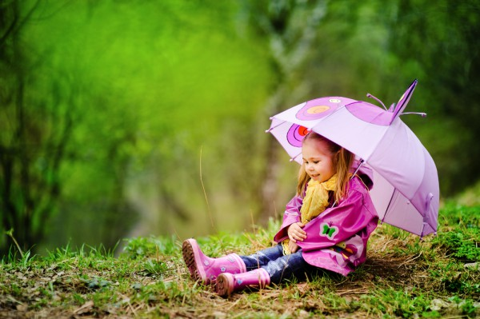
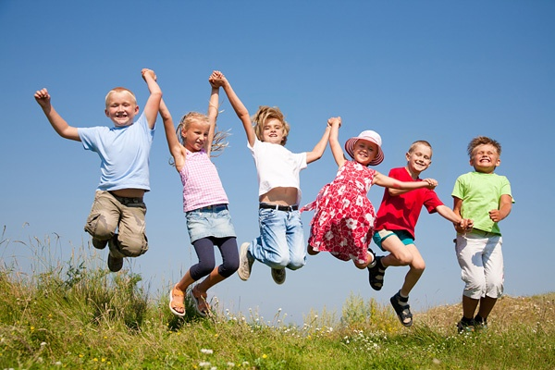
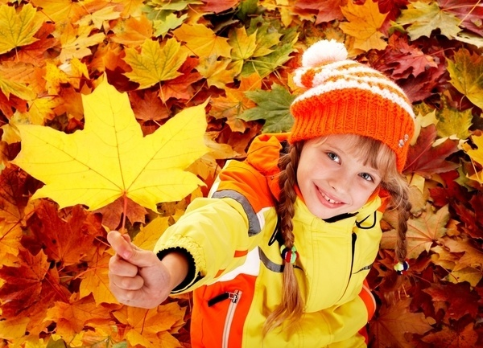
Dress right !

Slide 2
What are we going to do today?
In my opinion
I think that…
It seems to me that
….we are going to…
practise new words “Clothes”
Speak about seasons, weather
Present Simple and Present Continuous

Slide 3
[w] weather, windy, winter
[ ] there is, there are, clothes
[æ] bad, bag, January
[u] June, July, put on.

Slide 4
Put the words in the correct order
bad is weather no there,
bad there clothes are
There is no bad weather,
there are bad clothes.

Slide 5
Answer the questions
What day of the week is it today?
What season is it now?
What`s your favourite season?
What`s the weather like today?

Slide 6
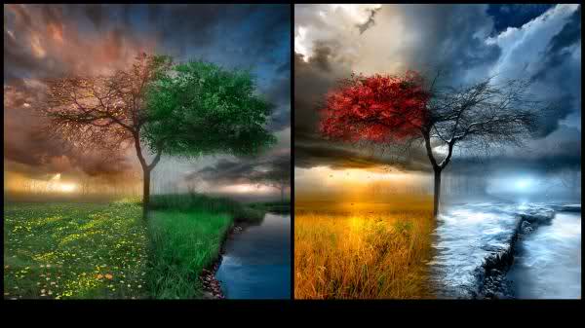
Seasons
spring
summer
autumn
winter

Slide 7
Months of the Year

Slide 8
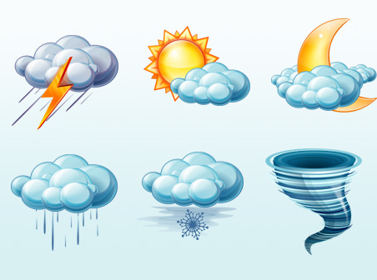
The weather is….. It is nice\bad.
hot
cold
stormy
sunny \ cloudy
moony
rainy
snowy
windy

Slide 9
Lexical Test
September, October, November are the months of the …
a) autumn b) winter c) spring d) summer
2. Spring has three months: March, April and
a) June b) July c) May d) August
3. New Year starts in …
a) January b) February c) November d) December
4. Winter months are: December, January and …
a) September b) October c) November d) February
5. After Monday goes …
a) Tuesday b) Wednesday c) Thursday d) Friday
6. What’s the weather like today?

Slide 10
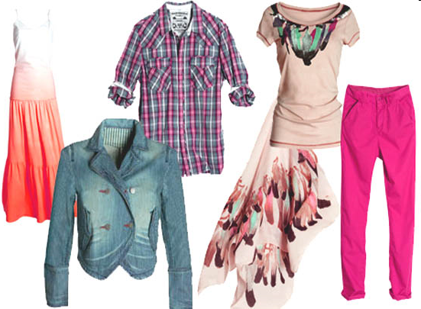
Clothes
What we wear

Slide 12
WB Ex 1
1 shoes,
2 jumper,
3 skirt,
4 gloves.
1 scarf,
2 trousers,
3 tie,
4 shirt.

Slide 13
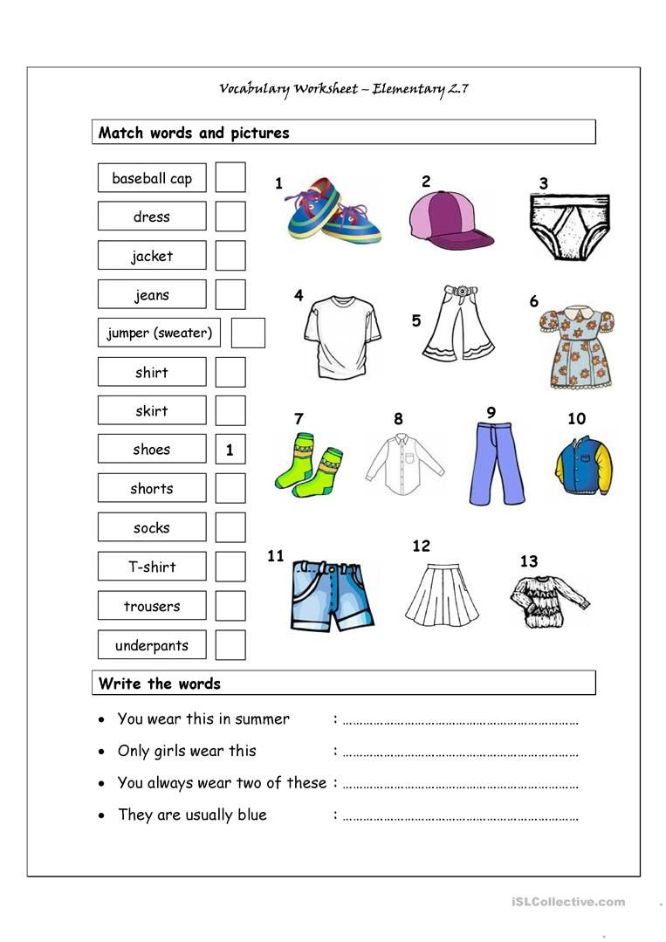
Clothes

Slide 14
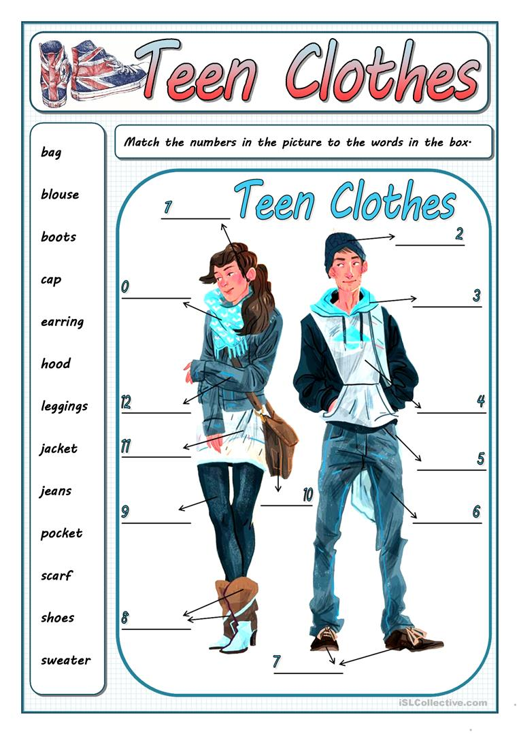

Slide 15
Clothes
Vest \Waistcoat — жилет
Top -топ
Cloak — плащ (накидка), мантия
Down-padded coat — пуховик
Jacket — пиджак\ (амер.) любая куртка
Leather jacket — кожаная куртка
Parka — парка
Anorak анорак (ветровка)
Blazer блейзер
Skirt — юбка
Apron передник
Dress- платье
Suit/ Costume- костюм
Sport suit/Tracksuit- спортивный костюм
Shirt — рубашка
T-shirt — футболка
Tunic — туника
Blouse — блузка
Coat — пальто
Raincoat / slicker — дождевик
Fur coat — шуба
Sheepskin coat — дубленка

Slide 16
Swim trunks- плавки
Swimsuit/swimming dress/swim costume- купальник
Dressing gown — домашний халат
Hospital gown — больничный халат
Nightdress — ночная сорочка nightie (сокращённо)
Pyjamas — пижама
Suit /Costume— костюм
Pullover / sweater / jumper- пуловер, cвитер/джемпер
Cardigan — кардиган
Hoodie — «худи», трикотажная кофта с капюшоном
Sleeveless jacket — безрукавка
Sweat-shirt- толстовка без капюшона, фуфайка
Trousers (брит.) / pants (амер.)-классические брюки
Jeans — джинсы
Shorts — шорты

Slide 17
Headgear/Headdress/Headwear-Головной убор
Beret — берет
Cap — кепка, фуражка
baseball cap- бейсболка
Hat — шляпа, шляпка, шапка
Helmet — шлем, каска
Scarf- шарф
Gloves - перчатки
Mittens -варежки
Socks носки
Stockings чулки
Tights - колготки
Leggings – леггинсы,
Drawers- лосины, подштанники
Underpants- кальсоны

Slide 18
Footwear (обувь)
Boots — ботинки
Shoes — туфли
High boots — сапоги
Trainers (брит.)/ sport shoes/ sneakers (амер.) — кроссовки
(High\Low) heeled shoes /High heels— туфли на каблуках
Flatshoes/Slippers – тапочки, шлепки
Sandals- сандалии
Wellingtons-резиновые сапоги

Slide 19
Accessories- аксессуары
umbrella зонтик
sunglasses тёмные очки
wallet кошелёк , бумажник
purse женский кошелёк
belt ремень
Buckle — пряжка
tie галстук
bow tie галстук-бабочка
watch часы
necklace ожерелье
bracelet браслет
cufflinks запонки
handbag сумочка
handkerchief носовой платок

Slide 20
Military clothes- военная форма
Full dress uniform –парадная форма
Working dress –роба (рабочее платье)
peakless cap –безкозырка
striped vest–тельняшка
jack –гюйс
battledress походное обмундирование
blouse гимнастерка
body armor, flak jacket бронежилет
breastplate нагрудный знак
camouflage камуфляж, маскировка
chevron шеврон
dress uniform парадный мундир
epaulet погон
tunic, coat китель
helmet, hard hat каска
trousers брюки, штаны
undershirt майка
belt пояс, ремень
socks носки
boots сапоги, ботинки
head gear головной убор

Slide 21
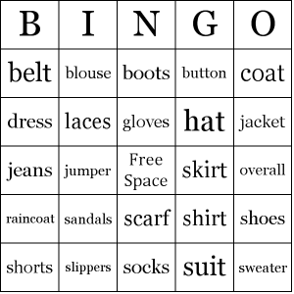
Let`s play!

Slide 22
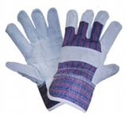
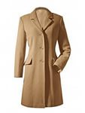
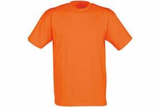
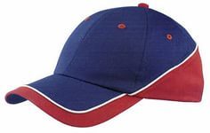
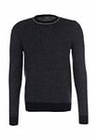
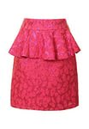
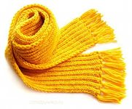
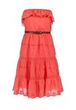
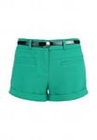
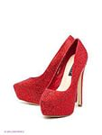
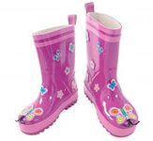
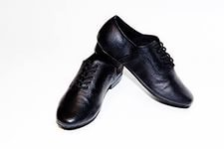
What clothes is suitable when it is cold/hot/rainy/sunny?

Slide 23
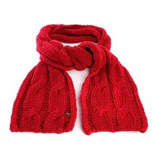
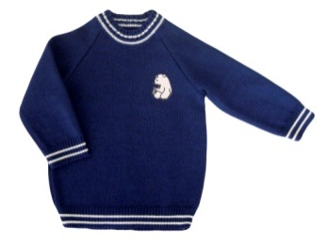
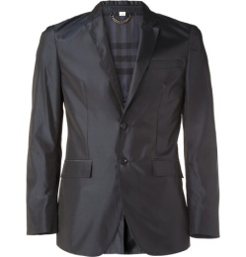
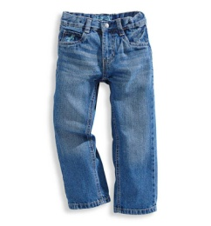
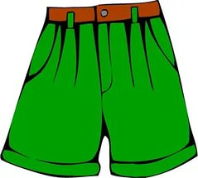
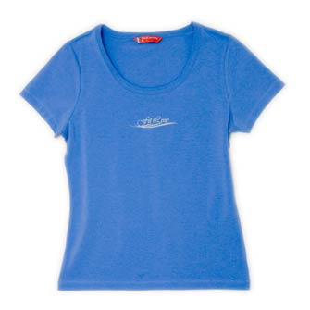
Complete the sentences.
When it’s cold, we put on
When it’s warm, we put on

Slide 24
I wear …… in cold weather.
I wear … in warm weather.
shorts
scarf
raincoat
coat
blouse
T-shirt
gloves
raincoat
boots
jumper
jacket

Slide 25
... and a blouse. She is wearing high heels.
Billy is wearing a T-shirt, shorts, socks and trainers. He is also wearing a cap and sunglasses.
Oliver is wearing a thick jacket and a long scarf. He is wearing trousers and boots. He’s also wearing a hat and gloves.
Max is wearing a long coat, a shirt and a tie. He is wearing trousers and he is holding an umbrella.

Slide 26
Describe the pictures
The men are wearing …
The girl is wearing …

Slide 27
SB p. 88 ex. 3
Everyday English
Asking about clothes
Asking | Answering
What do you think of my uniform? Do I look all right? Does it suit me? | It looks great/ fabulous on you. You look lovely /great! It suits you perfectly! I’m not sure it suits you.

Slide 28
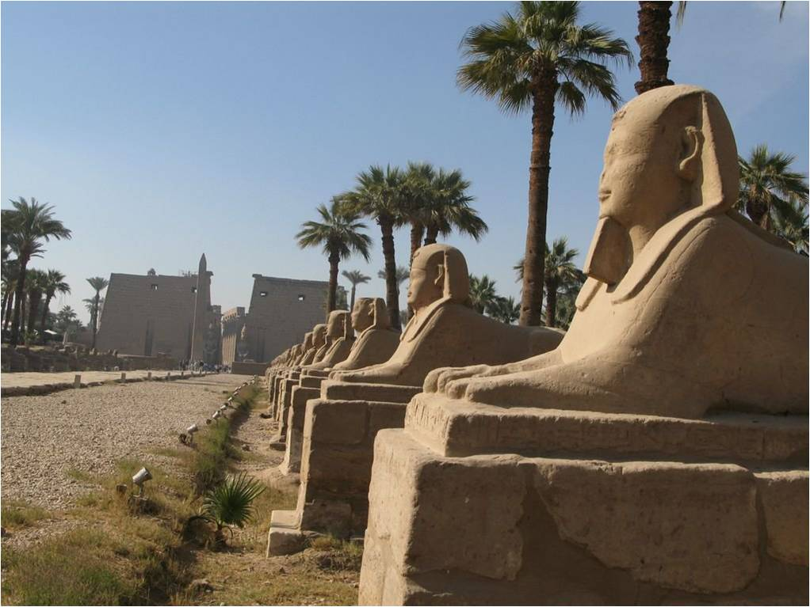
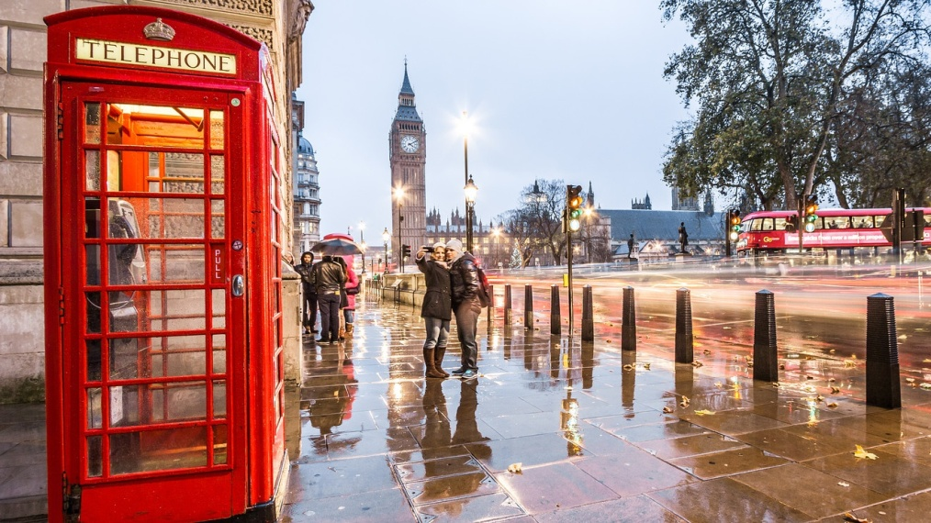
- Hello!
- Hello!
What country are you visiting?
- I am in …… now.
What is the weather ?
- The weather is……..
What should I wear in …..?
- You should wear…….

Slide 29
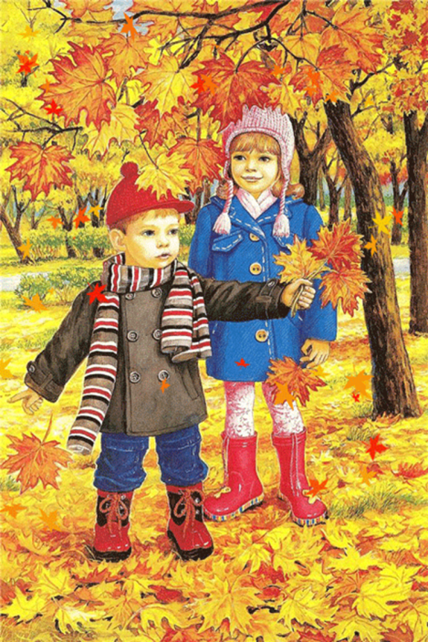
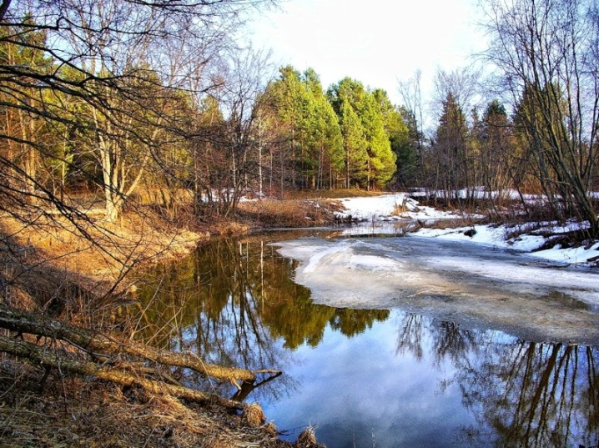
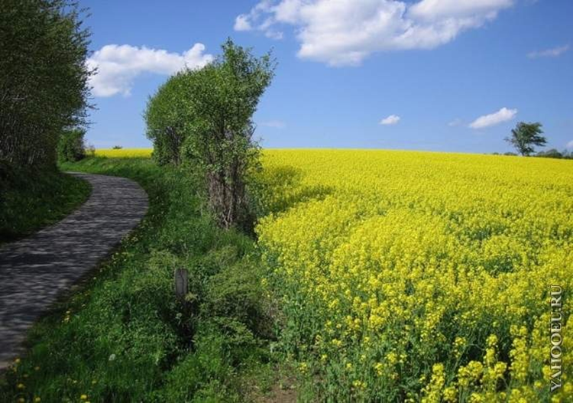
Work in pairs
What season is it?
What months are there in autumn?
What is the weather like in autumn?
What do we wear in autumn?

Slide 30
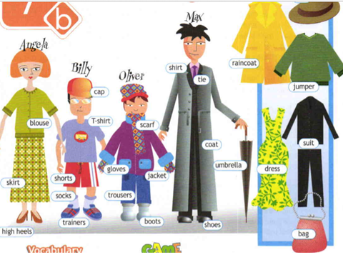
Tell about yourself
My name is ….
My surname is ….
I am …..years old.
I`m from ……
I'm at\in the 5-th class.
There are __ seasons.
My favourite ______ because____.
In winter/summer I usually wear____.
My favourite clothes is___ because it is comfortable/nice/bright/expensive.
I think, there is no bad weather, there are bad clothes!
I study at Kronshtadt Cadet Naval School.
I like studying at our corps.
I think, I am a good cadet!

Slide 31
Present
Simple
Continuous
am
are V ing
is
V1 (s,es)
постоянно
сейчас
He goes to school.
He is going to school.

Slide 32
always
всегда
never
никогда
usually
обычно
often
часто
sometimes
иногда
now
сейчас
Look!
Посмотрите!

Slide 33
buys
is drinking
are walking
is laughing
is playing
wear
eats

Slide 34
TEST Present Simple/Continuous
1. Her father________ (not/ to watch) TV at the moment. He _______(to sleep) because he _____(to be) tired.
2. Where______ your uncle ______(to work)? – He ___________(to work) at school.
3. ______your friend ______to do) his homework now?
4. When _____you usually ________(to come) home from school? – I _______(to come) at four o’clock.
5. My sister ____________(not/ to play) the piano now. She _____________(to play) the piano in the evening.
6.______you ______________(to read) a magazine and______________ (to think) about your holiday at the moment?
7. I ____________(to sit) in the waiting room at the dentist’s now.
8. When _____you________ (to listen) to the news on the radio?
9. ____you _______________(to play) chess now?
10. My father __________(not/ to work) at the shop. He _________(to be) a policeman.
11. Look at the sky: the clouds ____________(to move) slowly, the sun ______________(to appear) from behind the clouds, it _______________(to get) warmer.
12. I _________(not/ to drink) coffee in the evening. I ____________(to drink) coffee in the morning.
13. What ____your friend_______ (to do) now? – She _____________(to wash) the dishes.
14. _____your grandfather ________(to work) at this factory?- No, he ______(to be) a pensioner.

Slide 35
ANSWER-TEST
1. Her father is not (isn’t) watching TV… He is sleeping because he is tired.
2. Where does your cousin work? – He works at school.
3. Is your friend doing his homework now?
4. When do you usually come home from school? – I come at four o’clock.
5. My mother is not (=isn’t) playing the piano now. She plays the piano in the evening.
6. Are you reading a magazine and thinking about your holiday at the moment?
7. I am sitting in the waiting room at the doctor’s now.
8. When do you listen to the news on the radio?
9. Are you playing chess now?
10. My uncle does not (=doesn’t) work at the shop. He is a policeman.
11. Look at the sky: the clouds are moving slowly, the sun is appearing from behind the clouds, it is getting warmer.
12. I do not (=don’t) drink coffee in the evening. I drink coffee in the morning.
13. What is your sister doing now? – She is washing the dishes.
14. Does your father work at this factory? No, he is a pensioner.

Slide 36
TEST- Present Simple/Continuous
My aunt Olga is tall and beautiful with long red hair and big green eyes. She always wears/is wearing nice clothes. Today she wears/is wearing a wonderful black dress. She goes/is going to the theatre. Olga often goes/is going to the theatre. She is fond of plays and reads/is reading a lot. She usually helps/is helping me with my Literature classes. It's eight o'clock now. Olga is at the theatre. She watches/is watching a modern play. The actors play
/are playing well. Some people look/are looking at their programmes for the names of the actors. I think/am thinking my aunt will like the play.

Slide 37
T\F\NS
1. Olga is a short woman with blue eyes.
2. She is always well-dressed.
3. Today she is wearing rings and a bracelet.
4. She's wearing a beautiful dress because she's going to the theatre.
5.Olga is fond of reading. __
6.She's kind to her niece. __
7.The performance is good. __
8.Olga dislikes the play.__
1. – F;
2. – T;
3. – NS;
4. – T;
5. – T;
6. – T;
7. – T;
8. – NS.

Slide 38
Homework

Slide 39
Feedback
What have we done today?
We have learned…
Now I can/can’t…
Talk about…
Speak about…

