Slide 1
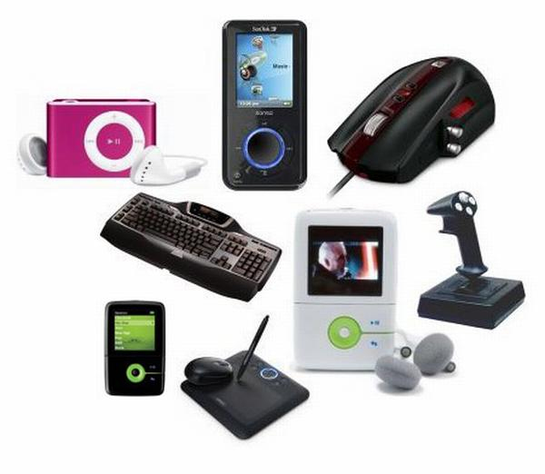
Friday, May 4, spring
Class Work
High tech gadgets

Slide 2
We are going to:
- learn new words: high tech gadgets and their uses
- read the text: profiles of people (matching)
- talk about your favourite gadgets

Slide 4
Concept Wheel
gadgets

Slide 5
The use of modern gadgets.
You know that modern inventions are used in everyday life and make it easier.
What are gadgets?
Why does a modern man need them?
This is what we are going to speak about at our lesson.

Slide 6
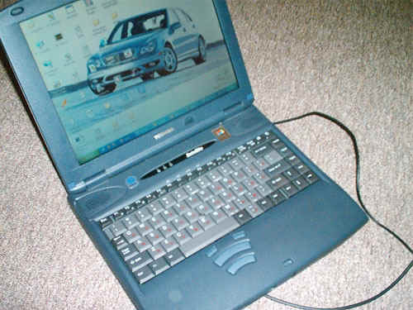
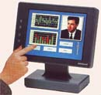
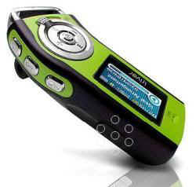
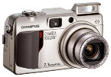
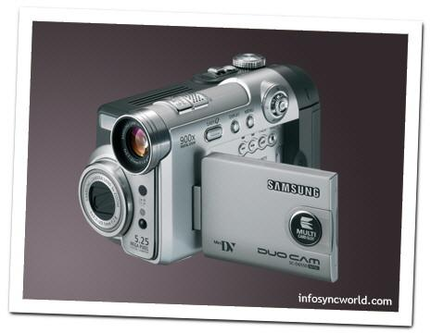
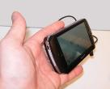
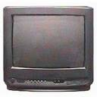
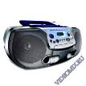
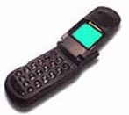
High Tech Gadgets
Look at the pictures. What are their names?

Slide 7
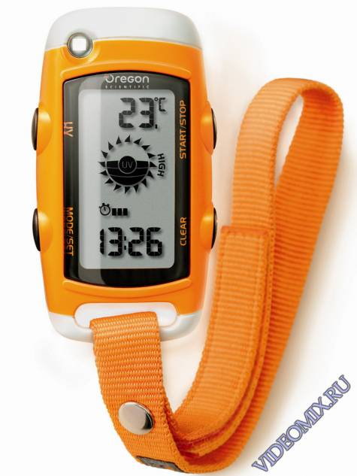
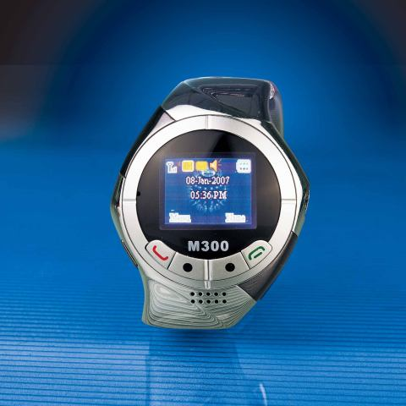
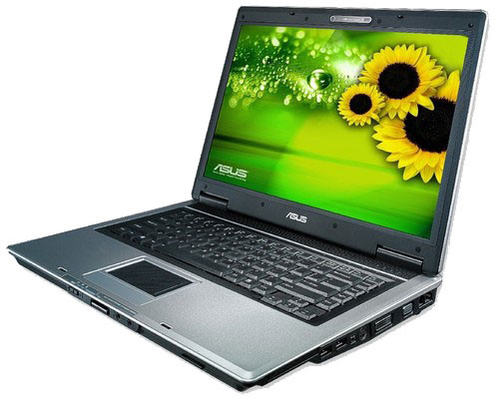
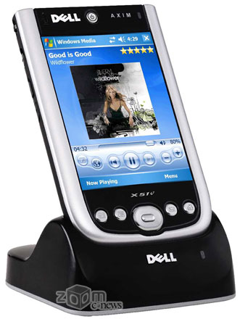
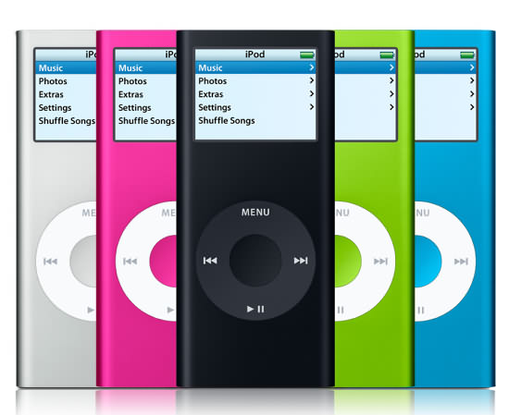
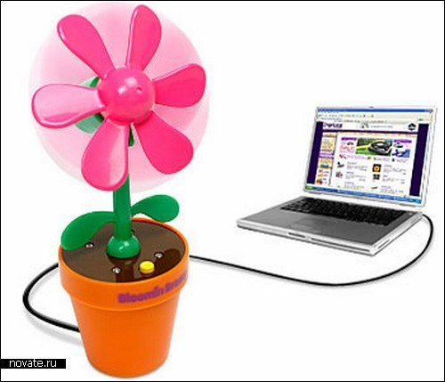
Are you a techno freak ?
What kinds of gadgets do you own?
What do you use it for?
What is your favourite gadget?
What kinds of high tech gadgets would you like to have?

Slide 8
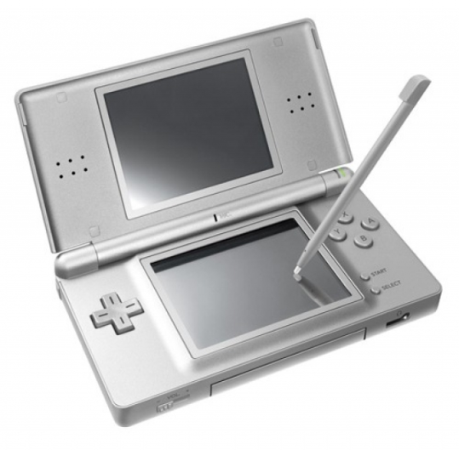
New words
gadget-техническая новинка
camcorder-видеокамера
device-прибор, механизм
digital-цифровой
techno freak-фанат техники
portable- переносной
laptop-ноутбук
headphones-наушники
software-программное обеспечение
equipment- оборудование
edit-редактировать
charge-заряжать (charge-заряд. устройство)
store information-хранить данные
up-to-date=modern -современный

Slide 9
Guess
A camcorder digitally records pictures and sound.
A laptop stores and deals with large amounts of information.
An MP3 player records and plays music downloaded from the Internet.
A video mobile phone makes and receives video phone calls.
A PDA organises and stores information such as telephone numbers, addresses, etc.
A digital camera takes and stores digital photographs.

Slide 10
A radio cassette player plays music from the radio or cassettes.
A Walkman® plays music through headphones, especially for use when travelling.
A dictaphone plays and records sounds, especially voices.
A TV broadcasts TV programmes with pictures and sounds.

Slide 11
Give the English equivalents:
техническая новинка,
видеокамера,
прибор, механизм,
цифровой,
фанат техники,
переносной,
ноутбук,
наушники,
программное обеспечение,
оборудование,
редактировать,
заряжать, заряд,
хранить
современный

Slide 12
Ex 1p 140 Complete the sentences, using the names of the gadgets and the words below:
I would use a … to …
record my lessons at school
tell the time
send a picture message to a friend
film a friend’s birthday party
listen to music
send emails
keep a record of my spending
watch a DVD
look up a friend’s address
edit my essay on the bus
do some Internet research for a project
show photos to my friends
burn songs onto a CD
listen to the news
plan my day/week
1 dictaphone
2 video mobile phone, PDA
3 video mobile phone
4 camcorder
5 laptop, MP3 player, radio cassette player,
Walkman®
6 laptop, PDA
7 laptop, PDA
8 laptop
9 PDA
10 laptop
11 laptop
12 laptop, digital camera, video mobile phone
13 laptop
14 video mobile phone, Walkman®, radio cassette player, TV
15 laptop, PDA

Slide 13
High Tech Gadgets
I have got ____ . I use _____ to __V__ .

Slide 14
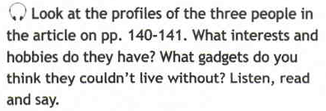
Ex.3a, p. 140 Reading
Sarah Tyson likes shopping and friends. I think she couldn’t live without her mobile phone.
Andy Cooper likes music and video games. I think he couldn’t live without his MP3 player and his computer.
Tina Appleby likes cinema and photography. I think she couldn’t live without her digital camera.

Slide 15
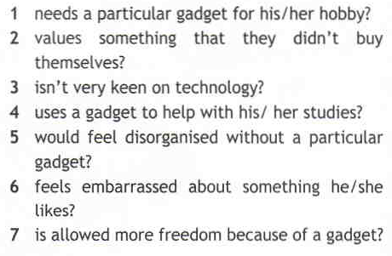
Ex.3a, p. 140
1 Tina
2 Andy
3 Sarah
4 Andy
5 Tina
6 Andy
7 Sarah

Slide 16
Ex 3b Identifying pronouns within a text
Sarah:
… couldn’t organise my life without it ― her mobile phone
… if I keep calling them ― her parents
Andy:
… good voice recorder on it ― his mobile phone
… listen to them ― university lectures
… ashamed to admit it ― the fact that he is hooked on his PlayStation 2®
… very keen on it ― his Playstation 2®
Tina:
… change documents on it ― her PDA
It keeps my whole life together ― her PDA
… lost without it ― her PDA
… when I visited them ― her clients
… edit them using software ― home movies
… It’s a great pastime ― making home movies

Slide 17
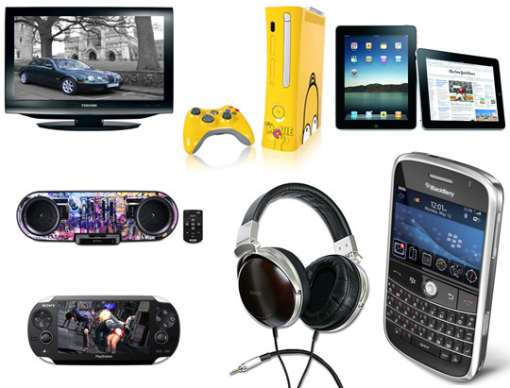
Ex 4 p 140 Identify the highlighted words throughout the text:
considering ― thinking about
handy ― convenient
hooked on ― addicted to
keen on ― interested in
on the move ― travelling
to the extent ― to the point
apart from ― other than
edit ― alter

Slide 18
Read & Translate
I’m considering going on holiday to Paris this year.
Sarah lives near our school so it’s handy for her in the mornings.
Helen is really hooked on tennis.
I’m not very keen on computers and I prefer reading.
The traffic is always terrible in August with all the tourists on the move.
I was very hungry yesterday, to the extent that I made a huge sandwich for myself when I got home.
Apart from playing computer games, I love soccer.
I always edit the photographs I take with my digital camera before I show them to people.

Slide 19
admit: confess; say something is true
device: a piece of equipment that has been invented for a particular purpose, e.g. to record or measure sth
social life: the time you spend with your friends enjoying yourself
techno freak: someone who is extremely interested in technology
voice recorder: a device that can record speech
university lectures: classes at university given by professors
ashamed: embarrassed
it goes without saying: it is obvious, clear
store: to save, keep
clients: customers, people you are working on behalf of

Slide 21
Ex 1 p 165
power
techno
charged
guarantee
recorder
digital
software
social

Slide 22
Ex 1 b
1 fully charged
2 social life
3 voice recorder
4 digital pictures
5 guarantee certificate
6 computer software
7 solar power
8 techno freak

Slide 23
Ex 3
MP3 player, TV, digital camera,
radio cassette player, camcorder,
Walkman®
video mobile phone, dictaphone,PDA, laptop

Slide 24
My Favourite Gadgets
I can’t imagine life without my mobile phone. I am always sending text and picture messages to my friends. Without it I’d feel so alone. I’d also feel lost without my digital camera because I’m very keen on photography. It takes great photographs. I also couldn’t live without my MP3 player. I have stored all my music on it and I download new songs all the time. Without it I wouldn’t be able to listen to my favourite songs whenever I like.

Slide 25
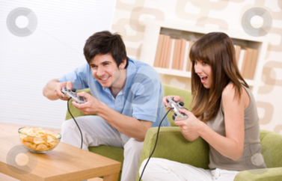
Speaking gadgets
Introduction Arguments Examples Opinion Conclusion | I’d like to give a talk about… I want to tell you about… First of all … Besides, …./In addition, …Moreover…./There are many reasons why … For example, for instance, such as…. In my opinion,…. From my point of view,…. To tell the truth,…. To be honest,… As for me,… Personally, I …. To sum up, I want to say that…. In conclusion, I’d like to point out that …

Slide 26
a letter
Ask 3 questions about his hobbies
St. Petersburg
Russia
04. 05. 2019
Dear Ben ,
Hi ! How are you? Hope you are OK. I’m fine . Thanks for your letter. I’m sorry I haven’t written for you so long, but I’ve been really busy with my exams.
In your last letter you asked me about ……\ I’d like to tell you about….\I’m writing to tell you about…..
What do you know about high tech gadgets?
What gadgets have you got? What do you use it for?
What kinds of high tech gadgets would you like to have? Why?
That’s all (my news) for now ! I have to go now… Give my regards to your family. I’m looking forward to seeing\meeting you soon . Write me back . (Wish you were here.)
Best wishes\Yours\Love\With love ,
Boris

Slide 27
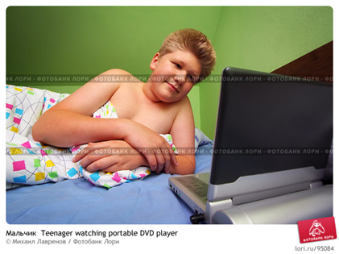
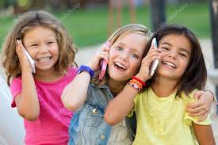
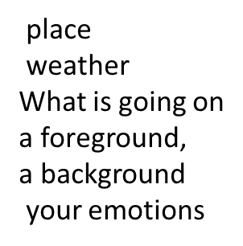
Imagine that these photos from your photo album. Choose one to present to your friend.

Slide 28
H\W:

