Slide 1
Prepare to describe a photo
Автор :Васильева Елена Васильевна,
учитель английского языка
ГБОУ СОШ № 180
Красногвардейского района Санкт Петербурга
2016

Slide 2
Do:
Look at your picture carefully and take a few moments to think before you start talking.
Talk for all the time you are given. If you have one minute to do the task, use every second.
Practise the useful language below so you can explain which part of the picture you are talking about.
Don’t:
Panic if you don’t know the words for all the things in the picture. You don’t need to know all the words for everything in the picture if you know what to say when you don't know an exact word.
Get distracted and start talking about something else. Focus on the photo or picture.
Panic if your mind goes blank. Take a deep breath, look at the picture and start again.

Slide 3
If you are asked to describe a photo or a picture in the exam, here is some language you can use:
Introduction
The photo/picture shows ...
It was taken by/in ...
It's a black-and-white/coloured photo.

Slide 4
What is in the picture?
In the picture I can see ... There’s / There are ... There isn’t a ... / There aren’t any ...
Say what is happening with the present continuous
The man is ...ing The people are ...ing It’s raining.
Where in the picture?
At the top/bottom of the picture ... In the middle of the picture ... On the left/right of the picture ... next to in front of behind near on top of under

Slide 5
Speculating - If something isn’t clear
It looks like a ... I think it’s … It could /might/must be a ... It seems to be … He could be ...ing Probably … Maybe it’s a ... I suppose …
Perhaps …
Opinion
I’d love/I’d like/ I wouldn’t want to be there.
It (really) appeals / doesn’t appeal to me.
This is a lovely/ horrible photo / image.
The thing that strikes me is …

Slide 6
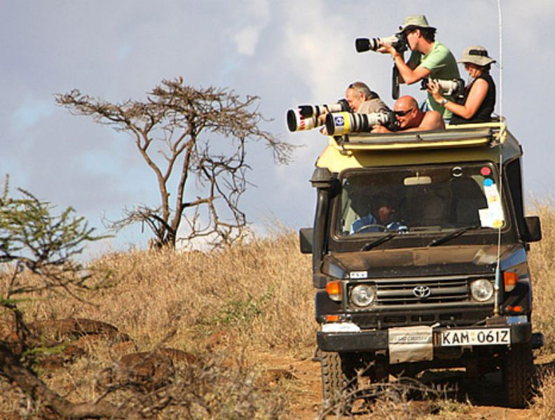
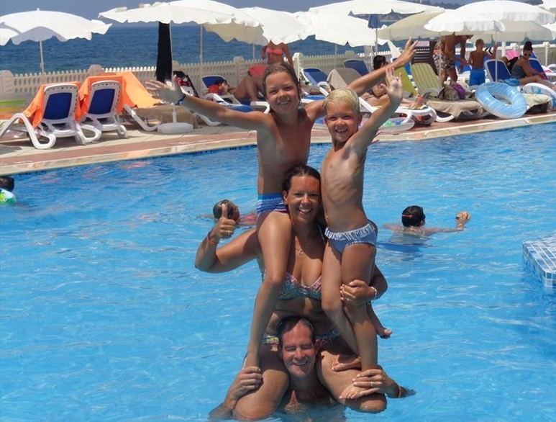
Travelling
Here are two photos showing different kinds of holiday. You should compare and contrast them. You have about 1,5 minute to do this.

Slide 7
OK. These are photos. Both photos show me a kind of a family holiday
Well, The first one is a photo of a family on safari, probably in Africa. They’re driving through the countryside in a jeep and they’re taking photos of all the animals they see. The other photo shows a family who are enjoying a beach holiday.
To my mind a safari’s more exciting than a beach holiday because it can be a little dangerous in the wilderness with all the wild animals. And I think it’s also usually quite expensive, whereas a beach holiday doesn’t have to be. Spending time at the seaside with your relatives can be a lot of fun, although you have to be careful you don’t get sunburnt. On this kind of beach holiday, you can relax and you probably stay a nice, comfortable hotel and don’t have to worry about anything. On safari, you might have to stay in a tent, which some people don’t like very much.
Personally, I think I would prefer to go on safari. I like to explore places and do exciting things. I like beach holidays, but that’s sort of thing I can do any time I like. A safari would be an unusual holiday that the family would probably remember for the rest of their life.

Slide 8
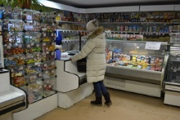
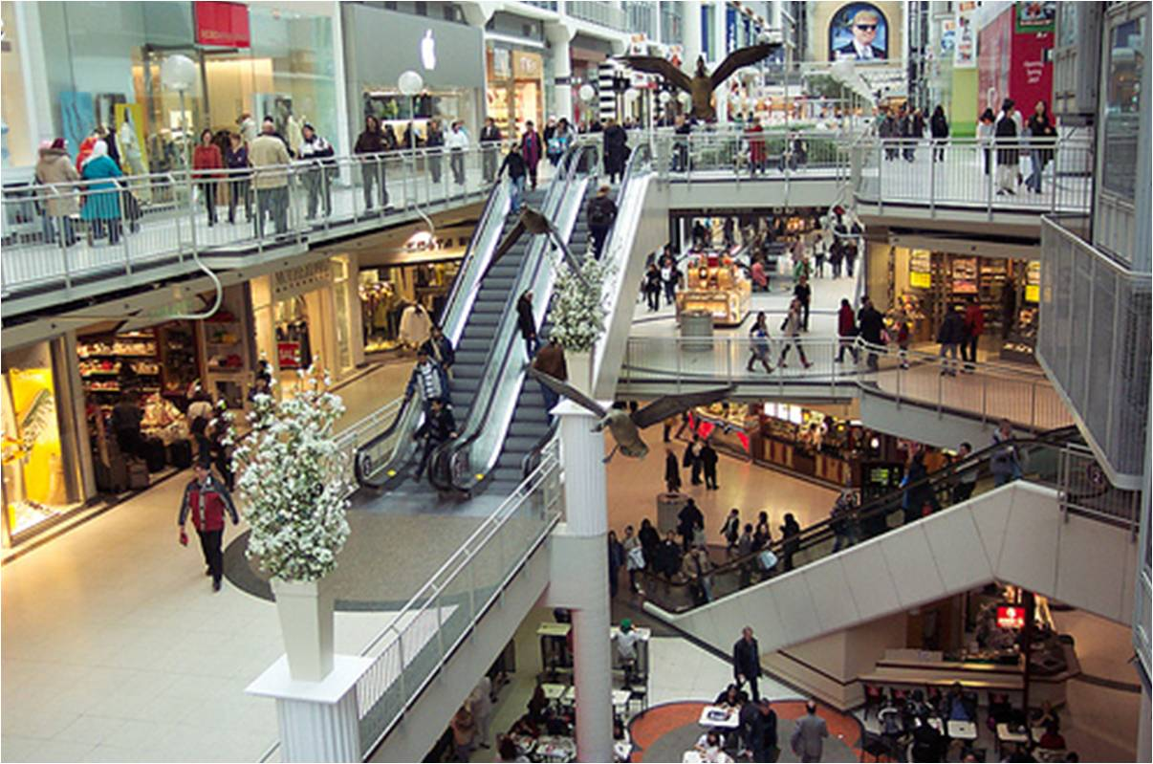
Shopping
Here are two photos showing different ways of shopping. You should compare and contrast them.
You have about 1,5 minute to do this.

Slide 9
Well, I can see two photos of different shops. Both of them are coloured. I want to compare and contrast them and say how I feel about shopping in these different places.
The first one is the kind of a local shop that you might find in your neighbourhood, while the second is usually found in the centre of the town. Well, in the middle of the first photo I can see a woman doing some shopping for her every day needs, such as bread, milk and maybe newspapers or magazines. For instance, people don’t have a lot of choice and the price can be quite high compared to, say a supermarket.
Er … . On the second photo, on the other hand, I can see a lot of people, visiting a large supermarket, maybe for things for the house, like plates or curtains and maybe clothes or shoes. With the second shop, there’s a lot of choice but also some disadvantages. The service might not be as friendly as in the first shop, for example.
I feel much happier about shopping in a large shop like the one in the second picture, rather than in the first picture. I think it can be very boring to buy the same things every day from a local shop and it’s much more exciting to go into town and get something you really want, like a new CD or some new trainers.

Slide 10
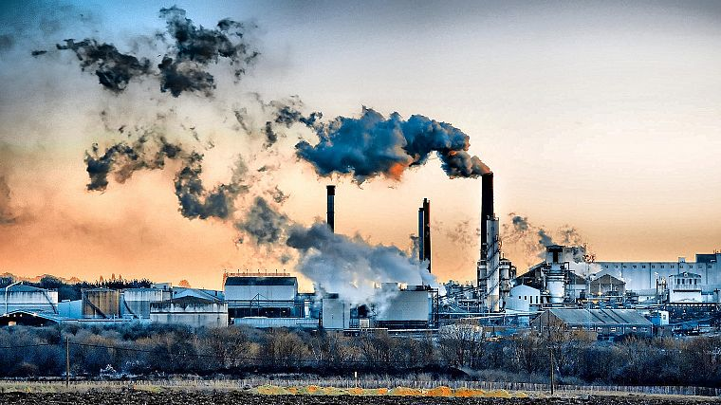
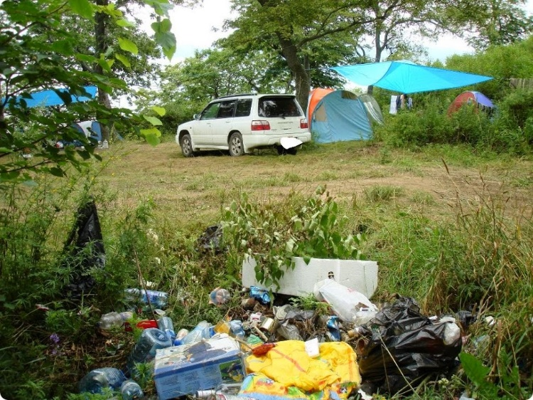
Environment
Here are two photos showing different things that threaten our natural environment.
You should compare and contrast them.
You have about 1,5 minute to do this.

Slide 11
OK, well there are two photos showing pollution of our environment. They’re coloured. On the first photo I can see a factory which is producing a lot of smoke and the second shows me a campsite of some tourists in the countryside. The thing that strikes me is a lot of rubbish in the foreground of the photo. I would say that pollution caused by factories is a major problem and it adds to the greenhouse effect, which causes global warming. On the other hand, tourism creates problems locally because large numbers of people mean large amounts of rubbish. People drop litter and, perhaps because they’re on holiday, they often don’t care about the problems they’re causing.
My personal opinion is that pollution caused by large business is far worse than damage to the environment caused by individuals. Factories often use chemicals which are poisonous and when those chemicals get into the environment, they can be harmful to plants and animals. I tend to think that rubbish in tourists sites is ugly, but it doesn’t usually create a serious threat. To my mind, industrial pollution is probably the bigger threat of the two.

Slide 12
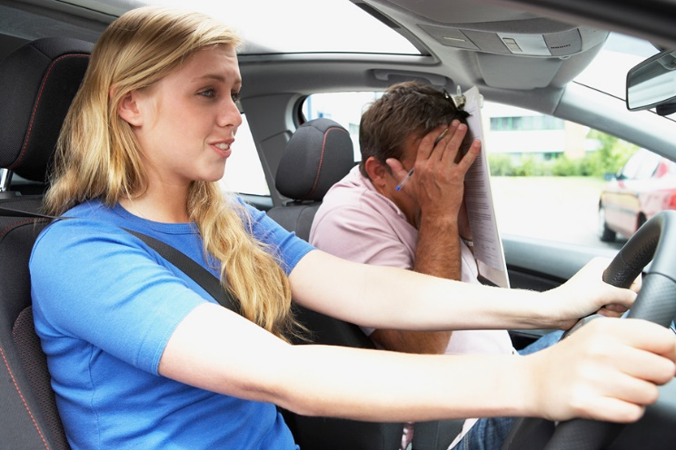
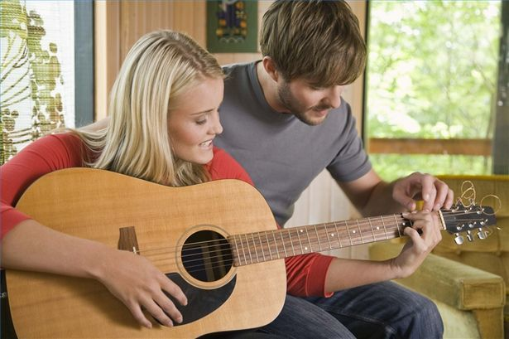
Here are two photos showing different kinds of learning new things.
You should compare and contrast them.
You have about 1,5 minute to do this.

Slide 13
OK, well there are two photos showing different lessons. These are both photos of people learning new things. A girl is in the foreground in the first photo. It’s hard to tell whether she’s having a driving lesson or taking her driving test. There is a man in the passenger seat in the background of the photo. He has got a pen and some papers in his hand, so the chances are he’s an examiner. Based on his body language, I’d say they might be about to crash! It’s clear from the expression on her face that something is wrong.
In the second photo a girl is learning to play the guitar. She could be learning from a teacher or a friend. It’s not easy to say whether she’s beginner or not, but she appears to be enjoying herself. The girl in the car, however, judging by the expression on her face, isn’t enjoying the situation much at all!

Slide 14
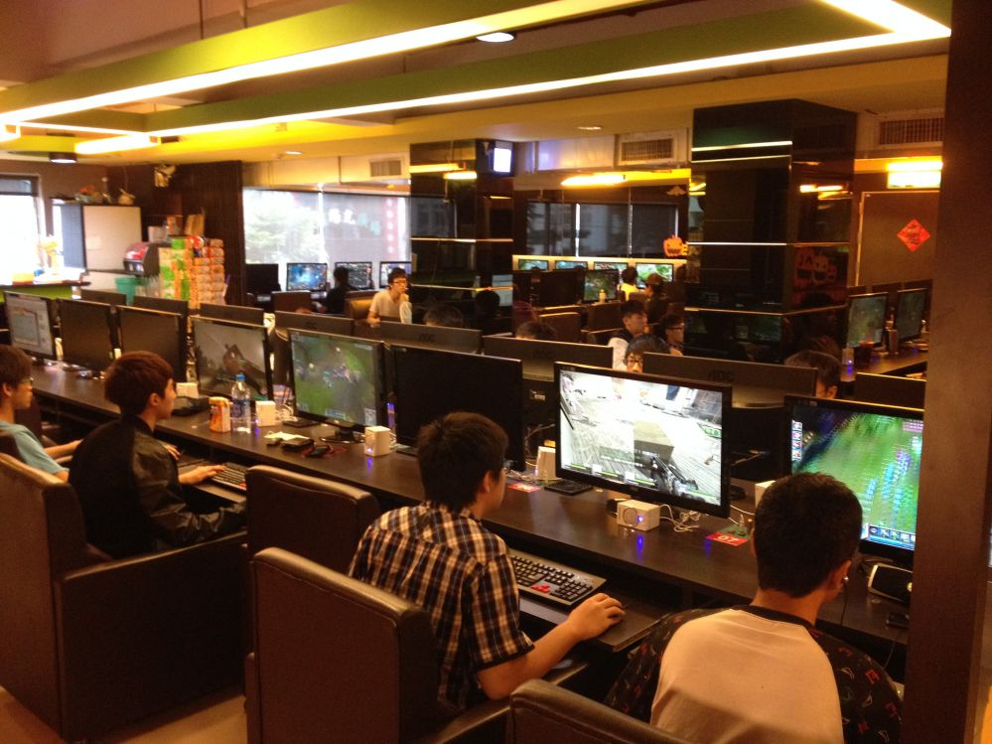
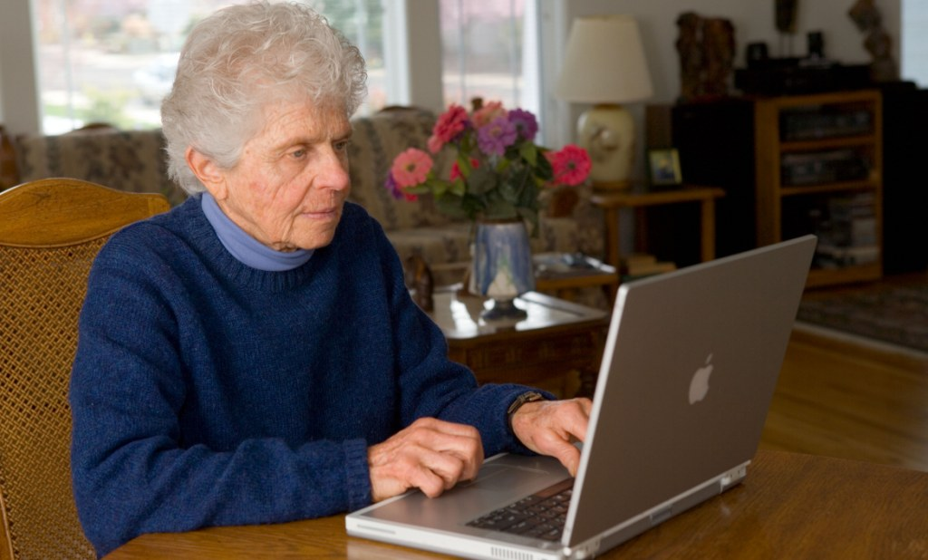
Here are two photos showing different people using computers.
You should compare and contrast them.
You have about 1,5 minute to do this.

Slide 15
OK, well both pictures are photos of people, and in both cases they seem to be having a good time; however, there is an important difference between them and that’s the age of the people in the pictures. The main subject of the photo “c” is the Internet café’ or a place like that and some people there sitting in front of computers. They have got drinks on the tables. It looks like it’s quite a modern place. I think it’s evening because the lights are on. But actually I can’t see any windows. I can’t really see people’s faces, but I imagine they’re interested in what they are doing. Nobody is talking. I can’t see what’s on the screens so I don’t know if they’re looking at interesting websites or not. I think people came to this place because they might not have computers at home, or access to the Internet. All people look like they’re quite young. I don’t think older people would be interested in going to a place like this because they’re probably not as interested in computers or the Internet.
The main thing I can see in the picture “d” is a woman, well a lady – she looks quite old. The lady must be in her 60s, I guess. I can tell she’s old because she’s got lots of wrinkles She’s got wavy grey hair.
I’m not sure but I think she’s in the living room in her house. I can see some flowers in the background of the photo. I think she’s buying something online with a credit card.
The important difference between the two photos is that the woman is on her own on the photo “d”, and the photo “c” shows me some people.

Slide 17
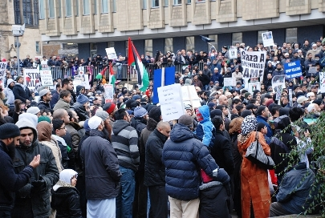
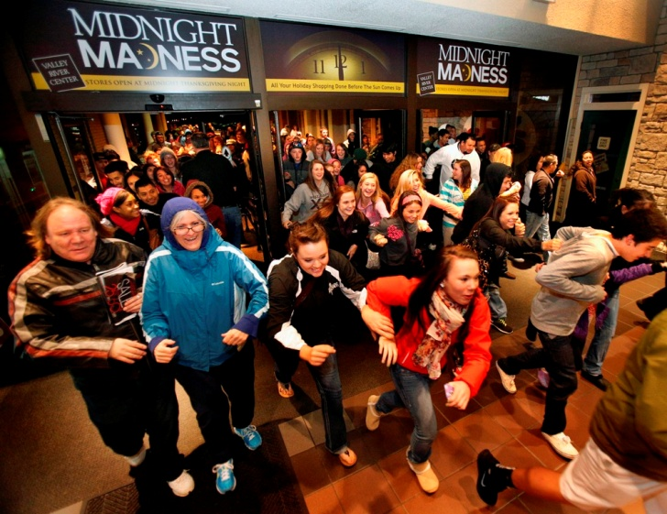
Here are two photos showing crowds of people who are in different situations .
You should compare and contrast them.
You have about 1,5 minute to do this.

Slide 18
Well, in the both pictures there are people on the street. I think it’s a sporting event.
In photo “A” I can see a lot of people of different ages.. To my mind they’re taking part in sport competition, I’m not sure what exactly the competition is, but it seems to be a marathon. Most of the picture is taken up with this huge mass of sportsmen. All participants feel happy They demonstrate the healthy style of life.
Another picture also shows me a lot of people. They are sport lovers too, but aren’t taking part in sport competition themselves, they’re fans. And this is the main difference between these two photos, because watching sports events and going in for sports are two different things.
So the first photo shows that sports maybe totally amateur, but it helps to stay in good shape, to keep fit and to be healthy.
And the second photo shows that large crowds of people support their favourite sportsmen. I can see true fans supporting their sport idols in the second photo.

Slide 19
Let me see, well, both pictures show me big groups of people and signs that show what they’re doing. In the first picture, the people are doing something together as a group. In the second one they’re all individuals out shopping. I think the first picture is of some kind of demonstration. The people are carrying those things – I’m not sure what they’re called, but they’re like big signs and when people are on strike or holding some kind of demonstration, they write slogans on them. I don’t really know what it’s about, but I imagine it’s some kind of protest – it could be against pay cuts or to do with jobs, or maybe the environment or something. I imagine they feel quite strongly about it. I’ve never been on a demonstration like this – I guess it’s a good way to show how you feel, but I’m not sure if they achieve anything.The second picture also shows a crowd, but it’s quite a different situation. I’m not too sure, but I think it’s when they reduce the prices, so you can buy something half price or with a big discount. It all looks a bit boring to me, and I don’t think I’d like to be there, but maybe the people are happy if they’ve been able to buy something they really want a lot cheaper than normal.I think both pictures show me people trying to get something – in the first case they could be trying to improve their working conditions or something, but in the second one their goal is to buy something. I wouldn’t especially like to be in either situation, but if I had to choose then maybe I’d say the first one, because it would be an opportunity to show how you feel and to be with other people who feel the same. I really hate shopping, so I don’t think I’d ever be in the second situation.

Slide 21
OK, well both pictures are photos of places where people go on holiday, and in both pictures people seem to be having a good time; however, there is an important difference between these pictures.
So the first picture is a beach scene, but the first thing that strikes me strait away is how horrible it looks. It’s really really overcrowded - there are loads of people. Most of the picture is taken up with this huge mass of holidaymakers – you can’t really distinguish individuals, just bodies and sunshades. There are people on the beach and people padding in the sea, but it doesn’t look like many of them are actually swimming because there isn’t room. It looks like a hot country, it could be somewhere on the Mediterranean or maybe somewhere like Brazil. In the background there are some sort of buildings – hotels or something, I’m not sure what they are. I really wouldn’t want to be there - it doesn’t appeal to me at all. I like going to the beach but there are far too many people here – that’s not holiday for me.
Another photo is lovely. In the foreground there are two people up a mountain or on a hillside with a river or a lake below. It looks sunny and they seem to be enjoying a perfect day out. Bellow them there are lots of pine trees and in the background there could be an island … or perhaps it’s the other side of the river. Anyway, it looks like they’re in Scandinavia or possibly Canada or the USA. I think the people are walkers or travelers. It’s very pretty – it looks like a really peaceful, unspoilt place – I’d love to be there.

