Slide 1
Present continuous tense

Slide 2
«Present Continuous» «Настоящее длительное время»)

Slide 3
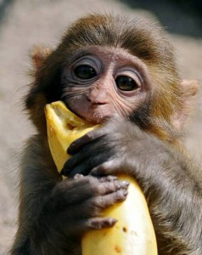
2
Look at the blackboard, please!
– Tell me please the difference between these sentences
Monkey eats bananas every day.
Monkey is eating banana now.

Slide 4
Time Expressions used with the Present Continuous
We use the Present Continuous:
to talk about actions and situations in progress now;
to talk about actions and situations in progress around now
now
at the moment
at present

Slide 5
Spelling
Swim-swimming
Sit-sitting
Run-running
Lie-lying
Die-dying
Write-writing
Drive-driving
Walk-walking
Wait-waiting
Open-opening

Slide 6
One of you will translate the sentence, the other will fill in the verb, then you will change.
1) Jane …a mystery story.
2) Bill and his granddad … in the lake.
3) Sue … the violin at the concert.
4) Mike …a bike in the park.
5) I … my pet dog.
6) Kathy … a new computer game.
7) Our classmates … on the farm.
is playing are fishing is riding
am walking are helping is reading.

Slide 7
Let’s check your variants. Right you are. Answers:
1) Jane is reading a mystery story.
2) Bill and his granddad are fishing in the lake.
3) Sue is playing the violin at the concert.
4) Mike is riding a bike in the park.
5) I am walking my pet dog.
6) Kathy is playing a new computer game.
7) Our classmates are helping on the farm.

Slide 8
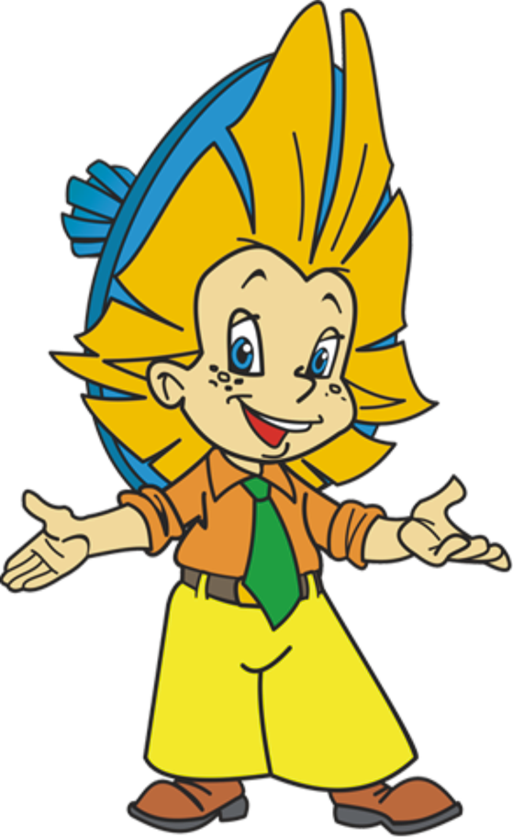
3. Физминутка.
1,1,1 - little dog run.
2,2,2 - cats see you.
3,3,3 - birds on a tree.
4,4,4 - rats on the floor.

Slide 9
4.Выполнение грамматических упражнений на Present Continuous. Работа с учебником.
Ex. 1, p. 60 student’s book -Look at the pictures and say, what they are doing.
Ex. 2, p. 60 student’s book - Read and put the sentences in the right order.

Slide 10
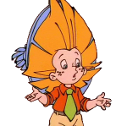
Keys:
1. I am swimming.
2. Mr. and Mrs. Green are watching TV.
3. They are making a cake.
4. My friend is running to school.
5. We are going to the cinema.
6. My brother is listening to the radio.
Find out mistakes:
(Найдите ошибки)
1. I am swiming.
2. Mr. and Mrs. Green is watching TV.
3. They are makeing a cake.
4. My friend is runing to school.
5. We are go to the cinema.
6. My brother is listenning to the radio.

Slide 11
Keys:
1. Mike is cleaning the windows,.
2. He is reading a book.
3. They are playing with their dolls .
4. They are having breakfast .
5. My little brother is riding a bicycle .
6. My mother is making a cake .
Make up sentences:
(Составьте предложения)
1.cleaning,is,Mike,windows,the.
2. is,a,reading,he,book.
3. with, they, their,are,dolls,playing.
4. breakfast, they, having, are.
5. little, my, riding, brother, bicycle, is, a.
6. cake, a, mother, my, making, is.

Slide 12
5.Подведение итогов. Рефлексия.
Что вы сегодня изучали?
Что изучили?
Что было самым трудным?

Slide 13
6. Выставление оценок
Today we have done many tasks and I put good and excellent marks to all of you.

Slide 14
Домашнее задание
Workbook - ex.1, 2,3 p.30-31
Our lesson is over. Goodbye!

Slide 15
Интернет ресурсы
шаблон презентации: автор Е.Н.Шалимова, учитель английского языка, МБОУ СОШ № 8, п. Бейсуг, Краснодарского края, Выселковского района
картинка для фона: fon-priroda29
рисунки:
Знайка: joyreactor.cc Загадки-от-Achi-2061181
знайка :www.uskazok.ru
Незнайка: 0002-001-Uproschenie-vyrazhenijdocuments.tips
Незнайка: www.linux.org.ru
сова-forums.moneysavingexpert.com
картинки:
обезьянка ест бананы : litsait.ru
обезьянка и банан : www.b17.ru
смайлики:1. fotki.yandex.ru0_2066e_e8a06b7c_S
смайлики:2. www.i2clipart.com
смайлики:3. animaciatop.ru
смайлики:4. smayls.rusmayliki-emocii-2181
грамматика:
http://festival.1september.ru/articles/634306/
http://www.openclass.ru/node/96662
http://rastivmeste.ru/foneticheskaja-zariadka-po-anglijskomu-jazyku/
http://festival.1september.ru/articles/588985/
Phonetic Start упражнения для фонетической зарядки автор-составитель С.Ю. Салаева.
http://festival.1september.ru/articles/606498/
http://www.pomochnik-vsem.ru/blog/urok_anglijskogo_jazyka_po_teme_the_present_continuous_tense/2013-07-12-383

