Slide 1
Computers in our life
Учитель английского языка
Сватиньш Ольга Имантовна

Slide 2
50 years ago people didn’t hear of computers.

Slide 3
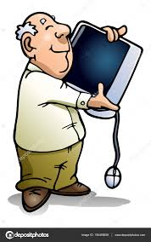
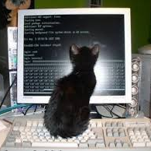
And today we cannot imagine our life without them.

Slide 4
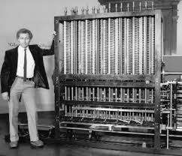
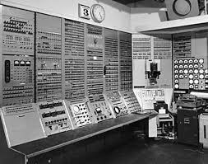
The first computer was the size of a minibus and weighed a ton.

Slide 5
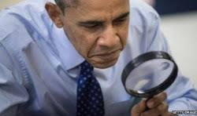
Computer technology is the fastest-growing industry in the world. Today, its job can de done by a chip the size of a pinhead. And the revolution is still going on.

Slide 6
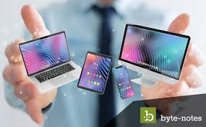
There are various types of computers.
A desktop
A monoblock
A laptop
A netbook
A nettop
A palmtop
A tablet PC

Slide 7
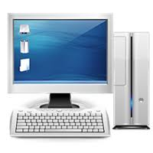
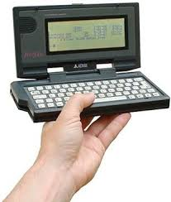
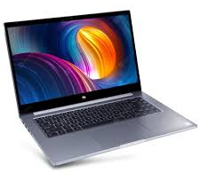
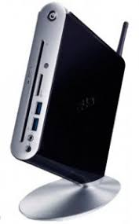
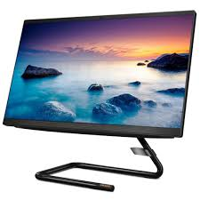
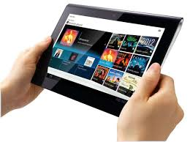
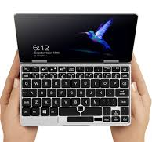
Can you name them?
1
3
2
7
4
5
6

Slide 8
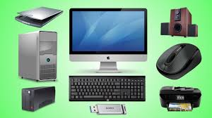
Do you know computer parts?
6
2
8
1
5
3
7
4
9
Scanner, monitor, printer, pendrive, mouse, base unit(CPU), UPS, speakers, keyboard

Slide 9
Software and Hardware
Software is a program that enables a computer to perform a specific task.
Hardware includes the physical components of the system.

Slide 10
Divide the words in two groups:
programmes, keyboard, disc drive, document, application, mouse, screen, file, monitor
Software
Hardware

Slide 11
Can you choose the correct word?
Can we delete or wipe a file by mistake?

Slide 12
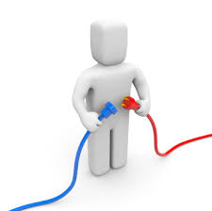
Do we join or connect the Internet?

Slide 13
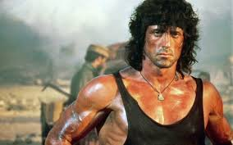
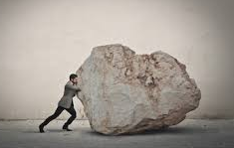
How is the disc that record and store information called?

Slide 14
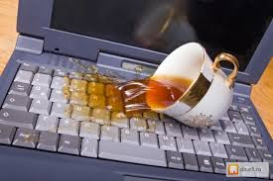
What do we say in this case? Have we spilled or poured something on the keyboard?

Slide 15
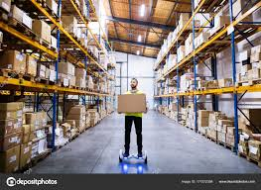
Do we save or store the documents?

Slide 16
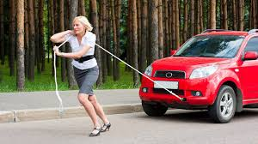
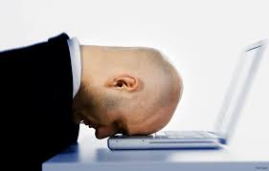
When we get a problem with a disc drive we say that DVD doesn’t …

Slide 17
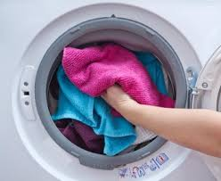
Do we transfer or download music on the computer?

Slide 18
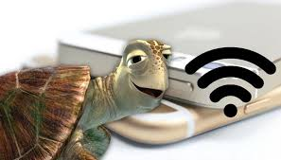
What can be slow link or connection?

Slide 19
What do we mean when we say that that the printer has run out of ink?
We have to run to buy ink
There is no ink in the printer

Slide 20
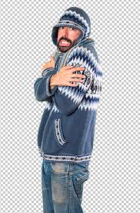
Computer problems
When the screen stays the same and does not change no matter what buttons you press we say that …..

Slide 21
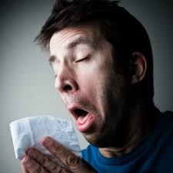
When our computer is very slow it can mean that it has a …

Slide 22
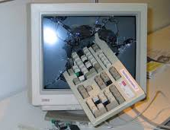
When a computer programme such as a software application or an operating system stops functioning properly and exits we say that computer….

Slide 23
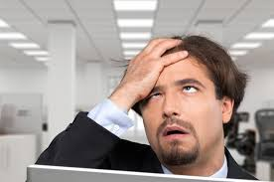
Why can’t they work?

Slide 24
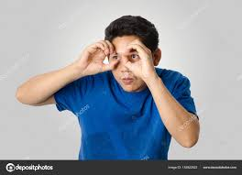
Can you guess this computer problem?

