Slide 1
Attractions of Khabarovsk
ПРЕЗЕНТАЦИЮ ВЫПОЛНИЛ ЛУЦЕНКО ДМИТРИЙ
(С) 2018

Slide 2
Khabarovsk city ponds
Ponds were opened in 1983 . Fountain equipment installed on the upper pond, every weekend there is a classical concert

Slide 3
Nikolai Muravyov-Amursky Monument
The monument to Nikolai Muravyov-Amursky by architect Opekushin was opened in 1891.
This monument is demonstrated on a bill of 5000 rubles

Slide 4
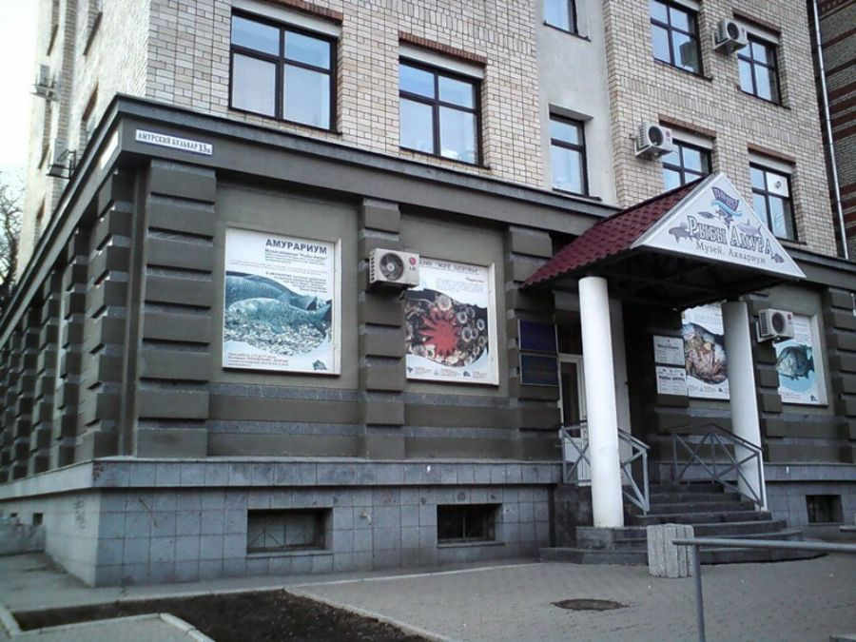
“Amurarium” Museum
One of the most original and unusual attractions of Khabarovsk is the Amur Fish aquarium Museum. A wonderful aquarium exposition presents a living collection consisting of more than ninety Amur fishes.

