Slide 1
Hello!!!

Slide 2
house

Slide 3
room

Slide 4
chair

Slide 5
TV

Slide 6
table

Slide 7
bed

Slide 8
lamp

Slide 9
under

Slide 10
What’s this? – It’s a red table.

Slide 11
What’s this? – It’s a green table.

Slide 12
What’s this? – It’s a pink table.

Slide 13
What’s this? – It’s a blue table.

Slide 14
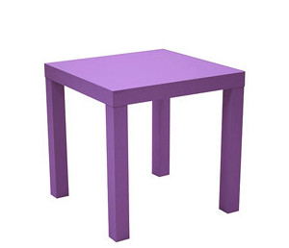
What’s this? – It’s a purple table.

Slide 15
What’s this? – It’s an orange table.

Slide 16
What’s this? – It’s a yellow table.

Slide 17
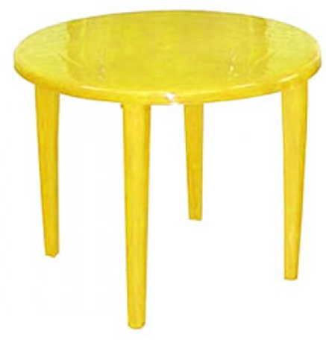
How many tables? – Six yellow tables.

Slide 18
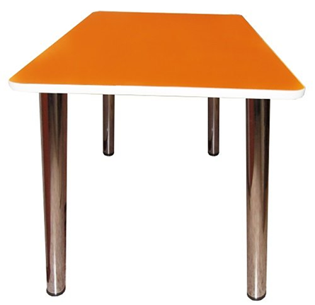
How many tables? – Five orange tables.

Slide 19
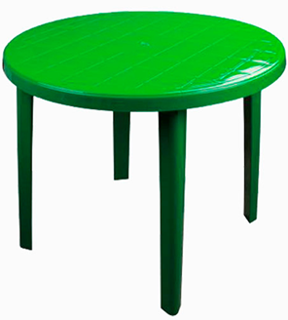
How many tables? – Ten green tables.

Slide 20
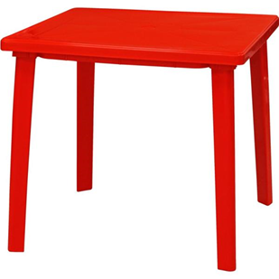
How many tables? – Eight red tables.

Slide 21
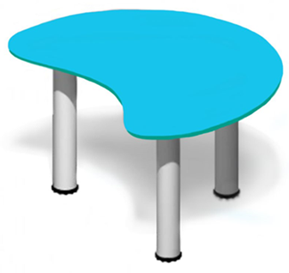
How many tables? – Seven blue tables.

Slide 22
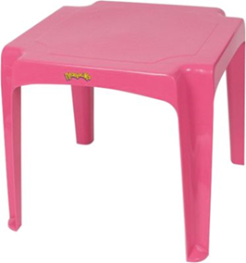
How many tables? – Nine pink tables.

Slide 23
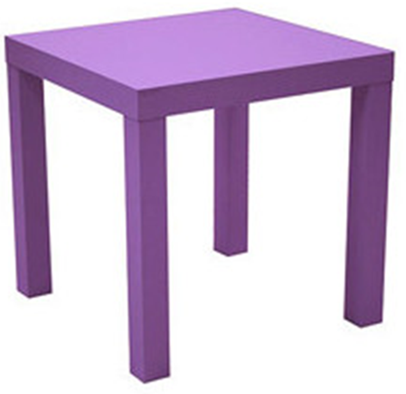
How many tables? – Four purple tables.

Slide 24
This is my room. I’ve got a red bed, a green lamp, a yellow chair, a blue table and a pink clock.

Slide 25
This is my room. I’ve got a purple bed, a pink lamp, a blue chair, a yellow table and a green clock.

Slide 26
This is my room. I’ve got a blue bed, a yellow lamp, a purple chair, a yellow table and a red clock.

Slide 27
This is my room. I’ve got a yellow bed, a pink lamp, a red chair, a green table and an orange clock.

Slide 28
Good bye!

