Slide 1
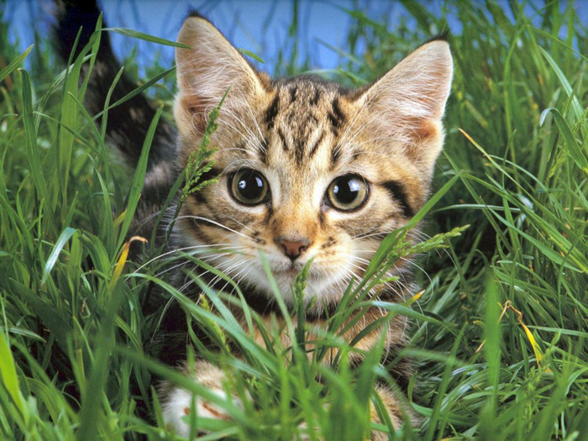
a cat

Slide 2
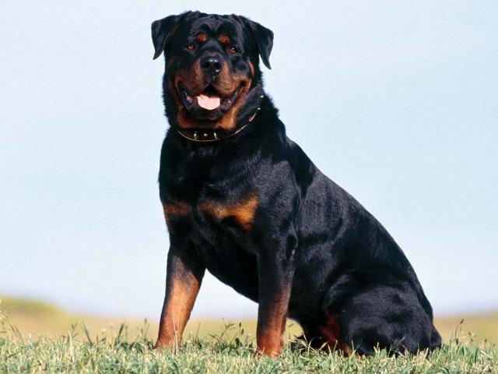
a dog

Slide 3
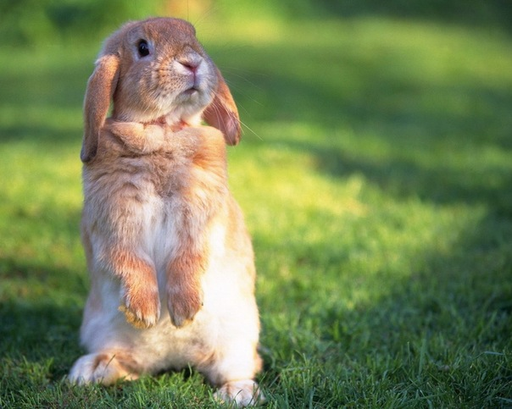
a rabbit

Slide 4
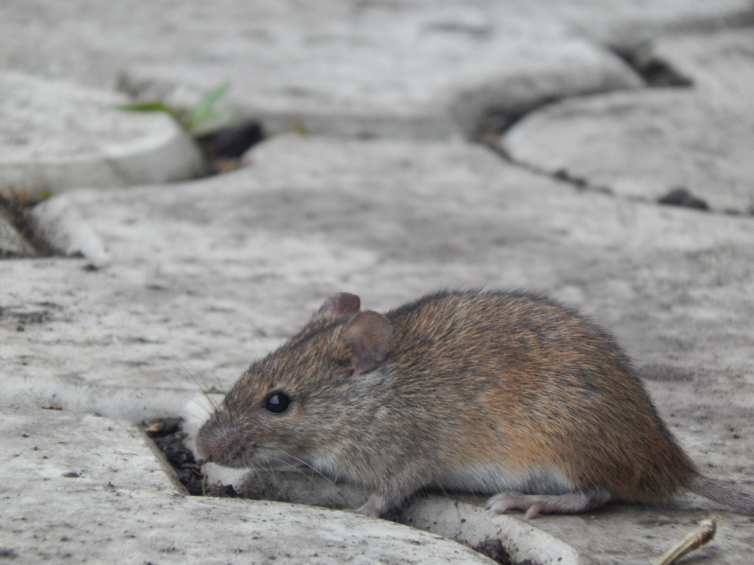
a mouse

Slide 5
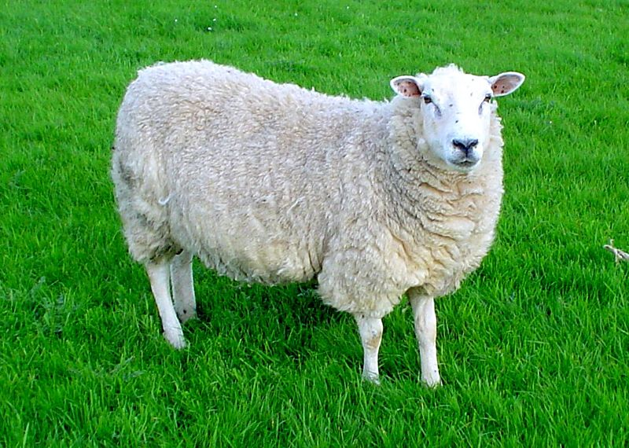
a sheep

Slide 6
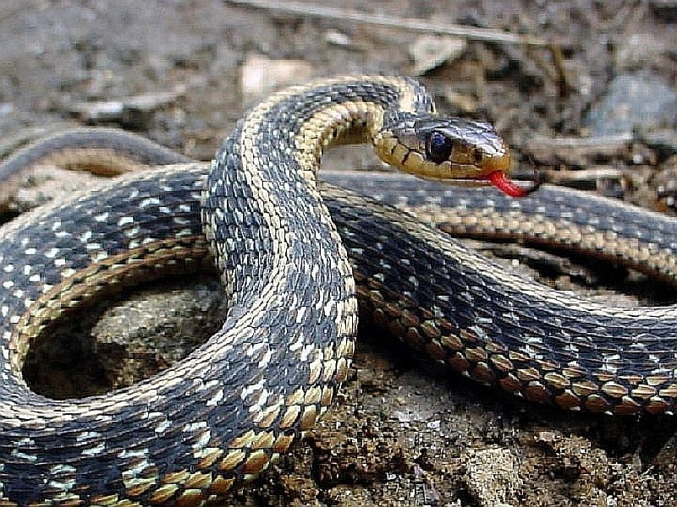
a snake

Slide 7
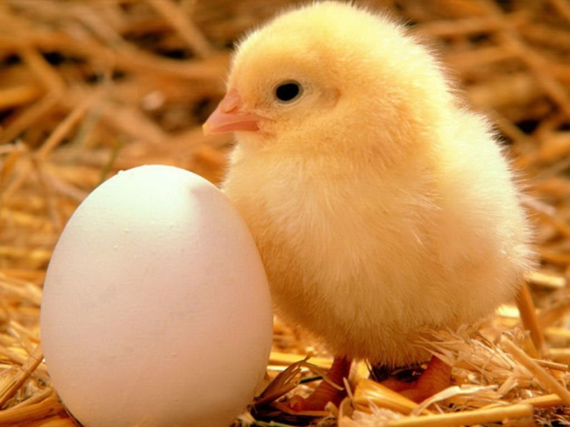
a chick

Slide 8
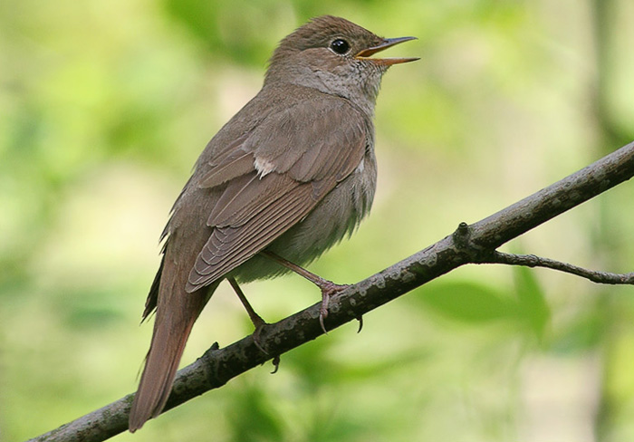
a bird

Slide 9
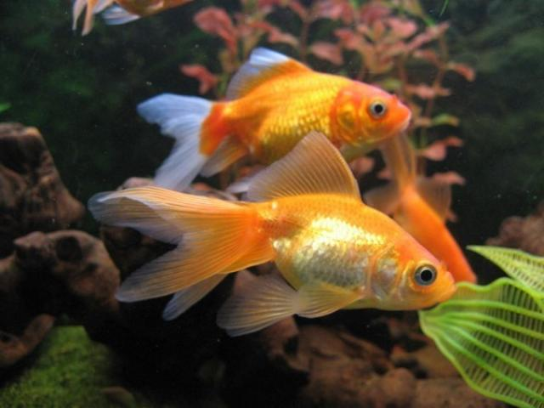
a fish

Slide 10
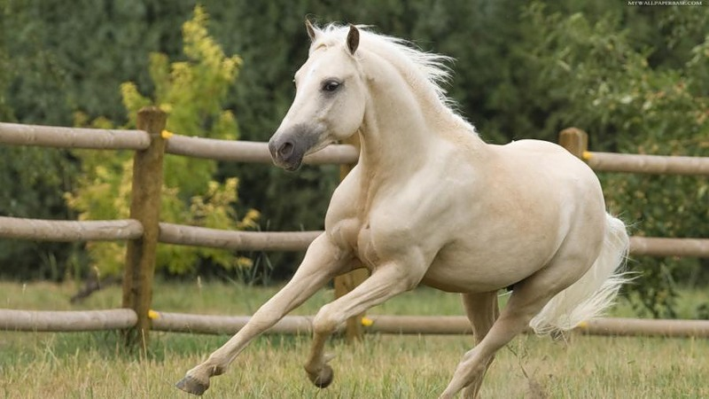
a horse

Slide 11
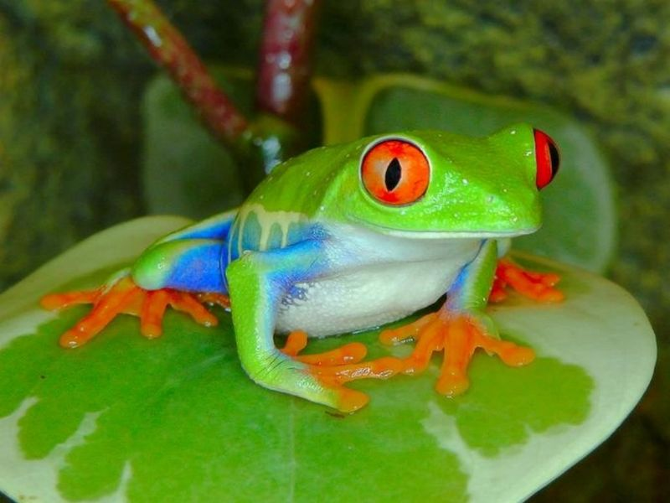
a frog

Slide 12
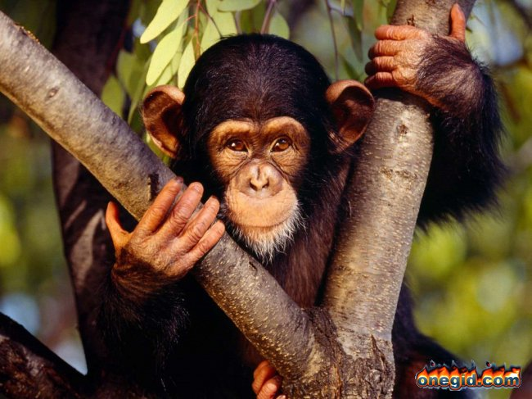
a chimp

Slide 13


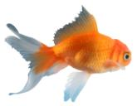
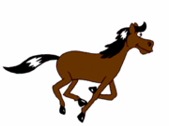

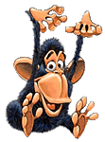
a bird
a fish
a horse
a frog
a chimp

Slide 14
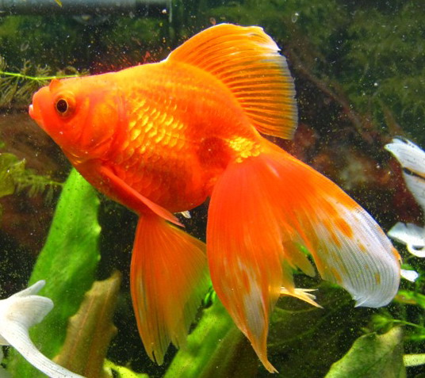
Назови животных:

Slide 15
swim - плавать
jump – прыгать
fly - летать
sing - петь
run- бегать
dance – танцевать

Slide 16
I can…. Я могу…
I can’t…. Я не могу…

Slide 17
A bird can fly and sing.
A fish can swim.
A horse can run.
A frog can jump.
A chimp can dance.

Slide 18
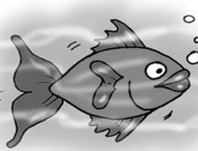
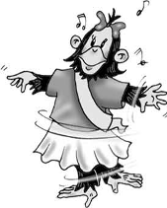
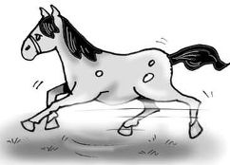
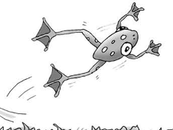
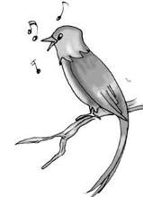
1
2
Кто что делает? Посмотри и скажи:
4
3
5

Slide 19
Вставь буквы в слова:
F i – h.
J – m p.
F r – g.
C – i m p.
H o r – e .
R – n.
S w – m.

Slide 20
Ответь на вопросы:
Who can fly?
Who can jump?
Who can swim?
Who can run?

Slide 21



I can swim like a fish,
I can run like a rabbit,
I can jump like a little kangaroo.
I can sing like a bird,
I can walk like a cat.
I can climb like a monkey in the zoo.
I can do it, he can do it,
She can do it, too, too, too.
We can do it, they can do it.
And what about you?

Slide 22

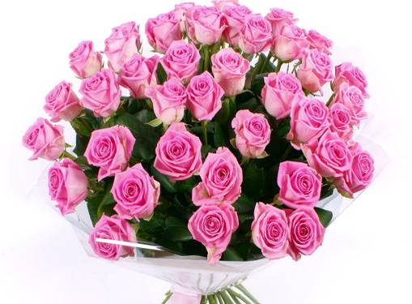
Thank you!

Slide 23
Good bye!

