Slide 1
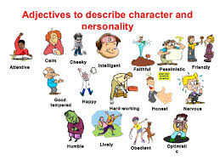
It Takes Many Kinds to Make the World.

Slide 2
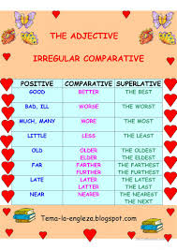
SB, p.118, ex. 29. LATE
Late – later- the latest
Late – latter – the last

Slide 3
I. Choose the word.
1. February is the latest/the last month of winter.
2. Megan always dresses in the latest/the last fashion.
3. What is the last/the latest news?
4. Tom bought the last/the latest edition of the encyclopedia.
5. We saw a comedy and a drama last week. The last/the latter was more exciting.
6. My parents travelled to Italy last/the last summer.
7. The last/the later train to Rome left at 5 pm.

Slide 4
SB, p.120, ex. 33. OLD
Old – older – the oldest
Old- elder – the eldest

Slide 5
II. Choose the word.
1. Jane is my (older, elder) sister.
2. Pam is 5 years (older/elder) than Steve.
3. Jill is (the oldest, the eldest) child in the family.
4. Nick is (the oldest, the eldest) son.
5. My grandpa is (the oldest, the eldest) member of our family.
6. Tom’s aunt is (older, elder) than mine.

Slide 6
III. Farther or further?
1. I am waiting for …. information.
2. Tim’s parents worried about his … education.
3. Omsk is … away from Moscow.
4. Do you have any … questions?
5. The cinema is …. from the bank than the library.
Farther - further

Slide 7
RUSH
to rush AT | наброситься, накинуться
to rush IN//INTO | торопливо войти, ворваться
to rush OUT//OFF | торопливо выйти, уйти
to rush TO | броситься, спешно отправиться
to rush TO conclusions | торопиться с выводами

Slide 8
IV. Write the preposition.
1. The children rushed … the door when mother came home.
2. The large dog rushed … the boy and frightened him.
3. Jack rushed … the room but it was empty.
4. Sue rushed … of the house without saying anything.
5. Don’t rush … conclusions, wait a little bit.
TO, AT, INTO, OUT.

Slide 9
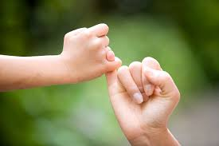
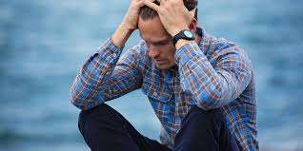
V. Match the word and its description.
1.gloomy | a) very powerful, excellent
2.solemn | b) to raise your hand and move from side to side
3. a promise | c) dark, depressed
4.tremendous | d) worried about something
5.to wave | e) a statement that you will do smth
6.anxious | f) very serious and happy

Slide 10
VI. Find the opposites and translate into English.
Веселый, с хорошим чувством юмора, заботливый, мрачный, хорошо воспитанный, с плохим настроением, злой, добрый, плохо воспитанный, отвратительный.
1 …. - …..
2
3
4
5

Slide 11
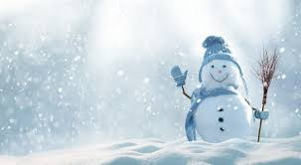
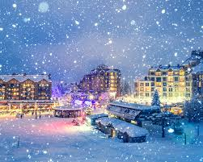
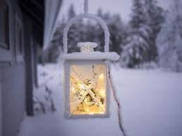
Thank you for attention.

