Slide 1
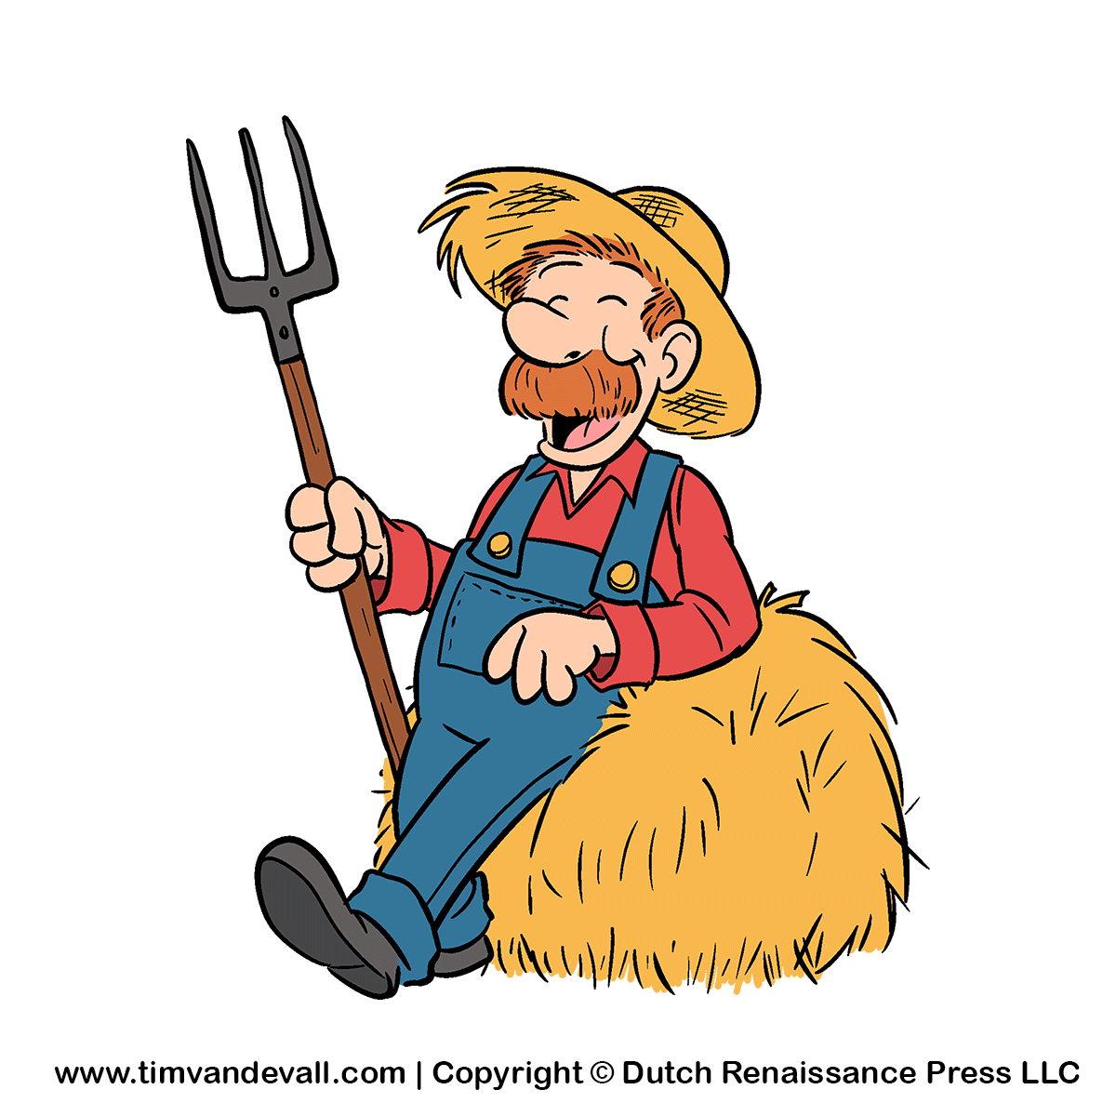
“Good morning, Farmer!”
Учитель английского языка
МБОУ «СОШ»
Села Ношуль
Республика Коми
Елдина Т.А.

Slide 2
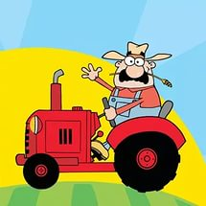
“Good morning, Farmer!” 1) Where did the farmer go one day? 2) What did he want to buy?

Slide 3
A farmer set out from the farmhouse on his red tractor.

Slide 4
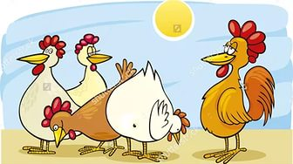
“Cluck, cluck!” Where are you going?

Slide 5
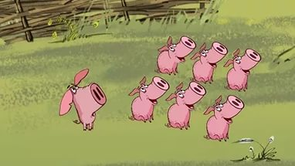
“Oink, oink!” snuffed the pigs. Are you going to the market?

Slide 6
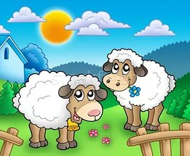
“Baa, baa!” bleated the sheep. Are you going to the field?

Slide 7
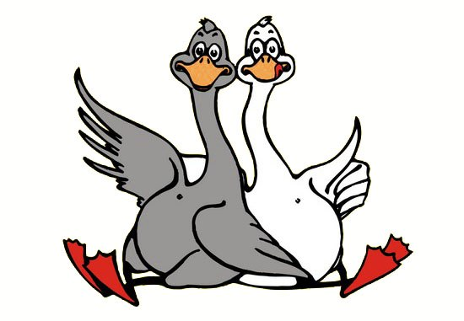
“Honk,honk!” honked the geese. Are you going far?

Slide 8
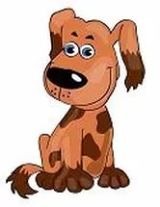
“Woof,woof!” barked the dog. Aren’t you taking me too?

Slide 9
“And where are you going?” they snuffed and honked and barked.

Slide 10
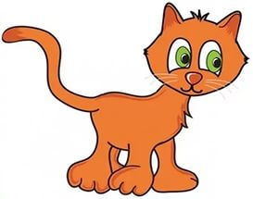
“Meow, meow!” meowed the cat. Are you going to the forest?

Slide 11
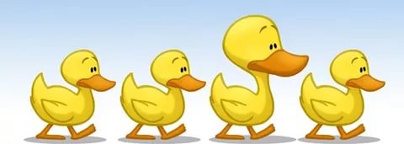
“Quack, quack!” quacked the ducks. Are you going to the river?

Slide 12
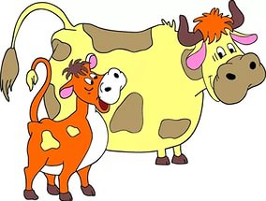
“Moo, moo!” mooed the cows. Are you going to the dairy?

Slide 13
And all together they meowed and quacked and mooed. “Where are you going?”

Slide 14
The farmer just smiled. “With all this noise, I think you can guess,” he said. “I’m going to town to buy some earplugs, of course!”

