Slide 1
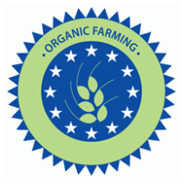
Organic farming

Slide 2
Organic farming [ɔːˈɡænɪk ˈfɑːmɪŋ] ( phr)
N-COUNT from of agriculture that uses only natural products to help the plants or animals grow
conventional - обычный, обыкновенный, традиционный; общепринятый; привычный
[kənˈvɛn(t)ʃ(ə)n(ə)l]

Slide 3
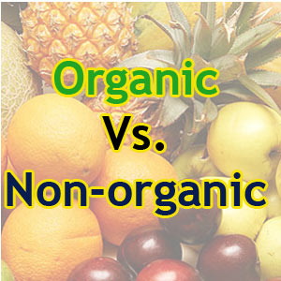
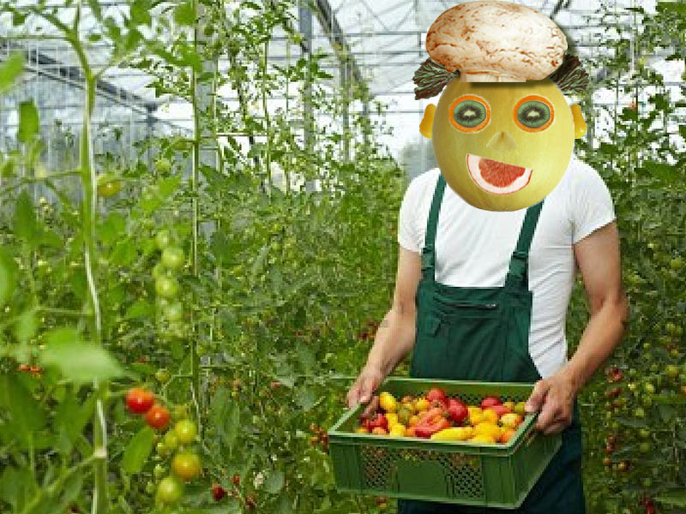
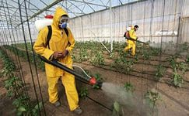
B
A

Slide 4
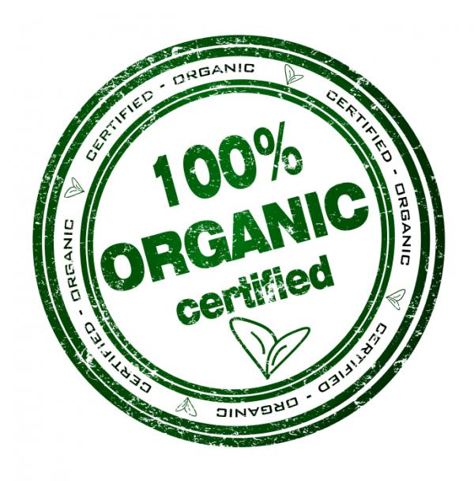
Read the text and complete the missing words
1. is
2. as
3. which
4. of
5. the
6. of
7. and
8. each / every

Slide 5
Answer the questions
1. How can conventional be harmful to the environment?
2. Why is organic farming better for the environment?
1.Conventional farming can be harmful to the environment because
2.Organic farming is better for the environment because
it uses a lot of energy through the amount of machinery used.
it uses less chemicals by using natural fertilisers and flame weeders.

Slide 6
Lexical work “Explain these words in English” ( SB “Spotlight” page117)
Intensive farming –the type of farming which uses a lot of chemicals (pesticides, fertilizers) and damages ecosystem
Ecosystem -…….
Machinery -……..
Beneficial insects -…..
Insecticides -……
Rotating crops -…..
Flame weeders -…..

Slide 7
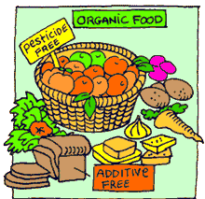
Organic farming is a form of agriculture that relies on techniques such as crop rotation, green manure, compost and biological pest control. Organic farming uses fertilizers and pesticides but excludes or strictly limits the use of manufactured (synthetic) fertilizers, pesticides (which include herbicides, insecticides and fungicides), plant growth regulators such as hormones, livestock antibiotics, food additives, genetically modified organisms, human sewage sludge, and nanomaterials.

Slide 8
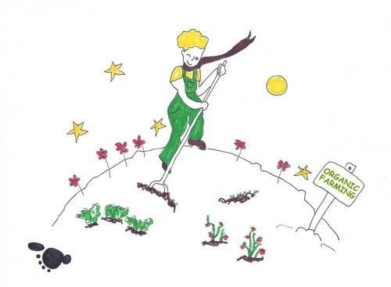
"Organic agriculture is a production system that sustains the health of soils, ecosystems and people. It relies on ecological processes, biodiversity and cycles adapted to local conditions, rather than the use of inputs with adverse effects. Organic agriculture combines tradition, innovation and science to benefit the shared environment and promote fair relationships and a good quality of life for all involved...«
—International Federation of Organic Agriculture Movements.

Slide 9
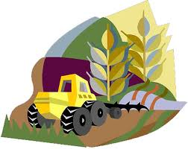
History
Organic farming (of many particular kinds) was the original type of agriculture, and has been practiced for thousands of years. Forest gardening, a fully organic food production system which dates from prehistoric times, is thought to be the world's oldest and most resilient agroecosystem. Artificial fertilizers had been created during the 18th century, initially with superphosphates and then ammonia-based fertilizers mass-produced using the Haber-Bosch process developed during World War I. These early fertilizers were cheap, powerful, and easy to transport in bulk. Similar advances occurred in chemical pesticides in the 1940s, leading to the decade being referred to as the 'pesticide era'.

Slide 10
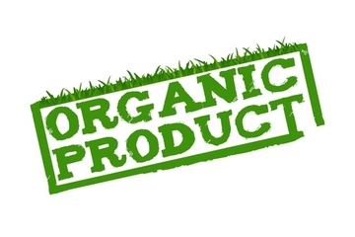
The modern organic movement is a revival movement in the sense that it seeks to restore balance that was lost when technology grew rapidly in the 19th and 20th centuries. The organic movement began in the mid-1920s in Central Europe through the work of Rudolf Steiner, whose Lectures on Agriculture were published in 1925. who created biodynamic agriculture, an early version of organic agriculture. The system was based on Steiner's philosophy of anthroposophy rather than on a solid grasp of science. Organic agriculture was independently developed in the 1940s England through the work of Albert Howard who was inspired by his experiences with traditional farming methods in India. Howard is widely considered in the English-speaking world to be the "father of organic farming". Further work was done by J.I. Rodale in the United States, Lady Eve Balfour in the United Kingdom, and many others across the world.

Slide 11
Complete the sentences using the information from the text “Organic and conventional farming”
1. If we use a lot of organic food………
2 .If we prefer to buy food of conventional farming…….
3. If all farmers used natural fertilizers such as manure……
4. If our agriculture had not used chemicals fertilizers ….
5. If farmers used ladybirds……
6. If all farmers all over the world thought not only about their benefit…
7. The planet would be the green garden if…….
8. People in different countries wouldn,t have problems with their health if…..

Slide 12
CROSSWORD “Organic and conventional types of farming”
Gor. 1.Form of agriculture that uses only natural products for growing crops
3. Form of agriculture that uses a lot of chemicals and harms the environment.
5. A natural fertilizer which is used by organic farmers
6.Insects which can destroy crops
Vert. 2. Beneficial insects which help to save crops
4. Type of machines which farmers use for weeding
 |  |  |  |  |  |  |  | 2.
 |  |  |  | 1.
 |  |  |  |  |  |  |  |  |  |  | 4.
 |  |  |  |  |  |  |  |  | 6.
3.
 |  |  |  |  |  | 5

Slide 13
Answers
 |  |  |  |  |  |  |  | 2.
 |  |  |  |  |  |  |  | L
 |  |  |  | 1. | O | R | G | A | N | I | C
 |  |  |  |  |  |  |  | D |  |  | 4.
 |  |  |  |  |  |  |  | Y |  |  | T
 |  |  |  |  |  |  |  | B | 6. | G | R | E | E | F | L | Y
3. | C | O | N | V | E | N | T | I | O | N | A | L
 |  |  |  |  |  |  |  | R |  |  | C
 |  |  |  |  |  |  |  | D |  |  | T
 |  |  |  |  |  |  |  | S |  |  | O
 |  |  |  |  |  | 5. | M | A | N | U | R | E
 |  |  |  |  |  |  |  |  |  |  | S

Slide 14
Quiz
1. Farmers use salt water instead of using pesticides.
True False
2. Farmers use ladybirds to combat greenflies.
True False
3. Organic farming aims to protect the environment by producing high quality food.
True False
4. Organic food is more expensive artificial.
True False
5. Artificial food more useful than natural
True False
6. Manure and compost are inorganic fertilizers.
True False
7. Conventional farming can be harmful to the environment because it uses a lot of energy through the amount of machinery used.
True False
8. Pesticides positively affect ecosystem.
True False
9. Organic farming is better for the environment because it doesn,t use chemicals.
True False

