Slide 1
Thirty-three people think
that their birthday is on Thursday.

Slide 2
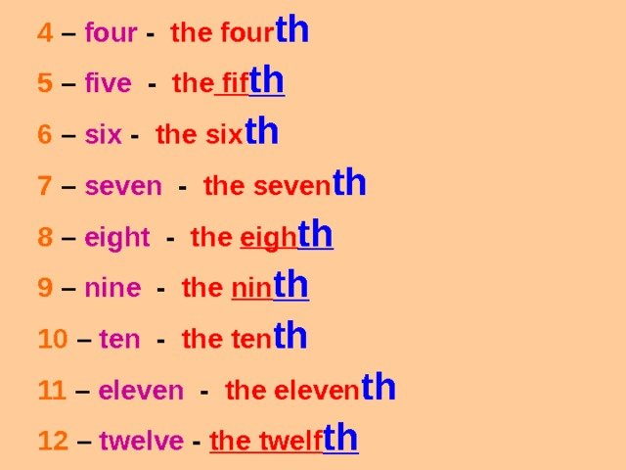

Slide 4
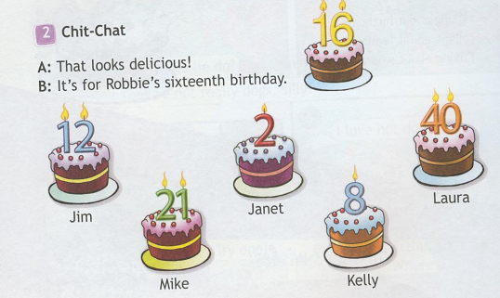

Slide 5
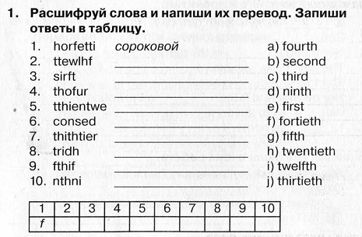

Slide 6
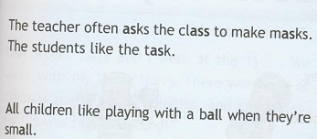

Slide 7
Let’s play
I am the…

Slide 8
Глагол to be в прошедшем времени

Slide 10
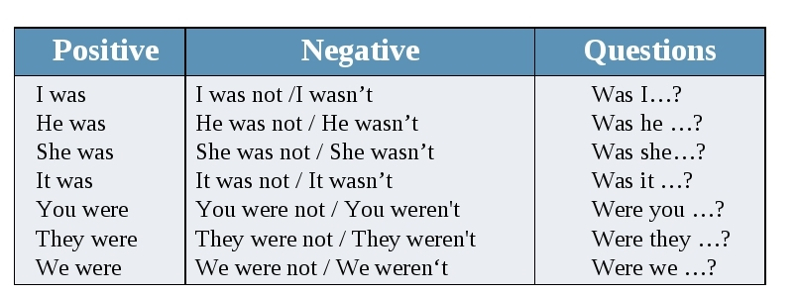

Slide 11
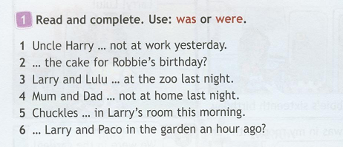
was
Was
were
were
was
Were

