Slide 1
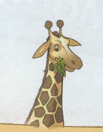
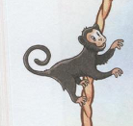
a dolphin
a monkey
a whale
a giraffe
a lizard
a crocodile
a seal
a hippo

Slide 3
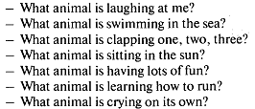
a tall giraffe
a silly monkey
a clever dolphin
a little seal
a lazy lizard
a big whale
a baby hippo
one crocodile

Slide 4
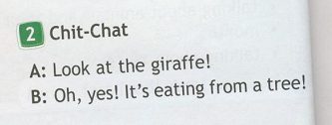

Slide 6
I usually play tennis. They often swim in the sea. You sometimes read a book. He plays football every day. She always sings songs.
Look! She is playing the piano now.
Listen! I am singing now.
They are swimming now.

Slide 7
2
3
4
5

