Slide 1
Тема урока: «Части тела» («Parts of the body»)
Учитель: Ибрагимова-Вагнер Марина Владимировна
Целевая аудитория: 2 класс

Slide 3
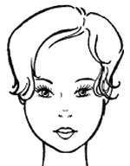
Hair
black hair
red hair
brown hair
grey hair
blonde hair
long hair
short hair
Notes:
Next we move to details such as hair and any other prominent features, like eyes, a nose, a mouth, a moustache, a beard and spectacles.
Hair
What colour is the hair?

Slide 4
Eyes
blue eyes
grey eyes
brown eyes
green eyes
Notes:
Eyes
What colour are the eyes?
Note! This is a black eye!

Slide 5
Theme: Parts of the body.
The aim:
Learn how to describe people

Slide 6
Two little hands go clap, clap, clap Two little feet go tap, tap, tap; Two little eyes are open wide, One little head goes side to side

Slide 9
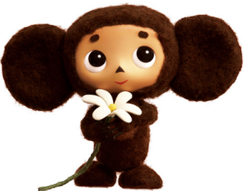
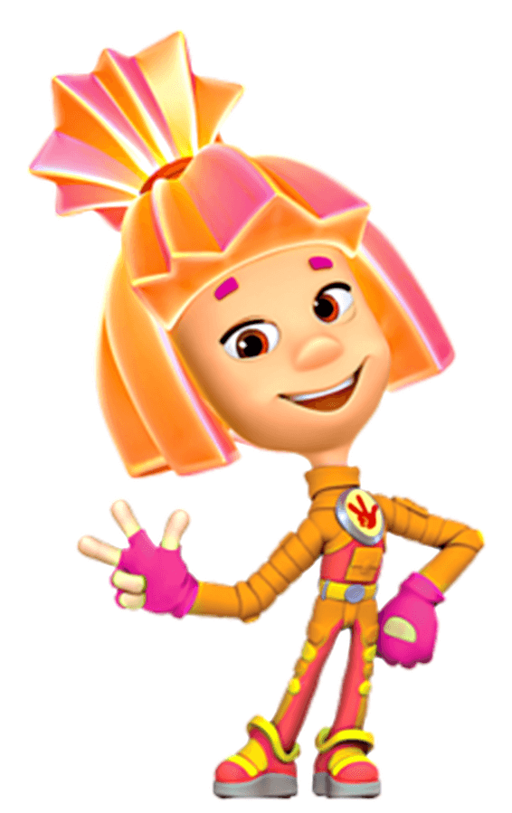
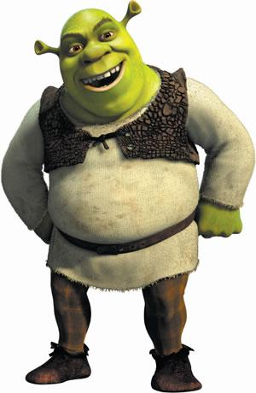
I have blonde hair, big green eyes, a little nose and a red mouth. I am funny.
He has big ears, brown eyes, a little nose and a little mouth. He is nice.
She has red hair, brown eyes, a big nose and a mouth. She is beautiful.
I have brown eyes, big ears, a nose and a mouth. I am green. I am kind.

Slide 10
Who has… ?

Slide 12
Head, shoulders, knees and toes…

Slide 13
Divide into groups

Slide 16
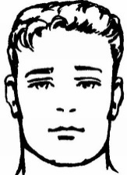
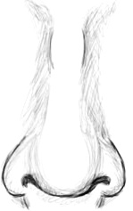
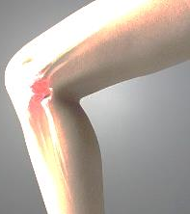
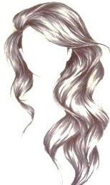
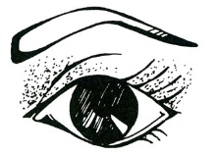
5
1
8
9
 |  |  | 1 |  |  |  | 2
3
 |  | 4
 | 5 |  |  |  |  | 6
 |  |  |  | 7
8
 |  |  | 9
6
3
2
4
7

Slide 17
Describe one of your family members.

