Slide 1
Festive time
6 класс

Slide 2
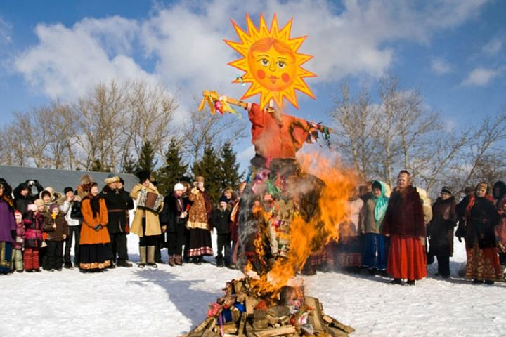
Look at the pictures. What holidays are people celebrating?
1
2
3

Slide 3
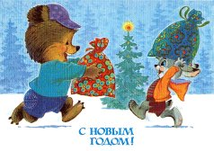
4
5
6

Slide 4
What do usually
people do
Before
celebrations?

Slide 5
Fill in make or do:
..…the decorations
………a phone call
………………tea
…………….a special dish
……………..a cake
………….the dusting
…………your homework
………….the gardening
………..the washing up
………..the shopping

Slide 6
Ex. 1 p.46 Check yourself:
make the decorations – украшать
do the dusting –протирать пыль
do your homework –делать домашнюю работу
make a phone call – звонить по телефону
do the gardening –заниматься садоводством
make tea – заваривать чай
make a special dish -готовить особенное блюдо
do the washing up – мыть посуду
do the shopping – делать покупки
make a cake – печь торт

Slide 7
Present Continuous Tense Affirmative – утвердительная форма
am
to be is
are
I am reading a book
now.
He/she/it is reading a
book now.
V ing
We/you/they are
reading a book now.
now – сейчас
at the moment – в данный момент

Slide 8
Глагол TO BE –AM, IS, ARE
I am
You are
He is
She is
It is
We are
You are
They are

Slide 9
Look at the pictures
in your books.
What are the people
in the picture doing?
Ex.1 b) p.46

Slide 10
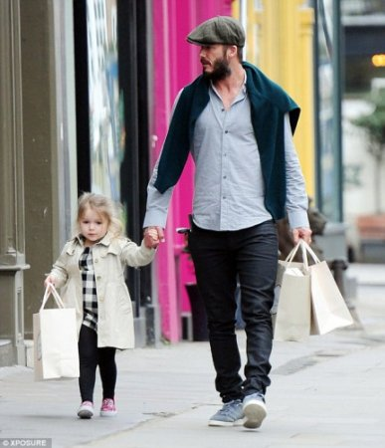
What are they doing?
1
2

Slide 11
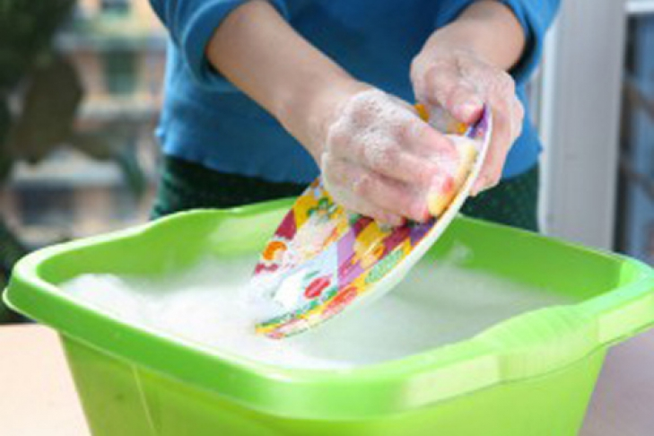
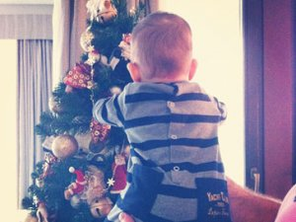
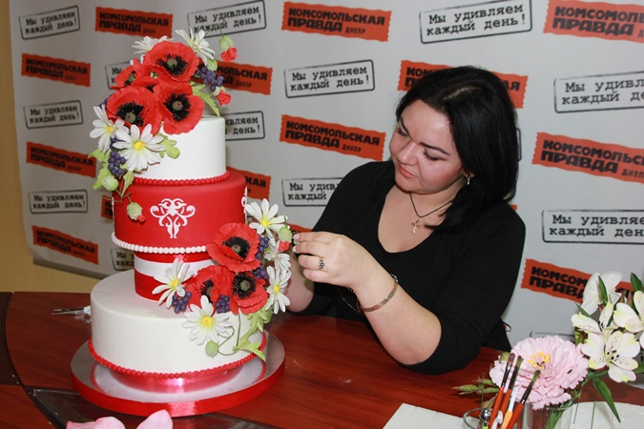
3
4
5
6

Slide 12
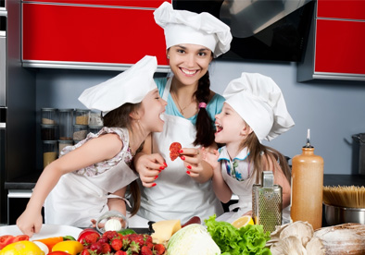
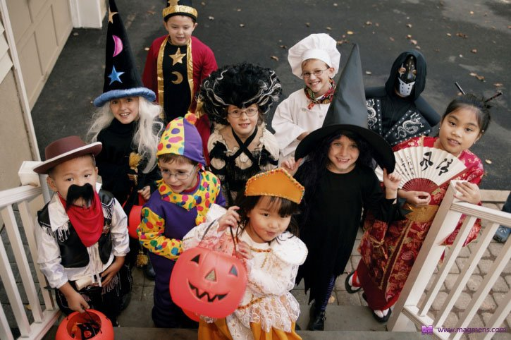
7
8
9

Slide 13
New words:
spend – проводить (время)
fried baby eels – жаренные молодые угри
delicious [diliЅəs] – вкусный
grapes [greips] – виноград
excited [iksaitid] – взволнованный
means – означает
celebrate – праздновать
council workers [kansl wɜ:kəz] – работники городских служб
make preparations - готовиться
celebration- празднование

Slide 14
From: Rosa To: Lizzie Subject: Season’s greetings. Dear Lizzie,
A_ What about you? How are you spending New Year’s Eve? Whatever you are doing, have a wonderful time. I wish you and your family a Happy New Year.
B_We are very busy at the moment. Dad id doing the last minute shopping. Mum is making a special dish, fried baby eels. They’re delicious, honest! Aunt Betsie is making tea for everyone and Grandma is doing the gardening. Clara
and Steve are doing the washing-up. Steve’s also washing the grapes for tonight. In Spain, it’s good luck to eat twelve grapes at midnight on New Year’s Eve! As for the twins, they are making the decorations. They are excited. Spanish people call New Year’s Eve Nochevieja, which
means the old night. This is because the 31 st of December is the last night
of the old year.
C_ How’s everything back in New York? I hope the weather isn’t too cold. Here in Madrid, everyone is getting ready to celebrate New Year’s Eve. The shops are full of people. They are buying presents and food. Council workers are decorating the streets and making preparations for tonight’s celebrations in the Plaza del Sol.
All the best!
Rosa

Slide 15
From: Rosa To: Lizzie Subject: Season’s greetings. Dear Lizzie,
C1 How’s everything back in New York? I hope the weather isn’t too cold. Here in Madrid, everyone is getting ready to celebrate New Year’s Eve. The shops are full of people. They are buying presents and food. Council workers are decorating the streets and making preparations for tonight’s celebrations in the Plaza del Sol.
B2We are very busy at the moment. Dad is doing the last minute shopping. Mum is making a special dish, fried baby eels. They’re delicious, honest! Aunt Betsie is making tea for everyone and Grandma is doing the gardening. Clara
and Steve are doing the washing-up. Steve’s also washing the grapes for tonight. In Spain, it’s good luck to eat twelve grapes at midnight on New Year’s Eve! As for the twins, they are making the decorations. They are excited. Spanish people call New Year’s Eve Nochevieja, which means the old night. This is because the 31 st of December is the last night of the old year.
A3 What about you? How are you spending New Year’s Eve?
Whatever you are doing, have a wonderful time. I wish you
and your family a Happy New Year.
All the best!
Rosa

Slide 16
1 Aunt Betsie is making tea for everyone. 2 Mum is making a special dish, fried baby eels. 3 Clara and Steve are doing the washing-up. Steve’s also washing the grapes for tonight. 4 Dad is doing the last minute shopping. 5 Grandma is doing the gardening. 6 The twins are making the decorations.

Slide 17
Use the prompts to say what the people in the picture are doing. What are they celebrating?
blow a party horn – дуть в рожок
talk on the mobile
dance
play the drums – играть на барабанах
eat a sandwich
bring a cake
John is blowing a party horn.
Ex. 5. p.47.

Slide 18
An invitation card
Jeff and Lynn
0
Invite you to a Halloween 1
2
, October 31
3
4
pm
Street
Fancy dress
RSVP Jely@yahoo.com

Slide 19
An invitation card
Jeff and Lynn
0
Invite you to a Halloween 1
party
2
Friday
, October 31
3
4
7:30
pm
Market
Street
Fancy dress
RSVP Jely@yahoo.com

Slide 20
Homework
Ex. 1 p.46 – words
Ex.1-3 p.29 (Wb)

Slide 21
Present Continuous Tense Negative – отрицательная форма
am
is not
are
I am not reading a
book now.
He/she/it isn’t
reading a book
now.
V ing
We/you/they aren’t
reading a book at the
moment.

Slide 22
Make sentences negative:
He is blowing a party horn.
Ann and Harry are doing the washing up.
We are making a special dish.
4. She is doing the gardening now.
5. His mum is doing the shopping at the moment.
6. I am blowing the horn.

Slide 23
Подведение итогов:
Present Continuous Tense – настоящее продолженное время.(утвердительная и отрицательная формы).
Выражения по теме «Праздники».

Slide 24
Homework
Ex. 1 p.46 – words
Ex.1-3 p.29 (Wb)

Slide 25
1. She is making
a special dish.

Slide 26
2. They are doing
Shopping.

Slide 27
3. She is doing
washing up.

Slide 28
4. He is decorating
The new year tree.

Slide 29
5. She is doing
The dusting.

Slide 30
6. She is making a cake.

Slide 31
7. They are making
A special dinner.

Slide 32
8. They are dressing up.

Slide 33
9. He is doing
the gardening.

Slide 34
Make up questions:
What …… Ann (do) now?
……. you ….. (listen) to music now?
………. he ……………. (decorate) the New Year tree?
4. What … your mum …….(do)?
5. ……. Ann and Tom ……..(watch) the fireworks?
6. ……..your friends …….(watch) street parades?

