Slide 1
English lesson
Project by Artikov R. Sh.

Slide 2
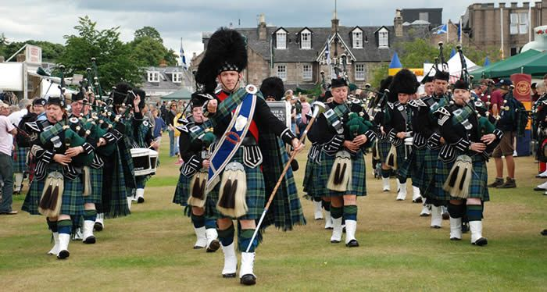
Ошская область Кара-Суйский район комплекс профильной школы-гимназии №65 имени Муродхана Сабирова
Урок английского языка для 8-го класса
Тема: Scotland.
Подготовил учитель английского языка: Артиков Р.Ш.

Slide 3
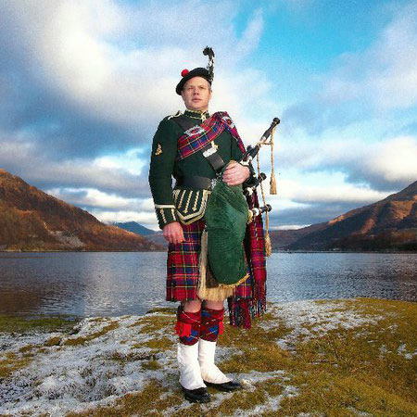
The purpose of the lesson:
To develop a positive motivation for learning English, a willingness to perceive the culture of the country of the language being studied through the topic.

Slide 4
Lesson objectives
To expand, with the help of the English language, the students' perception of the world around them, about the countries of the world.
Introduce Scotland to the customs and culture of this people.
Develop reading, listening and speaking skills
To educate students in interest in other countries and the knowledge of the world

Slide 5
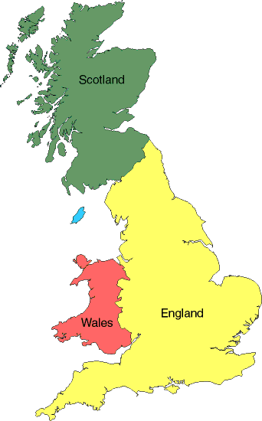
Where is Scotland?
Scotland is
noted on a card
by green color.

Slide 6
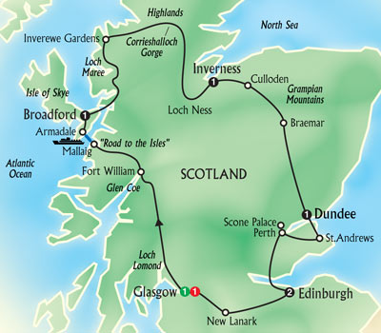
The Map of Scotland
The Map of Scotland

Slide 7
The flag of Scotland is a white cross on a blue background. It is one of the oldest flags in the world.

Slide 8
A Few Facts About Scotland
The capital of Scotland is Edinburgh.
The money used is called the pound sterling.
The population of Scotland is 4,996,000.
The language spoken is English.
Scotland is a part of the United Kingdom.

Slide 9
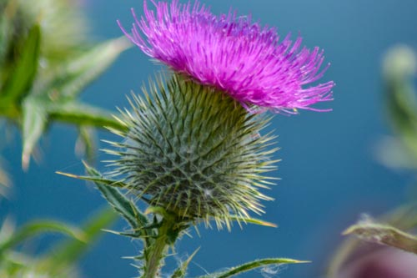
The national emblem of Scotland is the thistle.

Slide 10
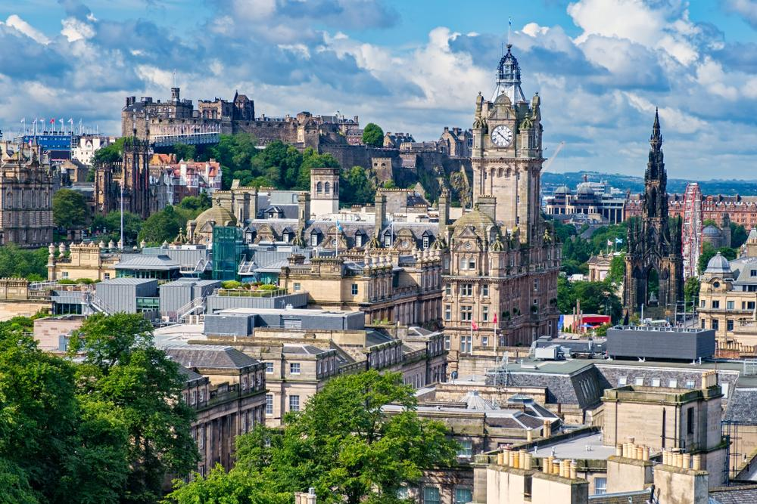
Let’s Visit Some Important Cities in Scotland
Edinburgh
Edinburgh is the capital city.

Slide 11
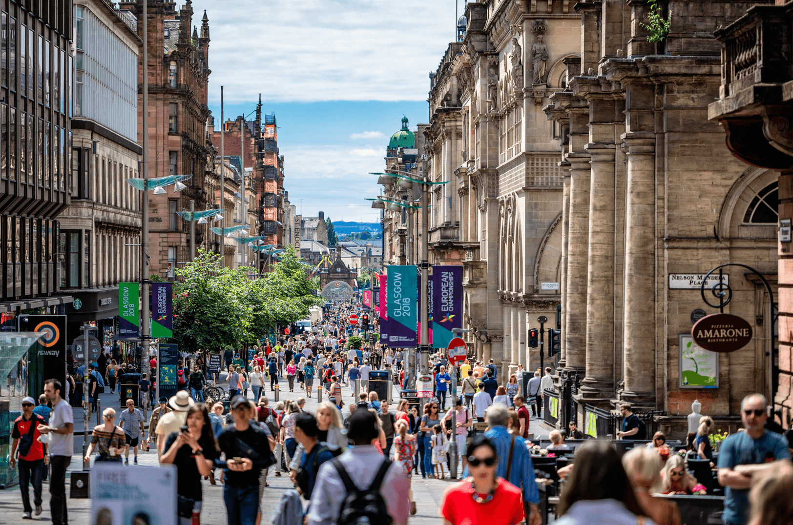
Glasgow

Slide 12
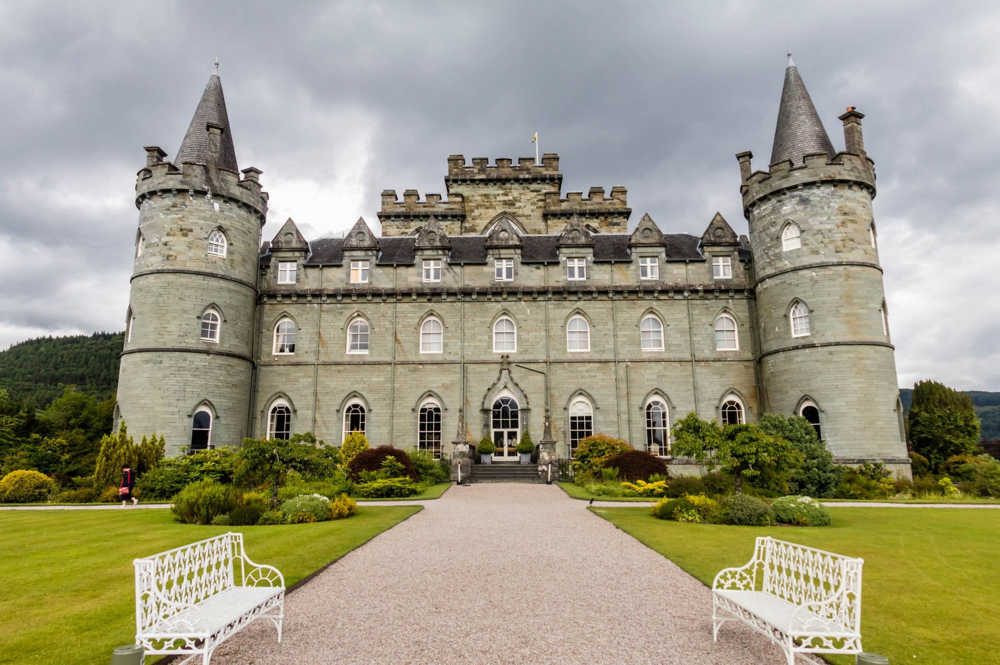
Scotland is famous for its castles.

Slide 13
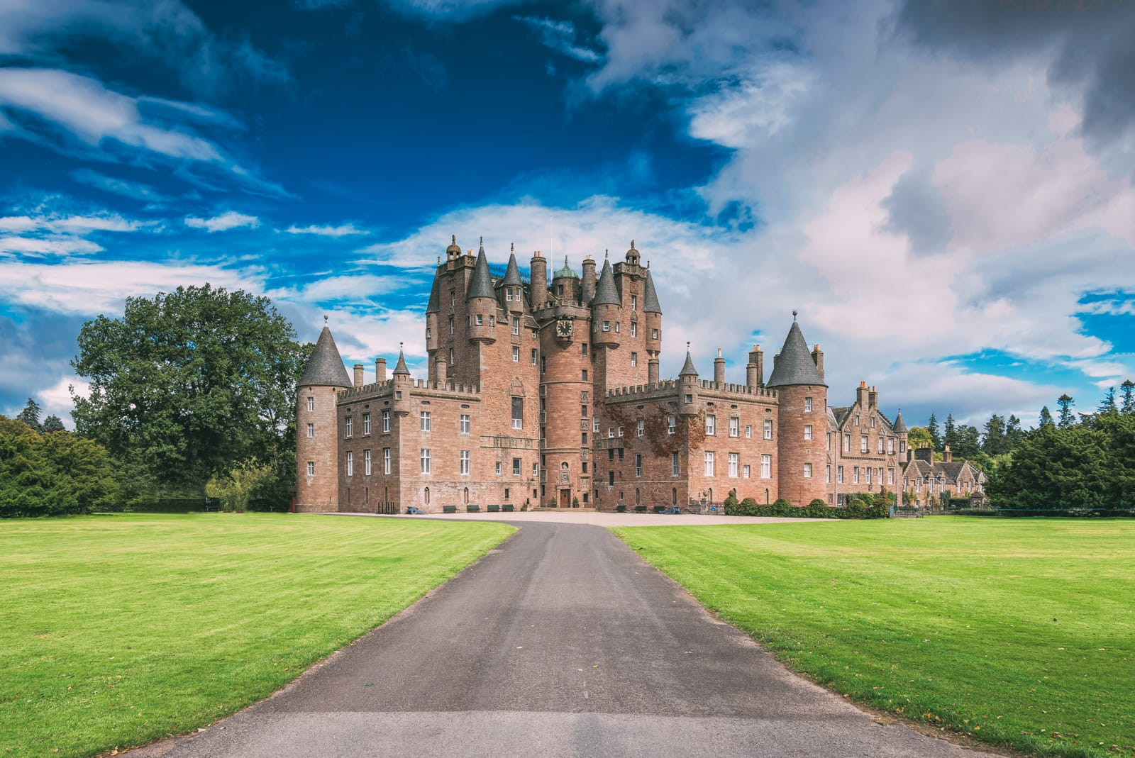

Slide 14
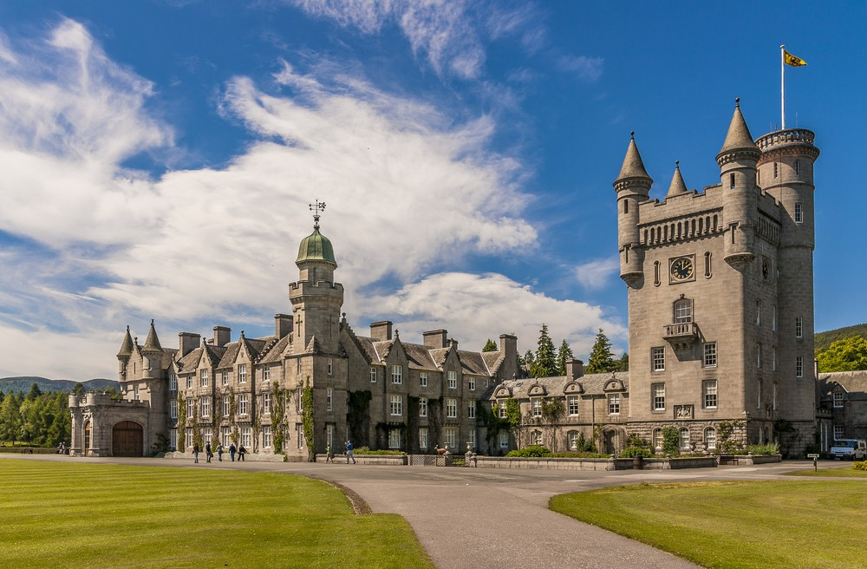

Slide 15
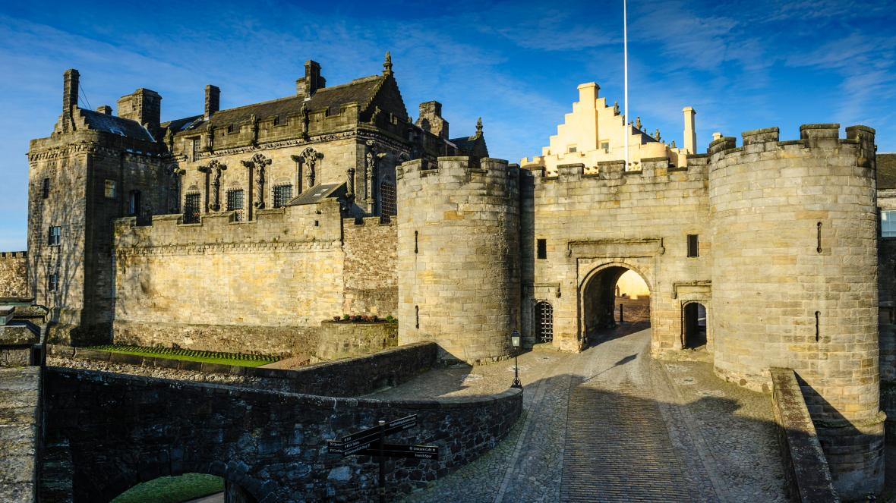
Stirling Castle
Stirling Castle is from medieval times and is near Edinburgh.
It is opened to visitors.

Slide 16
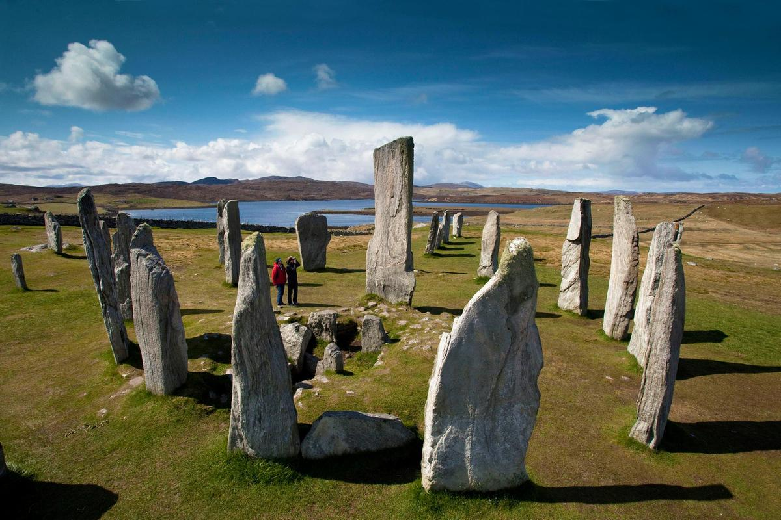
Ancient Stones of Scotland

Slide 17
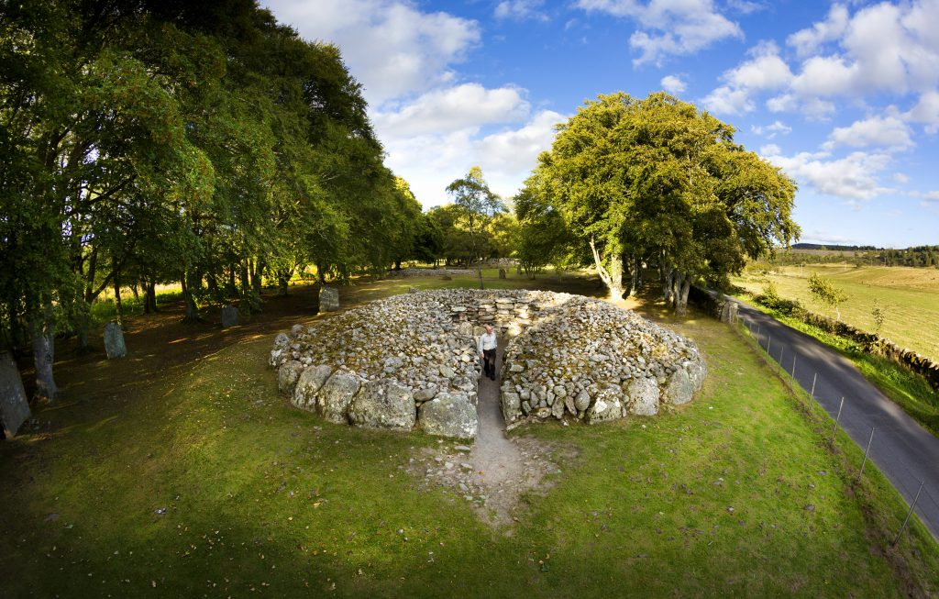

Slide 18
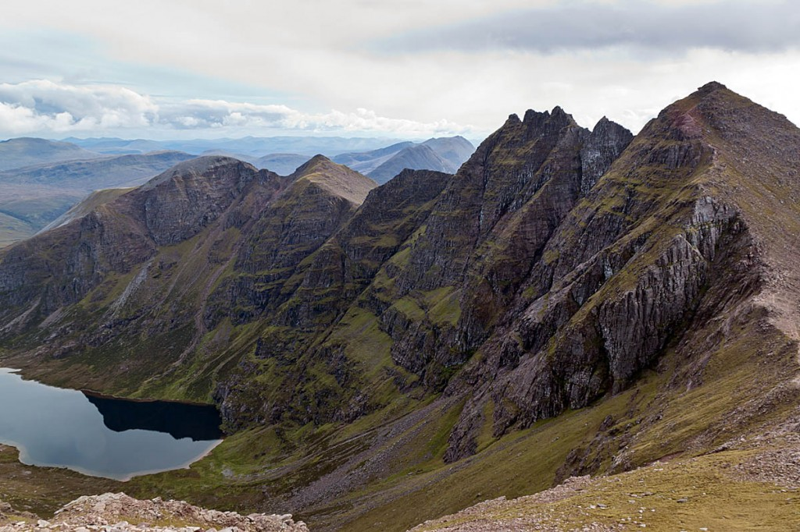
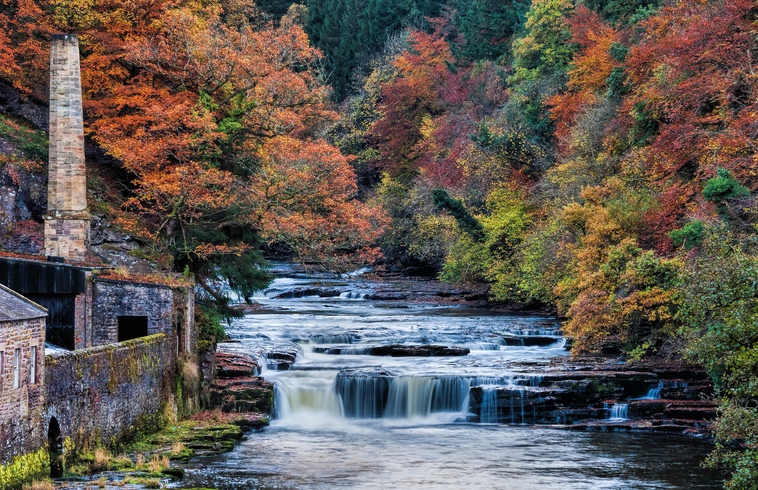
There are a lot of mountains, rivers and lakes in Scotland.

Slide 19
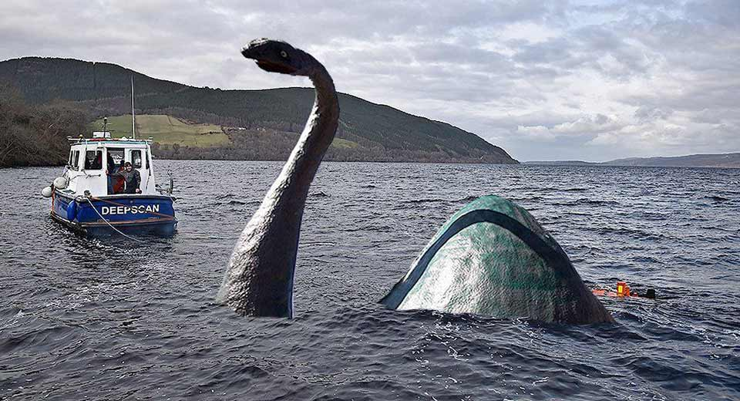
Loch Ness is the best-known lake. A popular nickname for the Loch Ness Monster is Nessie.

Slide 20
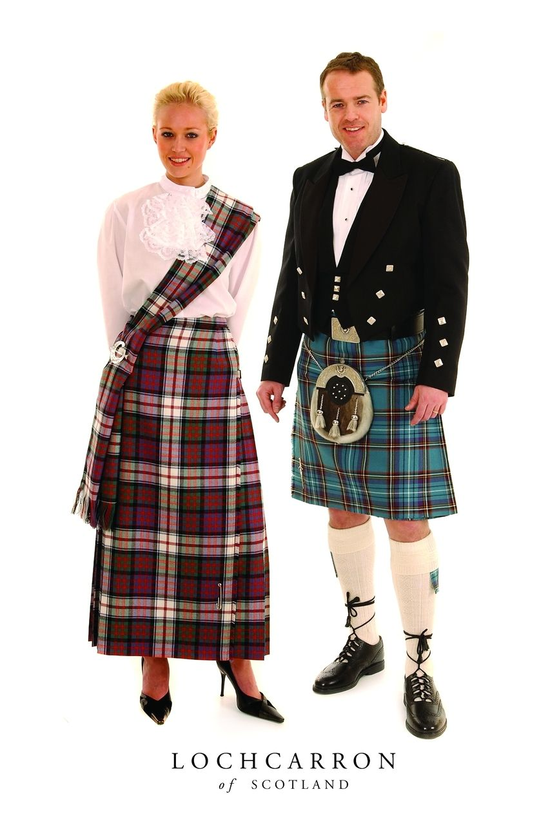
The national dress of Scots is the kilt.

Slide 21
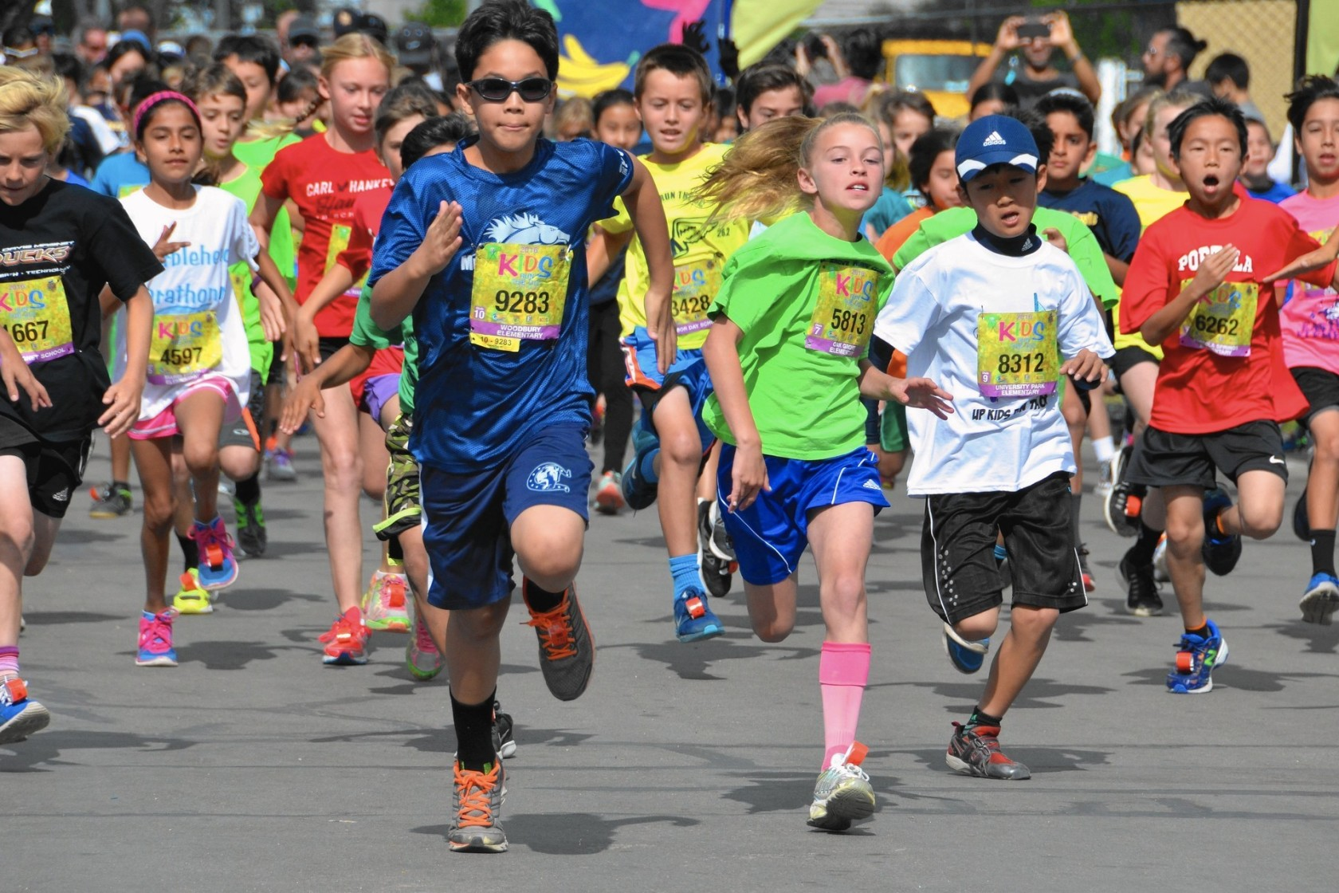
What Scottish Kids Do?
Scottish kids enjoy many sports. They play football, soccer, rugby, squash and golf.
They like to ride a bicycle, hike and fish in the summer. In the winter they ski and skate.

Slide 22
Scotland’s Important People
Alexander Graham Bell - the inventor of the telephone
Andrew Carnegie -came to the U.S. and made a fortune in the iron and steel business. He gave money to build many of our libraries.
Sean Connery - an actor who starred the first James Bond movies.
Sir Arthur Conan Doyle - the author of Sherlock Holmes mysteries.
Sheena Easton - a famous pop singer.
Captain Kidd - a famous pirate.
John Muir -founded our U.S. National Park system .
Robert Louis Stevenson - an author of Treasure Island .

Slide 23
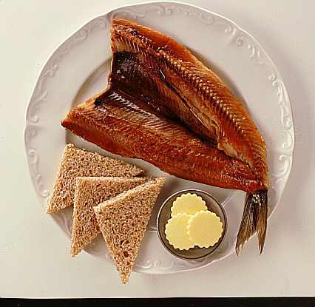
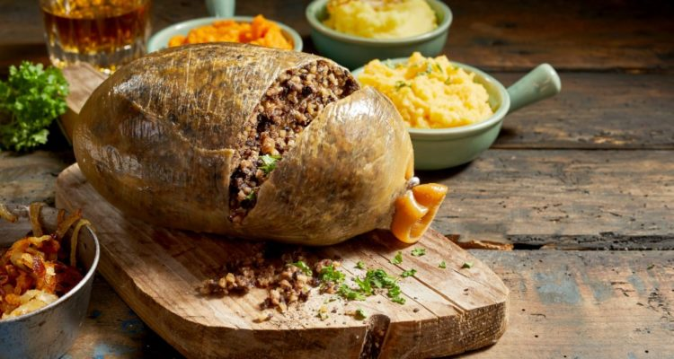
What Scots Like to Eat?
Haggis

Slide 24
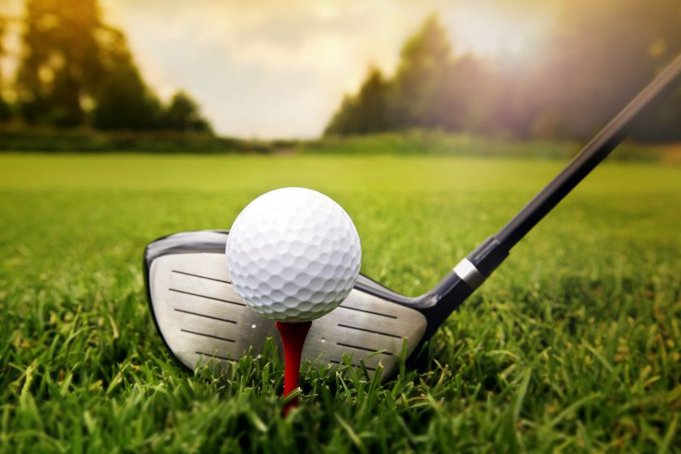
The sport of golf originated in Scotland.

Slide 25
Homework
answer the questions

Slide 26
Answer the questions
What is the capital of Scotland?
What’s the name of the skirt that men wear in Scotland?
What does loch (as in Loch Ness) mean?
What is the traditional Scottish meal made of sheep’s intestines and cereal called?
What’s the name of the highest mountain in Scotland?
What is the population of Scotland?
On January 25th Scottish people celebrate the birth of their most famous poet. What is this celebration called?
What’s the name of the famous Scot who invented the telephone?
Which sport was first played in Scotland?
The patron saint of Scotland is St. Andrew. He is patron saint of which other country?

Slide 27
Thank you
for your attention!

