Slide 1
Hello!!!

Slide 2
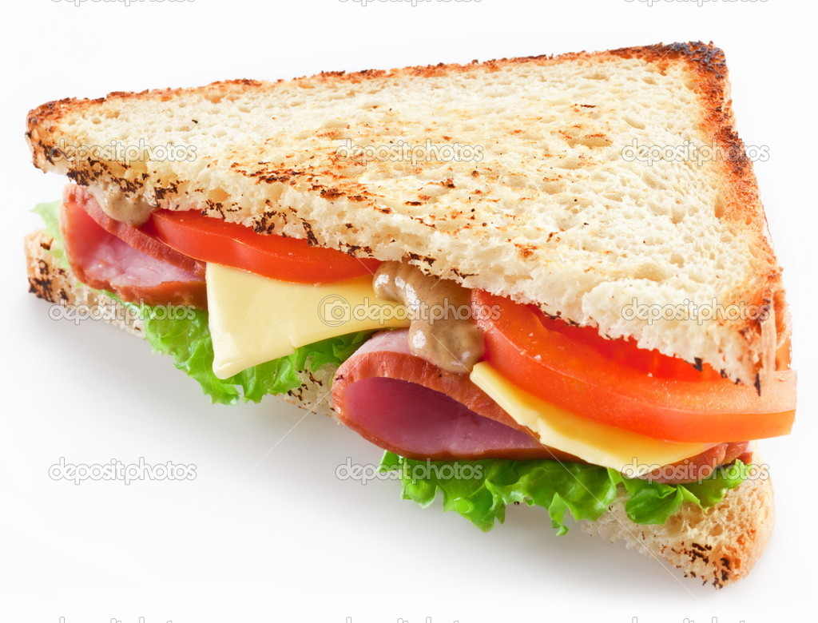
sandwich

Slide 3
ice cream

Slide 4
sausages

Slide 5
chocolate

Slide 6
egg

Slide 7
orange juice

Slide 8
apple juice

Slide 9
biscuits

Slide 10
milk

Slide 11
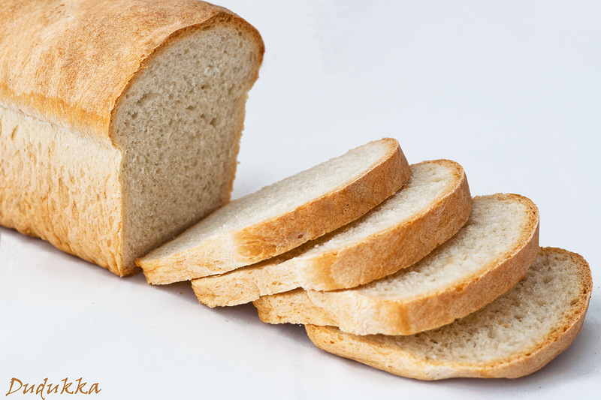
bread

Slide 12
cheese

Slide 13
pizza

Slide 14
tea

Slide 15
soup

Slide 16
coffee

Slide 17
porrige

Slide 18
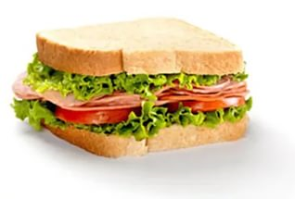
I have a sandwich and juice.

Slide 19
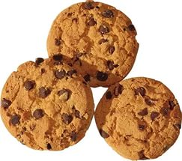
I have milk and biscuits.

Slide 20
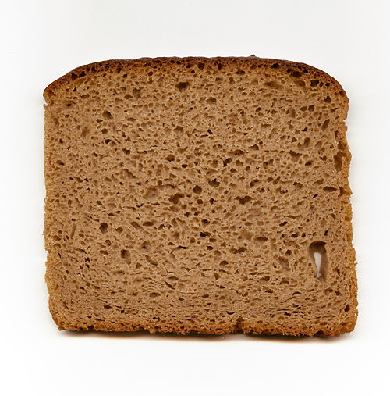
I have soup and bread.

Slide 21
I have porridge and tea.

Slide 22
I have pizza and coffee.

Slide 23
GOOD BYE!

