Slide 1
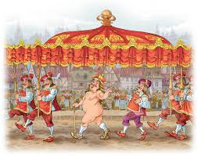
The Emperor’s new clothes

Slide 2
Welcome to my palace!

Slide 3
Room1 – Pronunciation room
Emperor, cloth, clothes, cheats, magic, says, invisible, great, days and nights, ministers, shout “Hooray”, a stupid boy, start talking quietly, right.

Slide 4
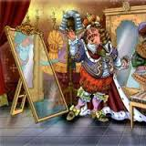
Room2 – Reading room

Slide 5
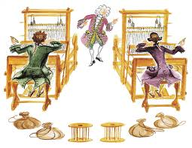
Room3 – English equivalents room
Кто глуп в моем дворце, работают день и ночь, невидимые брюки, смотрит в зеркало, я умный, надевает свои любимые перчатки, слева, справа.

Slide 6
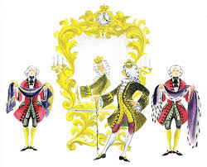
Room4 – Rest room

Slide 7
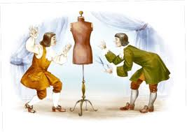
Room4 – Text making room
A little boy looks at the Emperor and says “Look! He’s got no clothes!”
One day two cheats come to the palace.
The cheats work days and nights.
People clap their hands and shout “Hooray!”
They say they can make clothes from magic cloth for the Emperor.
The Emperor puts on his invisible clothes and walks in the city.
Finally the clothes are ready.
People say that the Emperor hasn’t got any clothes but he walks and walks.

Slide 8
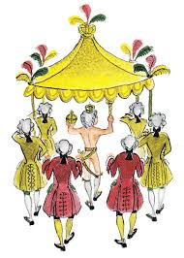
Room 6 – Dialogues room
Cheats: Would you like to have new одежда?
Emperor: Sure. Are they дешевый?
Cheats: No, they are дорогой, because they are волшебный.
Emperor: Why are they magic?
Cheats: Because they are невидимый.
***
Boy: Emperor, you haven’t got any одежда!
Emperor: You are глупый!
Boy: No, you are stupid. you haven’t got any новый clothes!
Emperor: My clothes are волшебный.Fools can’t see them!

Slide 9
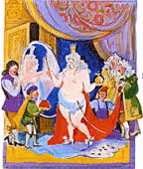
Room 7 – Questions room
What invisible clothes has the Emperor got?
Who says that the Emperor hasn’t got any clothes?
Who is stupid?

Slide 10
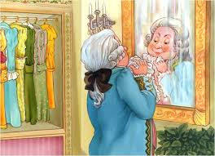
Home task
To retell the text
To read the text expressively

Slide 11
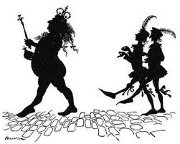
Think with your head only!

