Slide 1
Understanding
Words to learn

Slide 2
opportunity
blush
palm
sweat
look away
approach
fancy
get down
benefit
develop
avoid

Slide 3
Optimistic

Slide 4
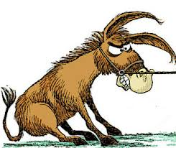
Stubborn

Slide 5
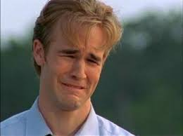
Sensitive

Slide 6
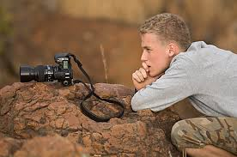
Patient

Slide 7
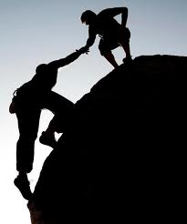
Reliable

Slide 8
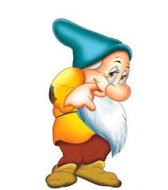
Shy

Slide 9
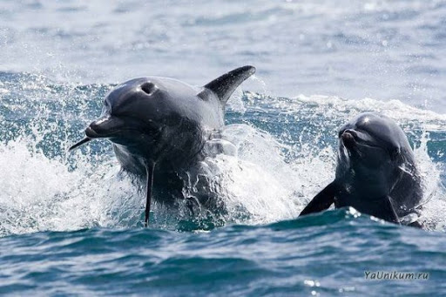
Easy-going

Slide 10
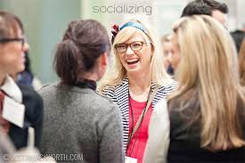
Sociable

Slide 11
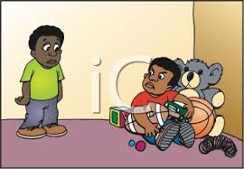
Selfish

Slide 12
Honest

Slide 13
Circle the correct word
My best friend John is the coolest friend in the world. He is really easy-going/selfish and flexible/pessimistic. Everyone likes him. He is reliable/impatient, honest/irritable and is always there for me. His only fault is that sometimes he gets very stubborn/sincere and wants to do things his own way

Slide 14
You should work in pairs and prepare your advice using these phrases. Exchange and discuss advices with your partner, you may write them.
Giving advice | Result
If I were you / in your position, I’d…/ I wouldn’t | This will/would…..
You should / shouldn’t | Then /This way …..
It would(n’t) / might be a good idea (for you) to ….. | If you do this, you will…. because….
Why don’t you…? | By (+ing form) …, you will….
Have you thought of /about (+ing)…?
Another good idea is to….

Slide 16
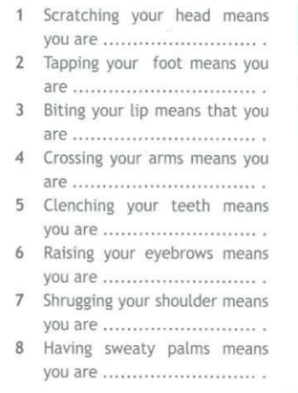
Complete the sentences

