Slide 1
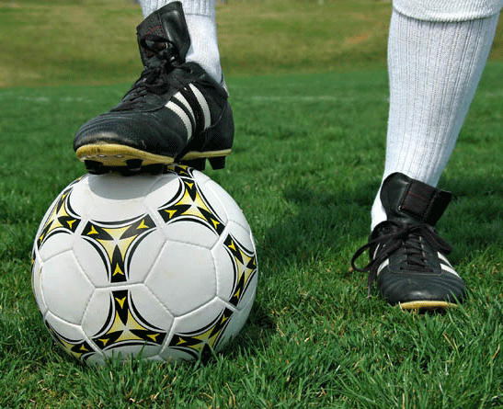
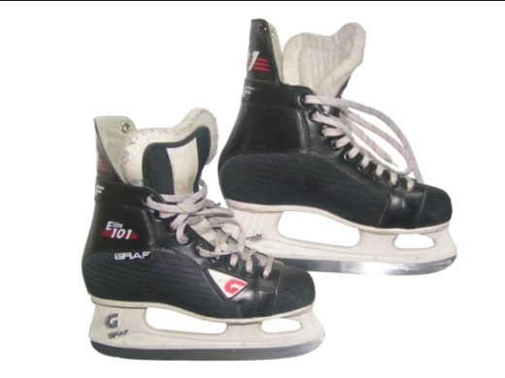
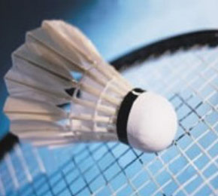
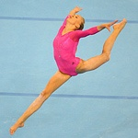
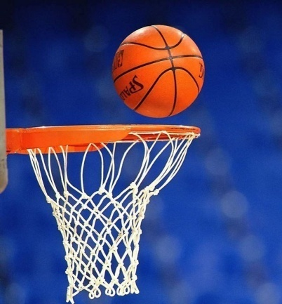
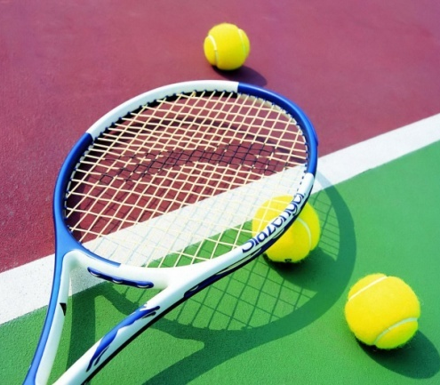
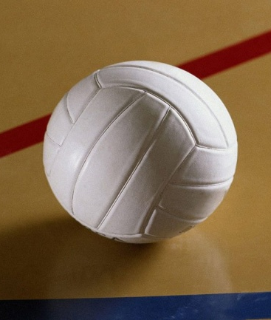
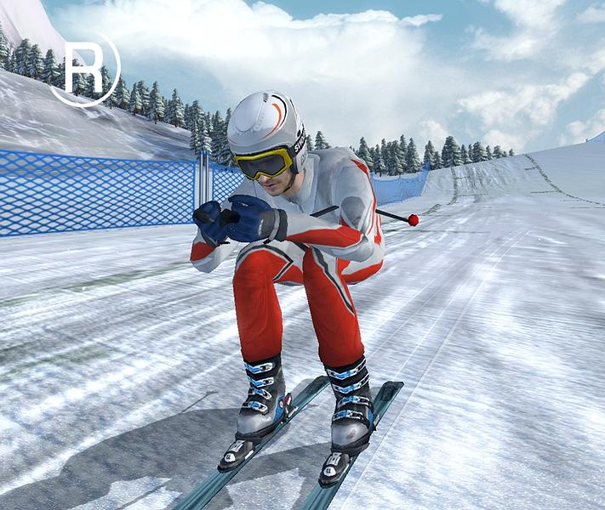
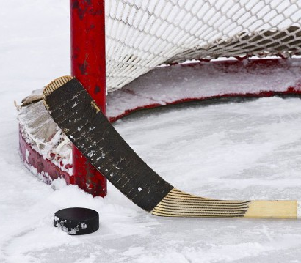
NAME THESE SPORTS
AND GAMES
FOOTBALL
ICE SKATING
BADMINTON
BOXING
GYMNASTICS
BASKETBALL
TENNIS
VOLLEYBALL
SKIING
HOCKEY

Slide 2
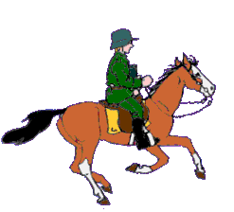
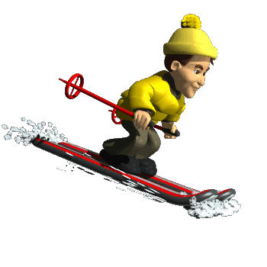
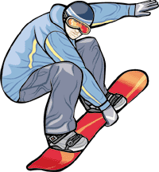
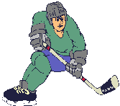
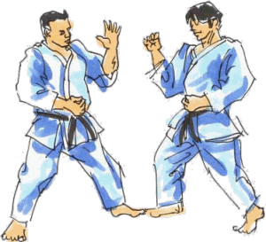
Sport in
Russia

Slide 3
Read the text
learn new words
Do test
Sports in Russia
play
Answer the questions

Slide 4
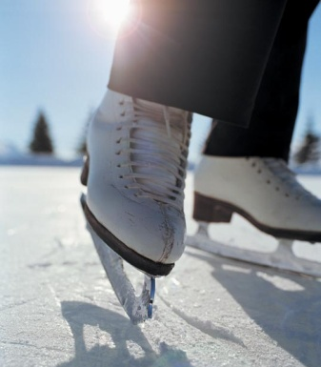
Group these activities into indoor and outdoor sports.
sailing
skating
surfing
baseball
diving
bowling
tennis
handball
horse-racing
wrestling
ice hockey
archery
volleyball
horse-racing
ice hockey
volleyball
diving
volleyball
Indoor
sports
Outdoor
sports
tennis
archery
bowling
sailing
baseball
handball
tennis
wrestling
skating
surfing

Slide 5
Stand up and look around Shake your head and turn around Stamp your feet upon the ground Clap your hands and than sit down.

Slide 6
What sport we CAN…
aerobics
skating
football
judo
tennis
handball
karate
gymnastics
swimming
athletics
basketball
PLAY ?
GO ?
DO ?

Slide 7
CHECK YOURSELF
PLAY- tennis, football, handball, basketball
GO- skating, swimming
DO - athletics, gymnastics, judo, aerobics, karate

Slide 8
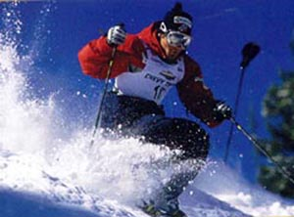
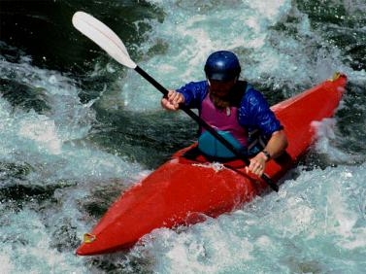
Thank you
for attention

