Slide 1
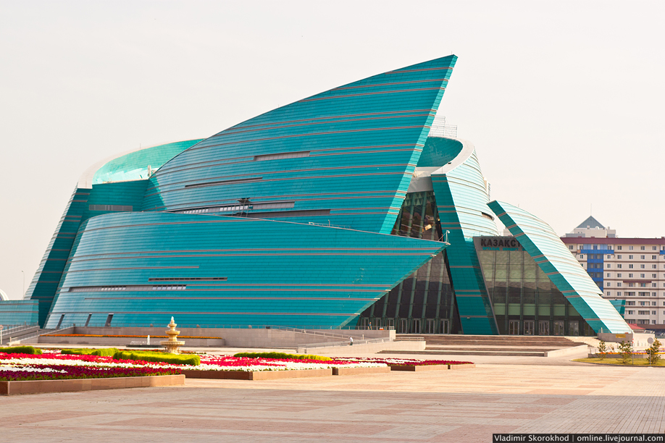
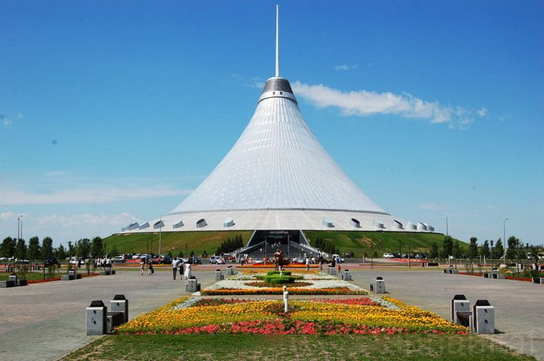
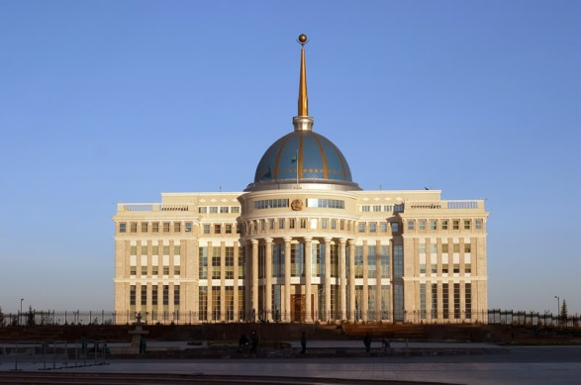
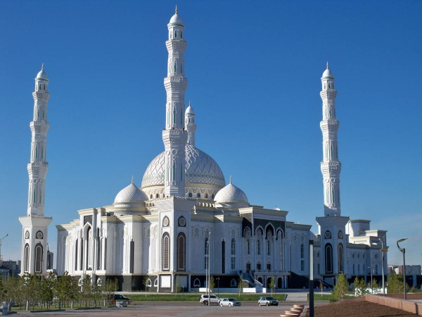
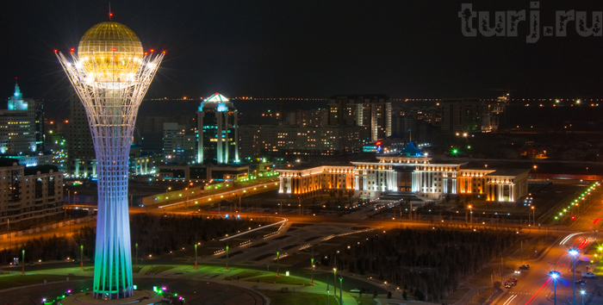

Slide 2
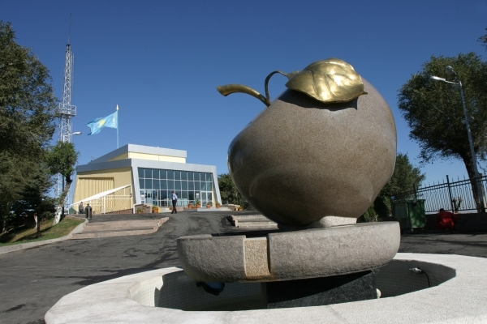
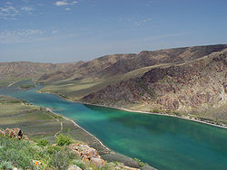
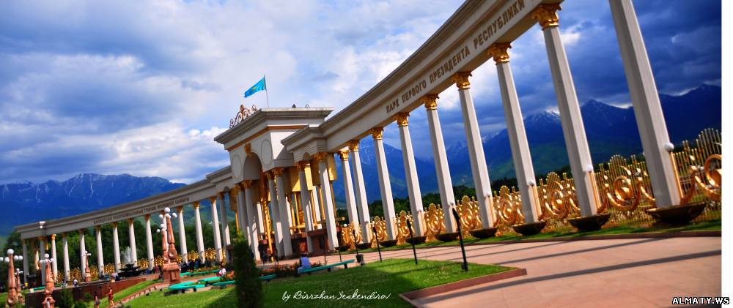
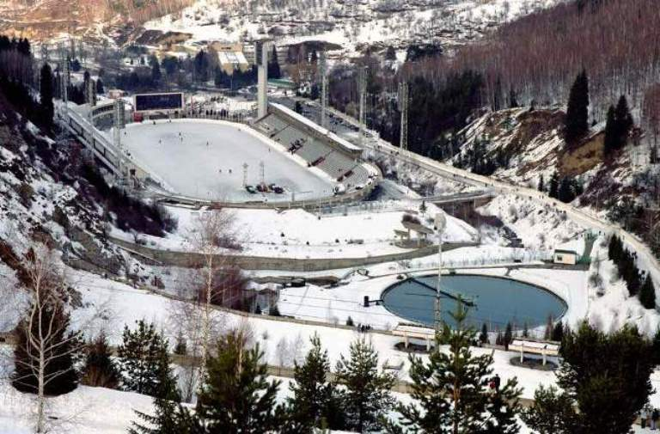
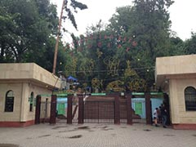

Slide 3
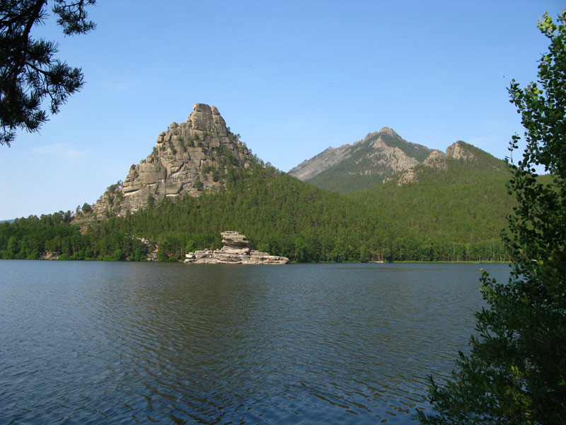
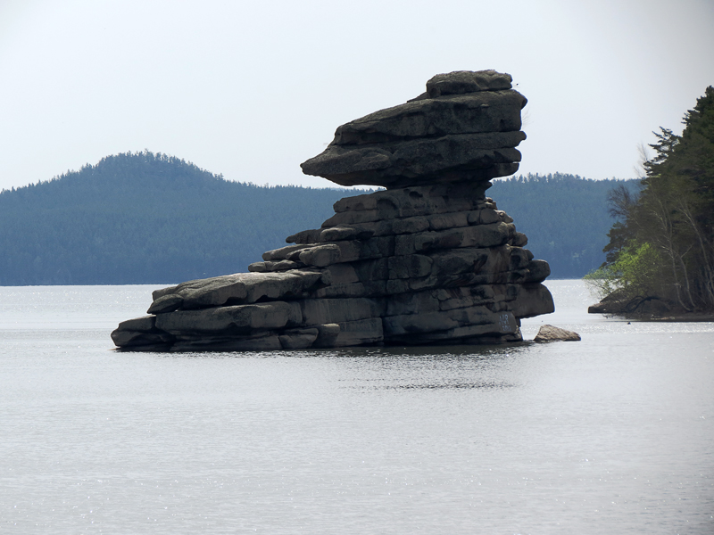
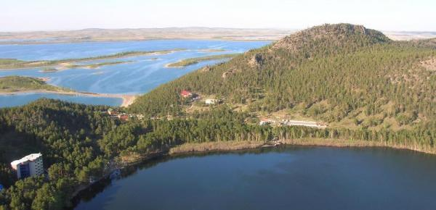
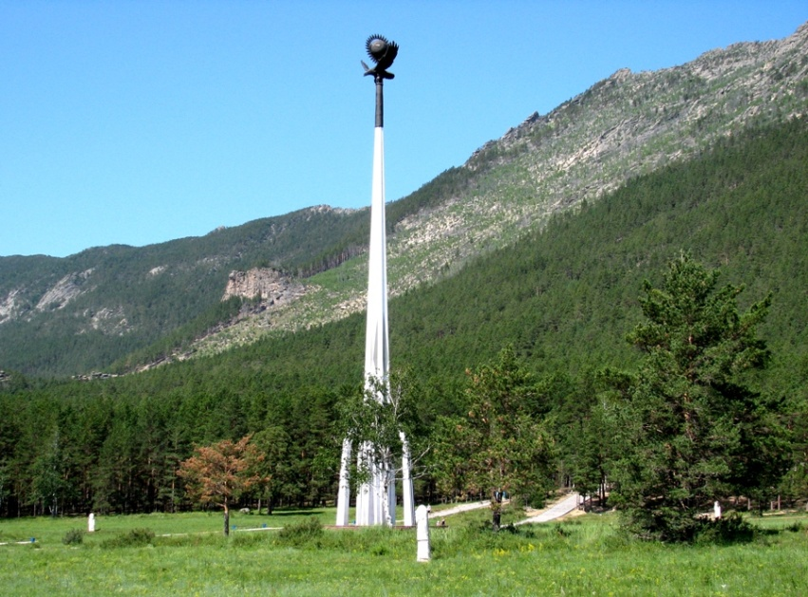

Slide 4
Moved, appear, fast, banks, columns, monuments, founded. 1) Every river has two … . 2) In 1703 Tsar Peter … a new city near the Baltic Sea. 3) The tall … make the theatre look very beautiful. 4) Do you know that there are … to animals in different places of the world? 5) The capital … from Moscow to St Petersburg and then back to Moscow. 6) More and more new theatres and museums … in our city every year. 7) Everything around us changes very … .

Slide 5
Keys
1. banks 2/ founded 3/ columns 4/ monuments 5/ moved 6/ appear 7/ fast.

