Slide 1
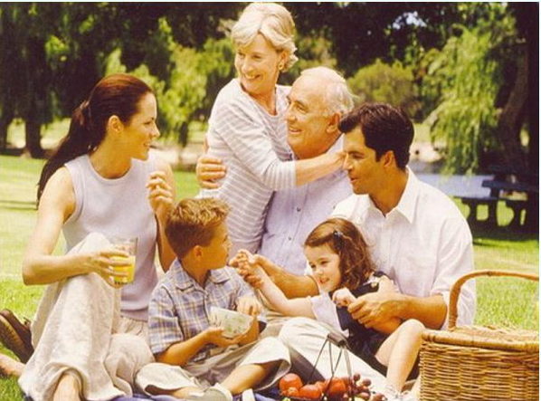
My family

Slide 2
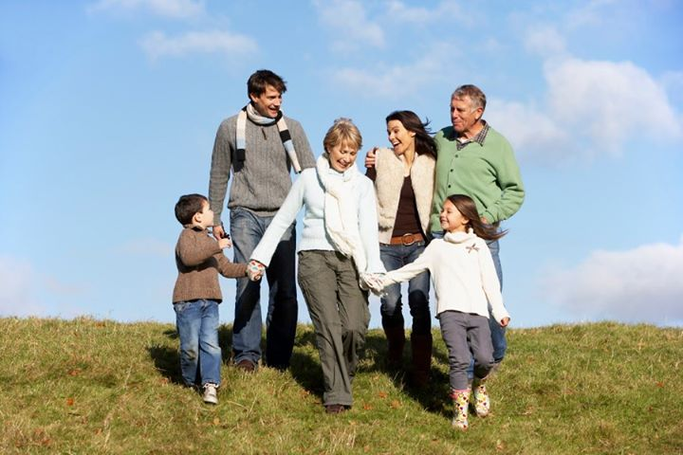
Our family is neither large nor small.
I have a mother, a father, a brother and a sister and grandparents.

Slide 3
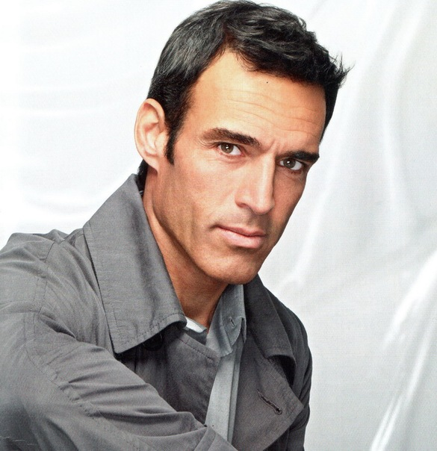
My father Peter Ivanovich is 47 years old. He is a tall and well-built man with short black hair and brown eyes.
He works as a manager at a plant. He likes his work and spends most of his time there.
His hobby is collecting stamps.
By character my father is a quiet man, while my mother is energetic and talkative.

Slide 4
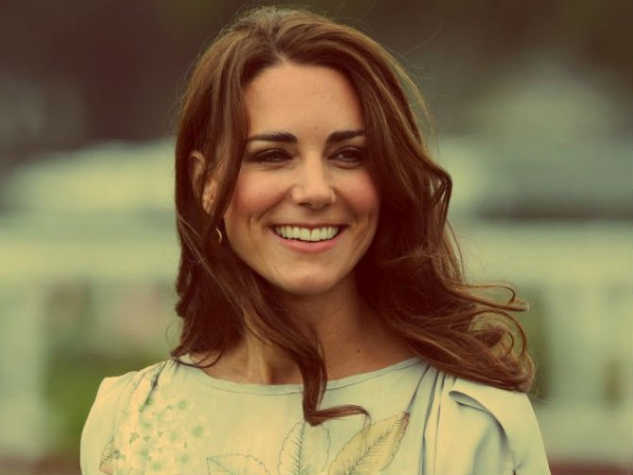
My mother’s name is Marina Petrovna. She is forty.
She is a teacher of music and plays the piano well.
My mother always has a lot of work to do about the house and at school.
She is a busy woman and we all help her.

Slide 5
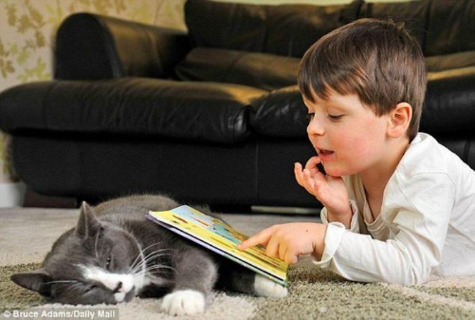
My brother’s name is Sergei. He is only 6 years old. Sergei has short black hair and grey eyes like our father. He is a clever boy. Sergei likes play with our cat and to read his favourite book «Russian fairytales».

Slide 6
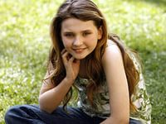
My sister’s name is Irena.
Like our mother Irena has brown eyes and beautiful hair. She is a very good-looking girl.
Irena is younger than me. She is a pupil of the 8th form.
She does well at school and gets only good and excellent marks. Literature is her favourite subject and she wants to become a teacher.

Slide 7
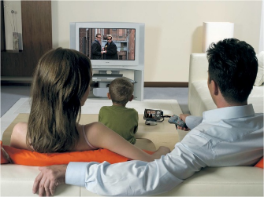
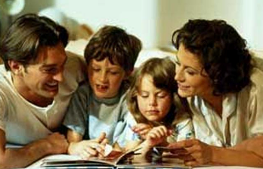
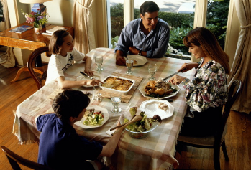
Our family is very united. We like to spend time together. I like to take photo of my family. In the evenings we watch TV, read books and newspapers, listen to music or just talk about the events of the day. Our parents don’t always agree with what we say, but they listen to our opinion.

Slide 8
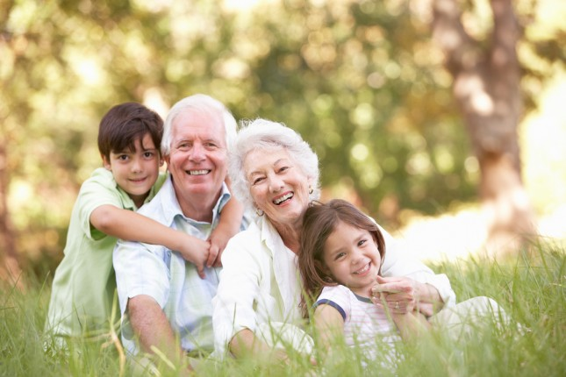
All of us like to spend our weekends in the country. We often go to the village where our grandparents live. They are pensioners now, but prefer to live in the country.

Slide 9
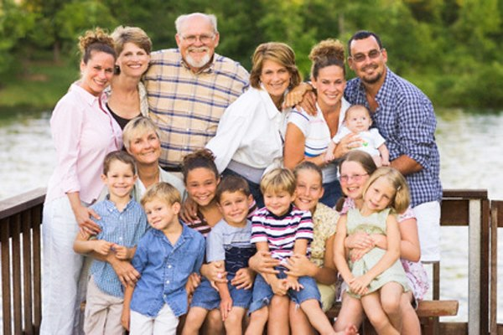
I also have many other relatives: uncles, aunts, cousins.
We are happy when we are together.

