Slide 1
Happy Birthday!!!

Slide 2
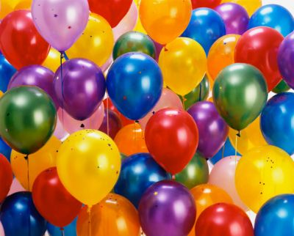
Birthday
mother
brother
father

Slide 3
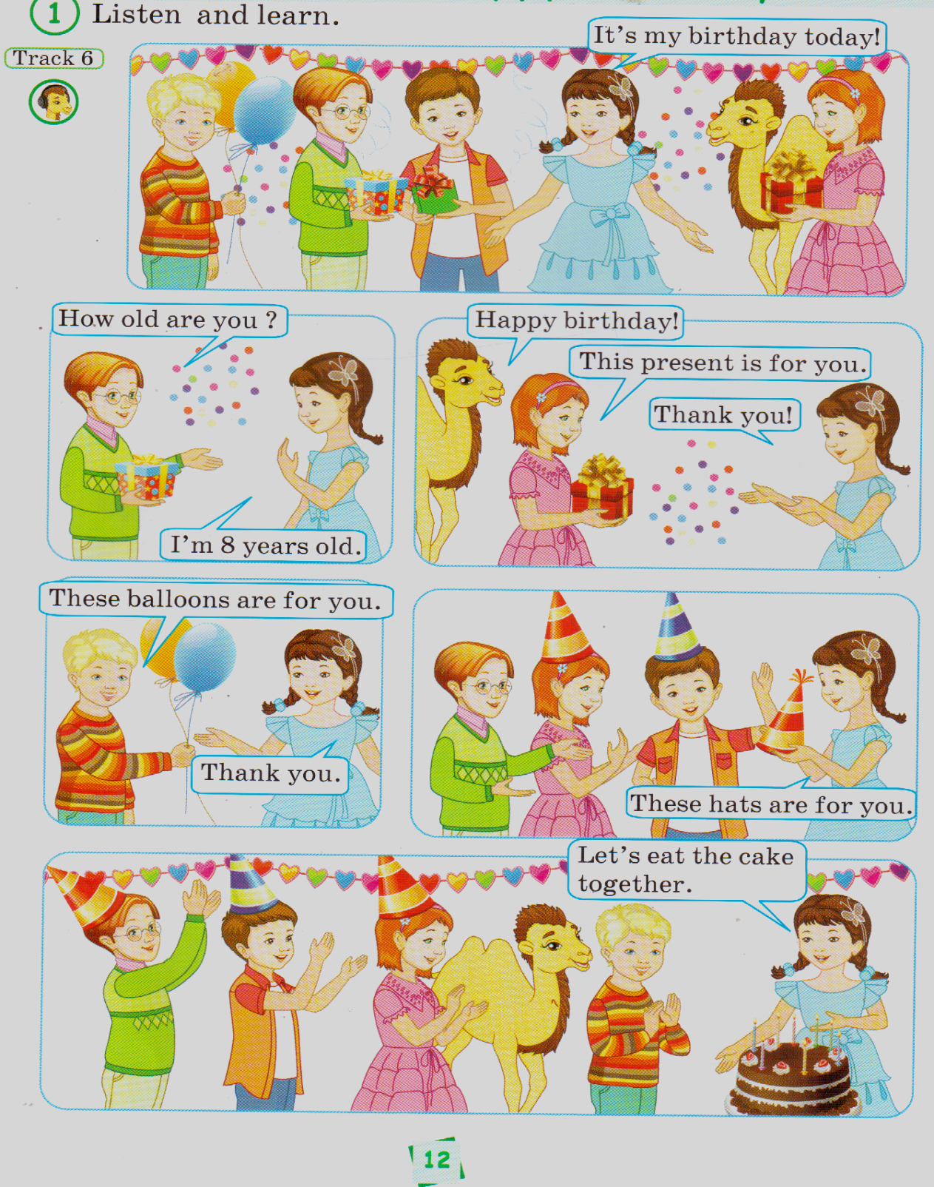


Slide 4
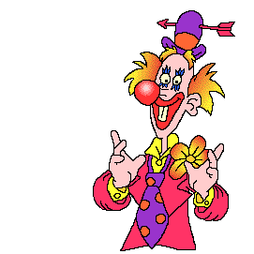
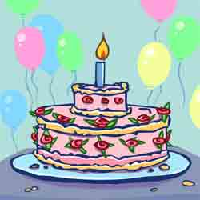
a cake

Slide 5

a present

Slide 6
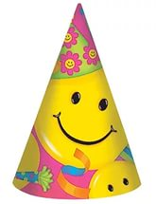
a hat

Slide 7
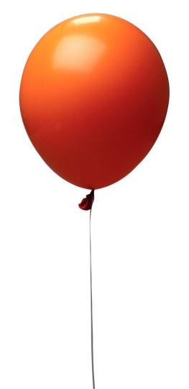
a balloon

Slide 8

a candle

Slide 9


Slide 10
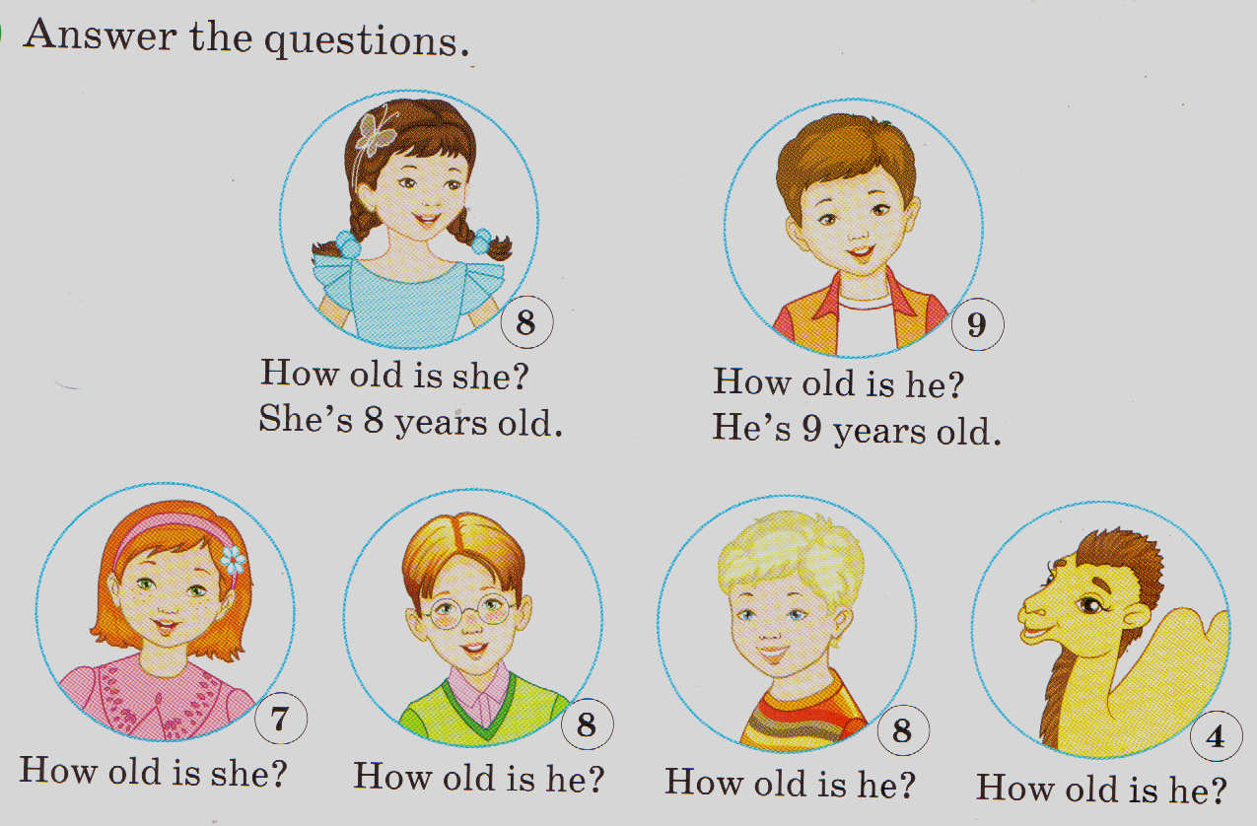

Slide 11
Thank you!!
Good Luck!!

