Slide 1
I know the ABC

Slide 2
Cats
Dogs

Slide 3
The ABC
Aa, Bb, Cc, Dd, Ee, Ff, Gg, Hh, Ii, Jj, Kk, Ll, Nn, Oo, Pp, Rr, Ss, Tt, Uu, Ww, Xx, Zz

Slide 4
Cats
d,r,i,b,
k,e,a,c
e,p,c,l,n,i
s,l,a,m,l
b,t,r,a,b,i
o,r,f,g
Dogs

Slide 5
pig,
fox,
frog,
jump,
cockerel,
rabbit,

Slide 6
D | G | K | F | Q | Z | U | T | R | Y
f | d | q | g | k | t | r | z | y | u

Slide 7
a | o | i | e | u
[e], | [i], | [o] | [⌡u] | [æ]

Slide 8
Can you swim?
Is his duck fat?
Is his pig green?
Has she got a cat?
Yes, it is.
No, it is not.
Yes, I can.
Yes, she has.

Slide 11
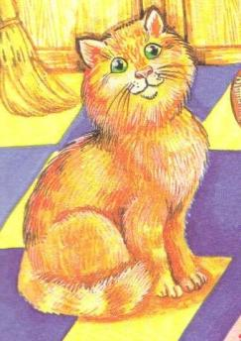
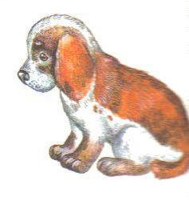
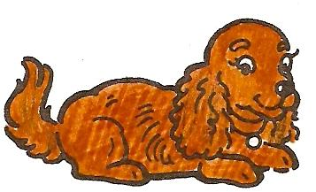
.
1.
.
2.
.
3.
.
4.
S

Slide 12
Cats
Dogs

