Slide 1
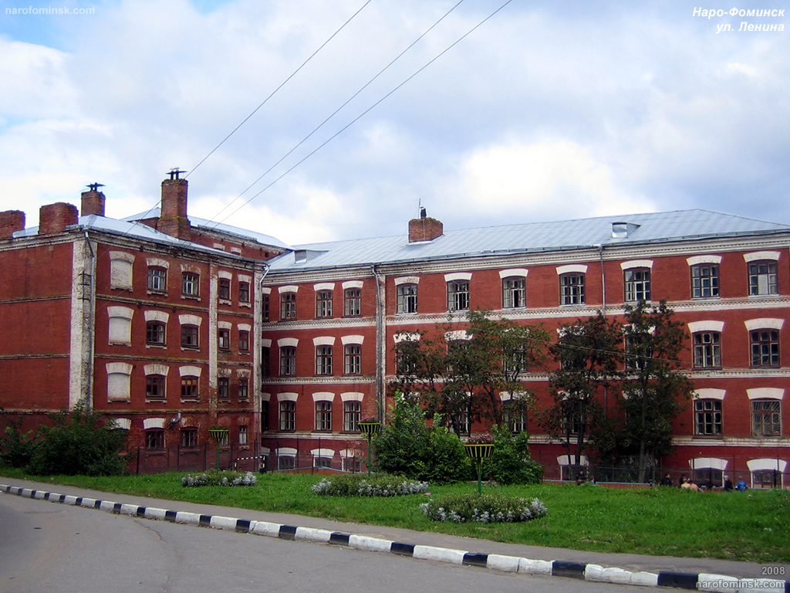
Our college

Slide 2
Our college is an old four-storeyed building
There is a sports ground behind it
The college is equipped with laptops and multimedia tools

Slide 3
In front of the college we can see a block of flats

Slide 4
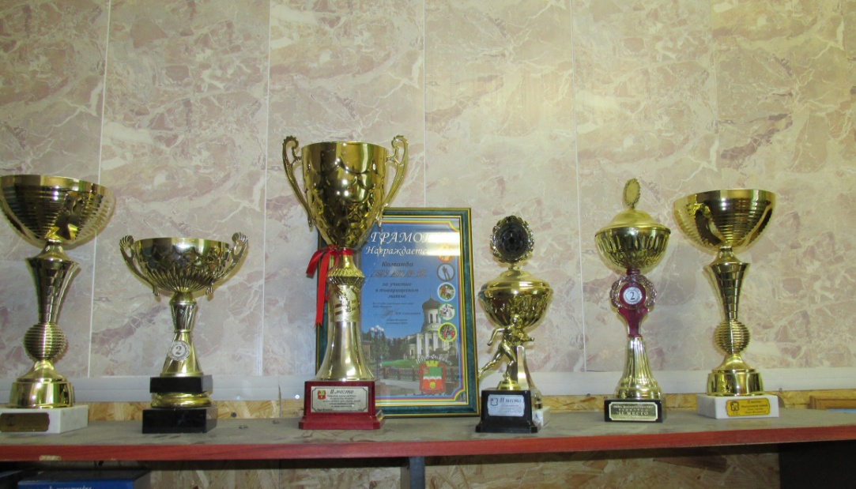
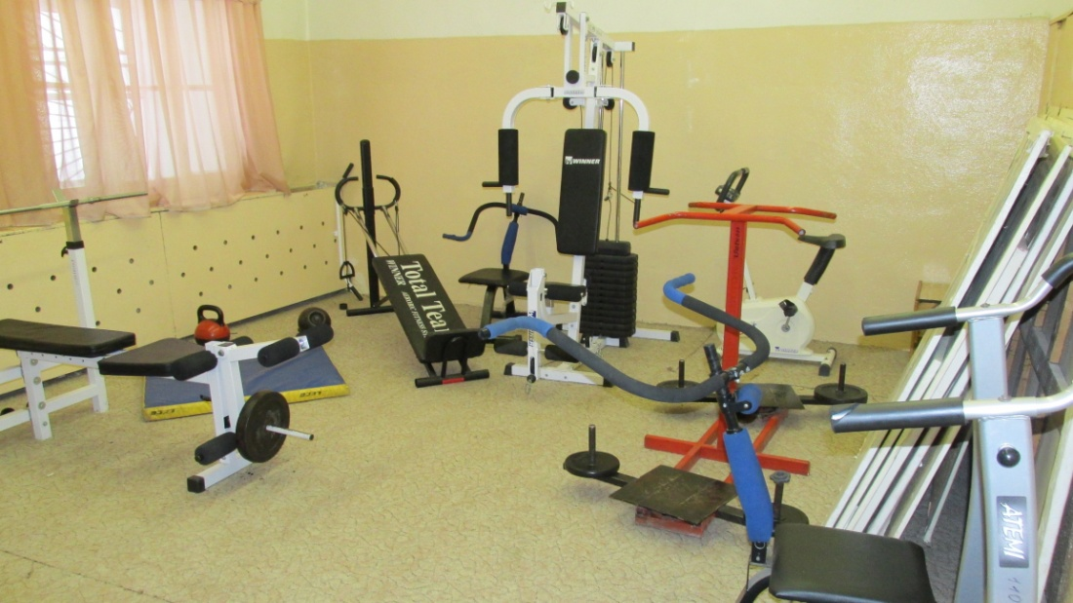
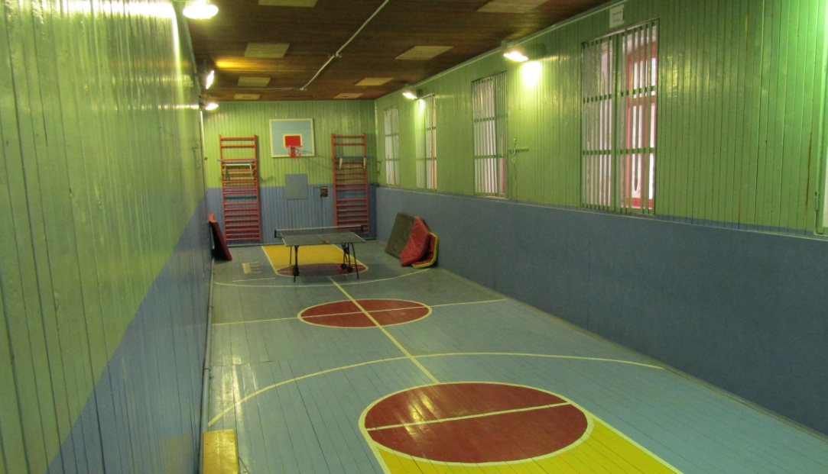
There are workshops and a gym on the ground floor

Slide 5
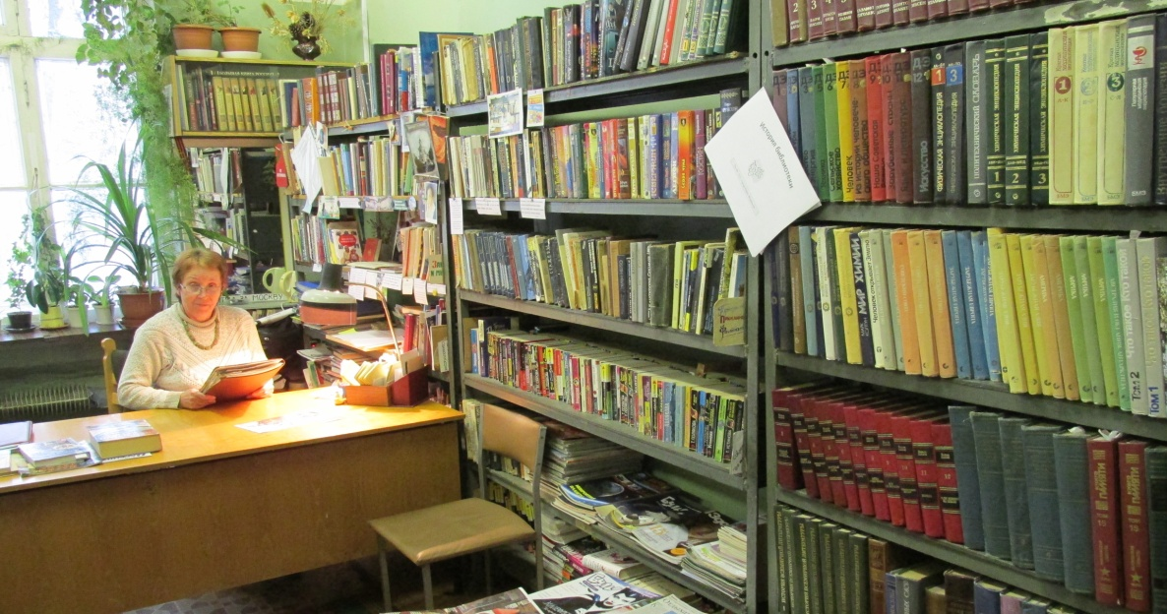
There is a canteen and a library on the first floor

Slide 6
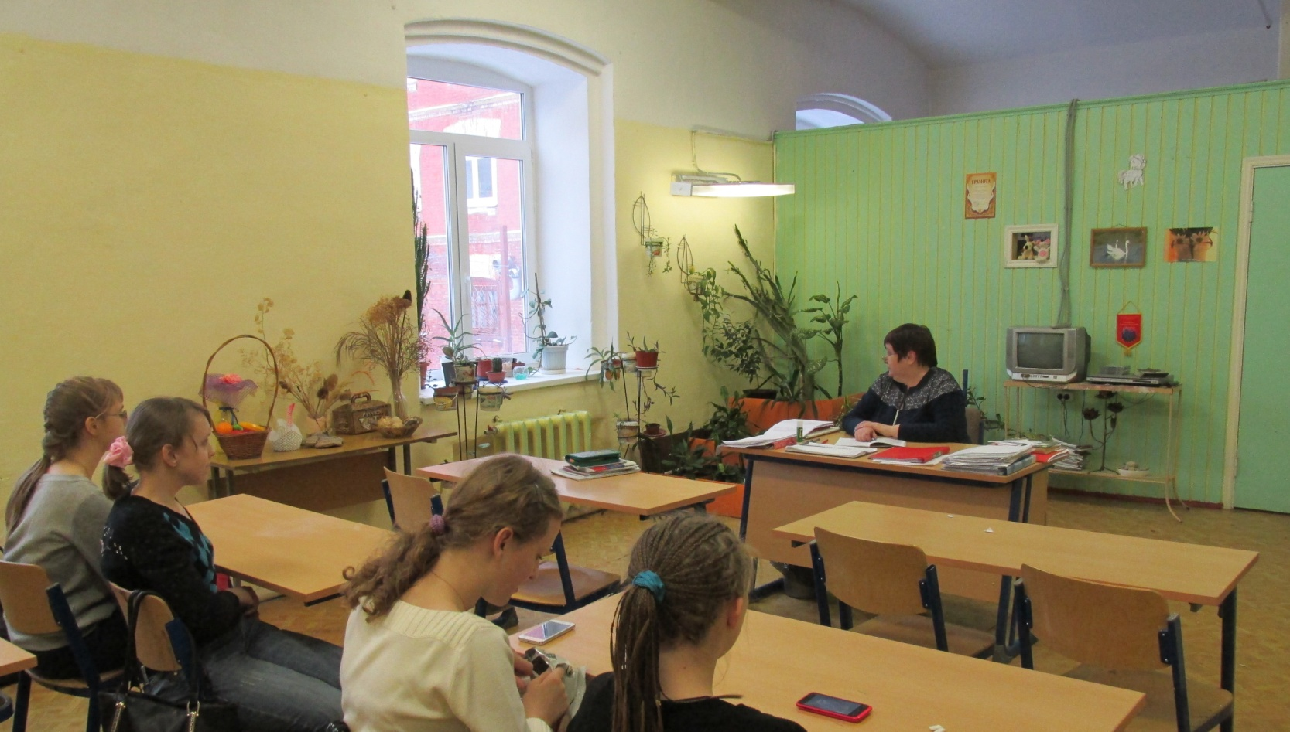
When we enter the classrooms we can see many pots with plants
Our students try to take good care of them

Slide 7
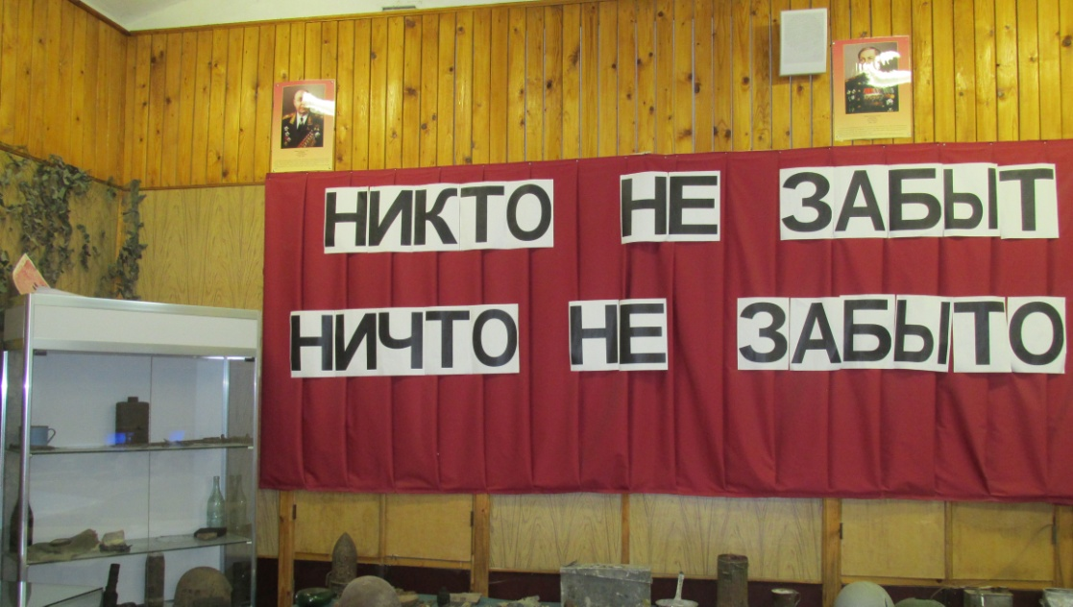
I think our college is a good educational institution

