Slide 1
an email

Slide 2
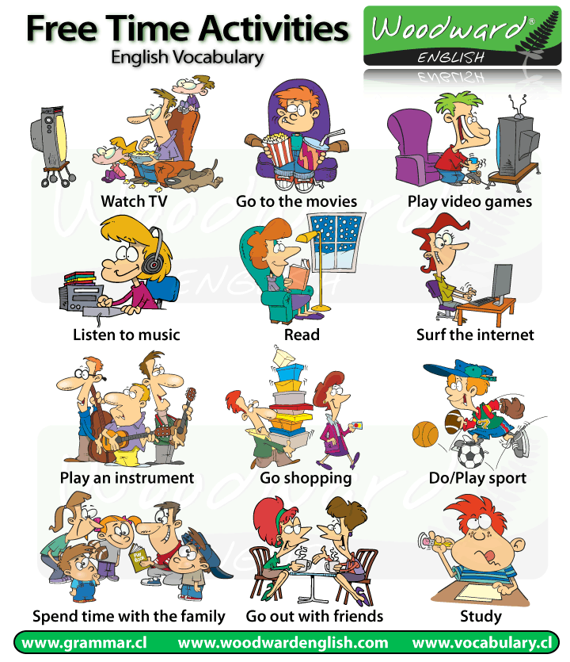

Slide 3
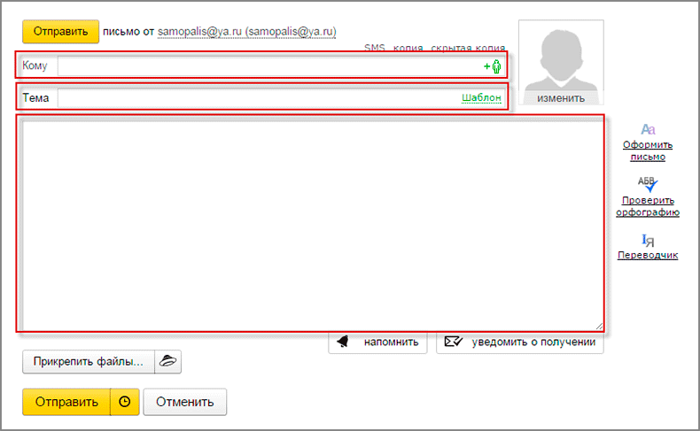
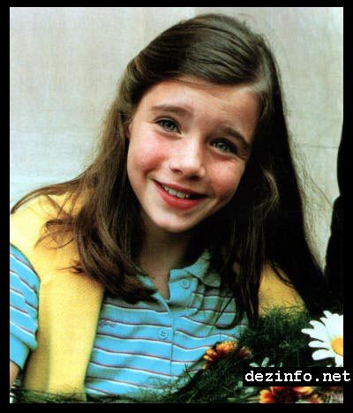
Send
To: Sarah
From: Andrea
Hello,
My name is Andrea, and I’m 13 years old. I’m from Budapest, and (1)…................ I’ve got one brother.
In my free time (2)…………………… I like Green Day and I love Good Charlotte. (3) …………….. , but (4)………………. They are boring!
What about you? Do you like music?
Andrea
p.s. Send me your photo!

Slide 4
Your task:
Complete the emails with these sentences.
I don’t play computer games.
I go to Budapest Central School
I often listen to music
I watch TV every day

Slide 5
Send
To: Sarah
From: Andrea
Hello,
My name is Andrea, and I’m 13 years old. I’m from Budapest, and I go to Budapest Central School. I’ve got one brother.
In my free time I often listen to music. I like Green Day and I love Good Charlotte. I watch TV every day, but I don’t play computer games. They are boring!
What about you? Do you like music?
Andrea
p.s. Send me your photo!

