Slide 1
In the Bath

Slide 2
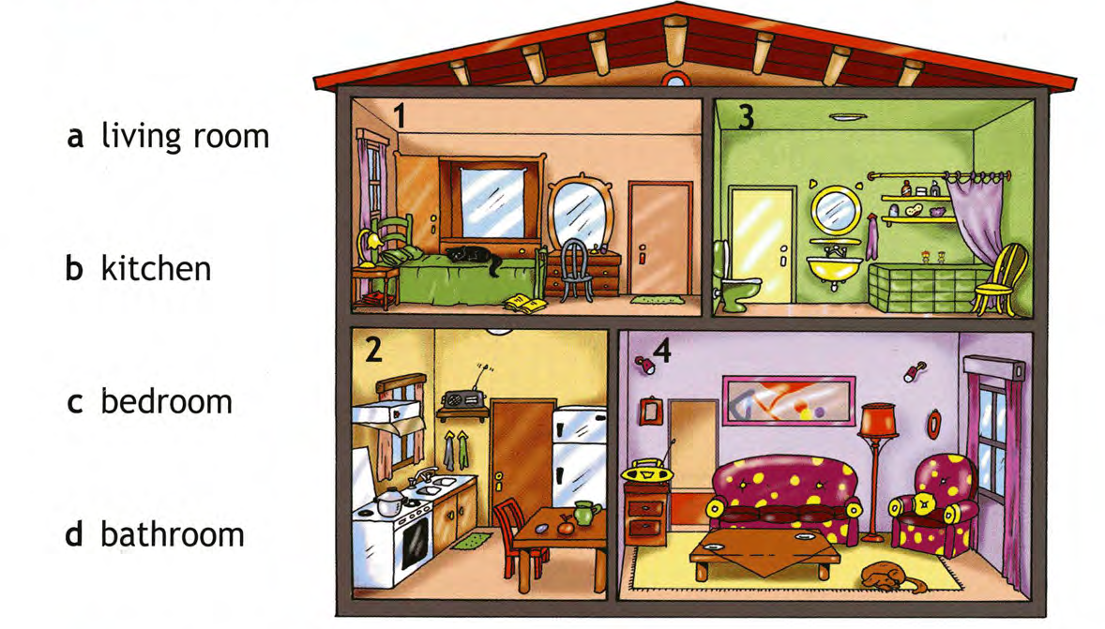
HOUSE

Slide 6
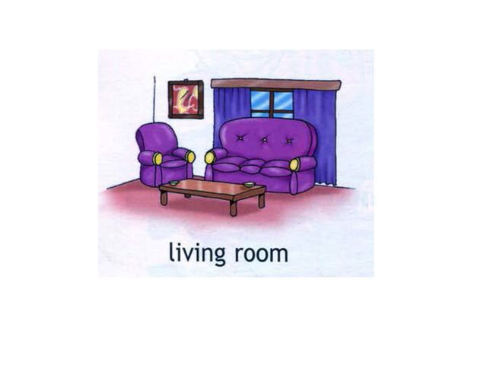

Slide 7
Open your books
p.43 ex. 2
Read,Choose and match

Slide 8
Homework “5”- Уч. с.38 Portfolio “4”- ex.4,p.37 ; WB p.19 ex 2

Slide 9
Thank you for the lesson!
Goodbye !

