Slide 1
Lunch box

Slide 2
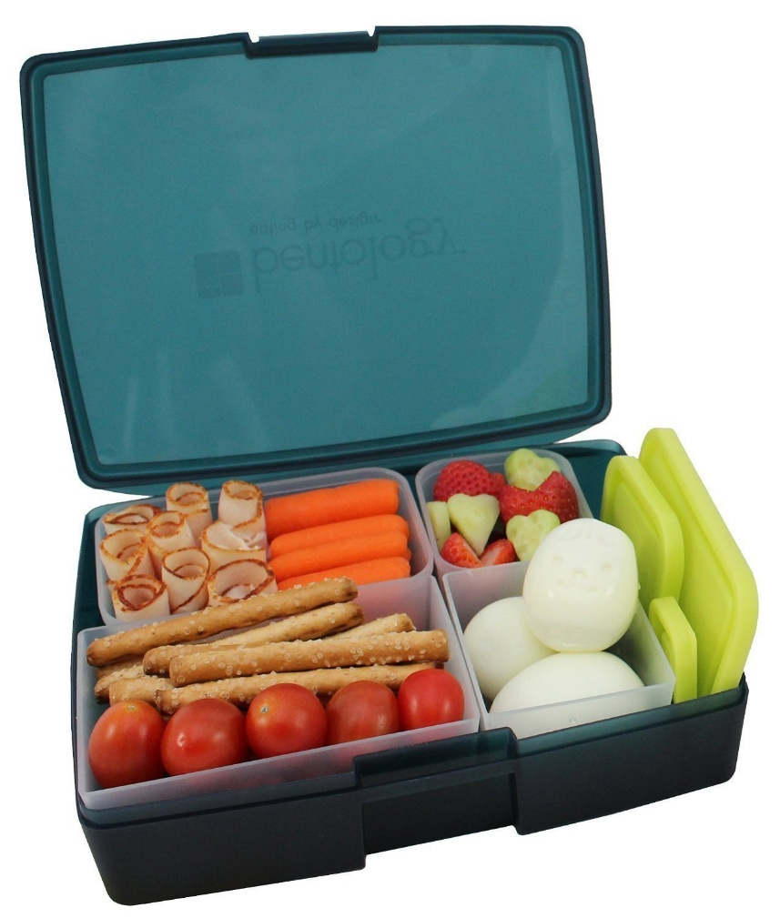
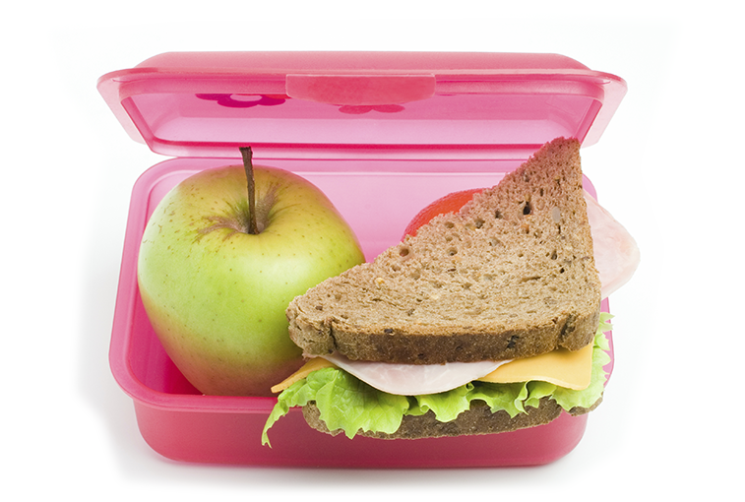
lunch box

Slide 3
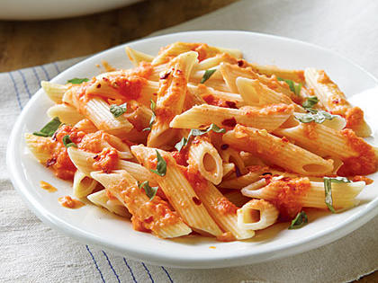
pasta

Slide 4
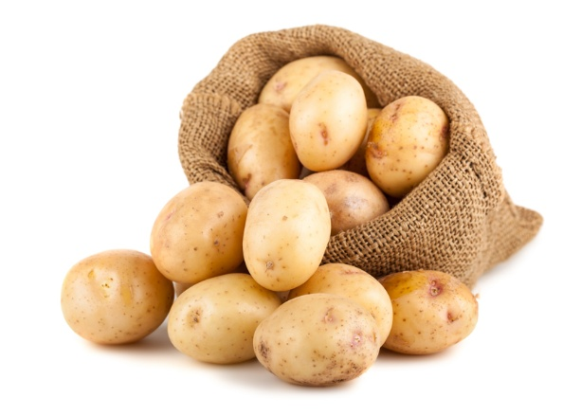
potatoes

Slide 5
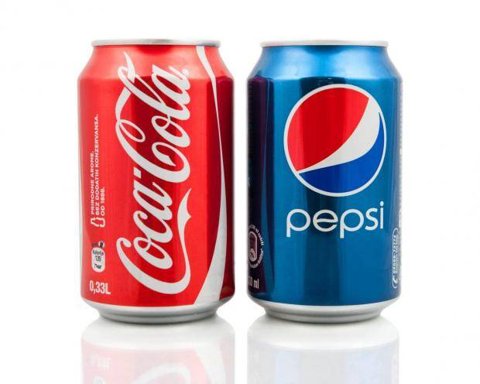
Coke

Slide 6
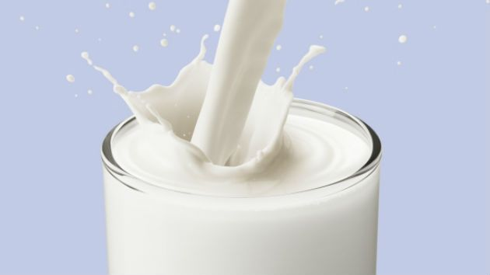
milk

Slide 7
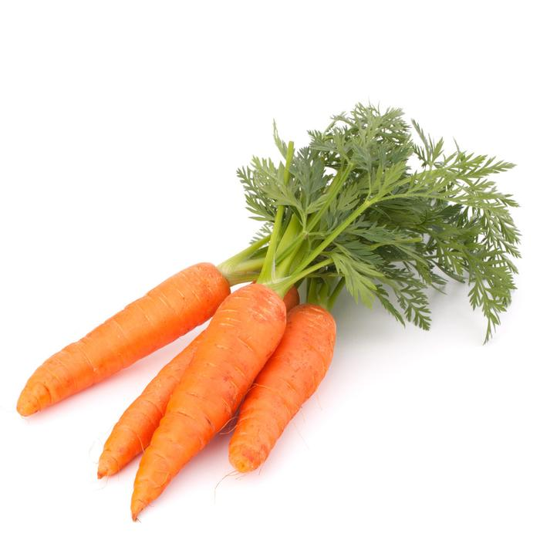
carrots

Slide 8
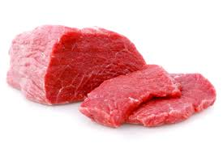
meat

Slide 9
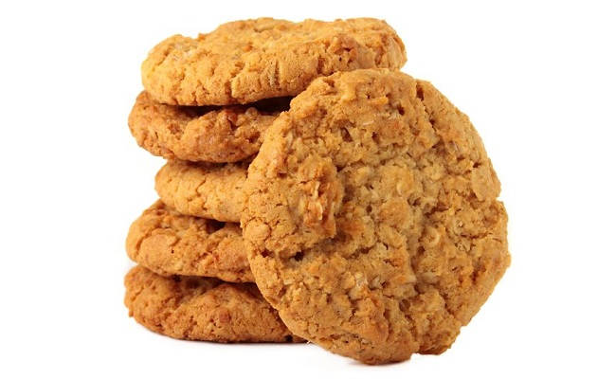
biscuits

Slide 10
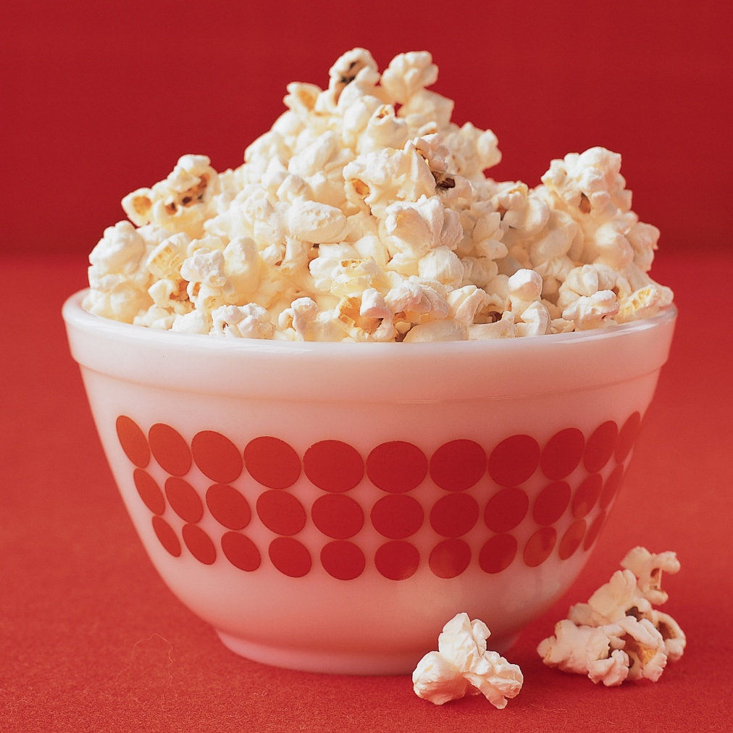
Popcorn

Slide 11
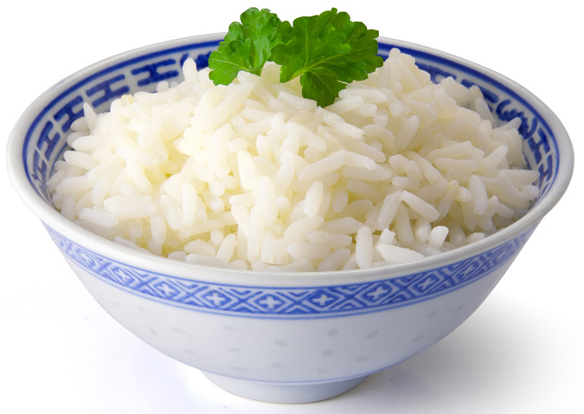
rice

Slide 12
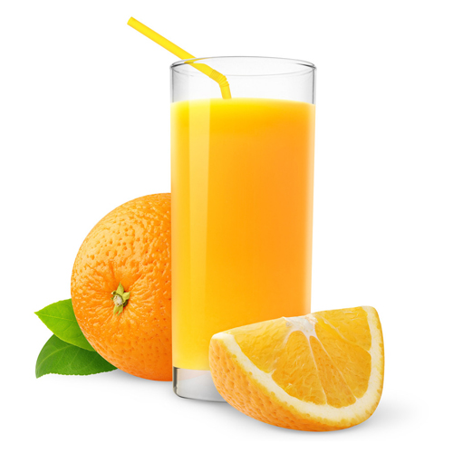
Orange juice

Slide 13
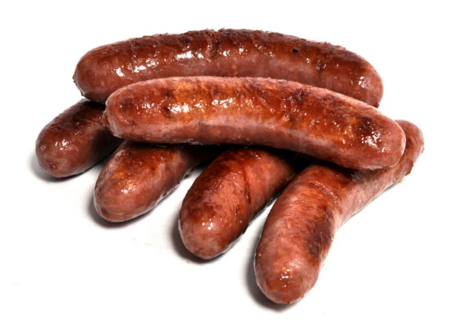
sausages

Slide 14
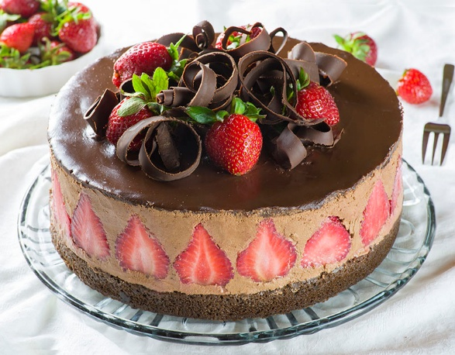
cake

Slide 15
some any
немного, несколько, некоторое количество
We have got some biscuits.
We haven’t got any biscuits.
Have you got any biscuits?
НО:
Can I have some biscuits, please?

Slide 16
Have you got….?
Have you got any potatoes?
Yes, I have some.
No, I haven’t any.

