Slide 1
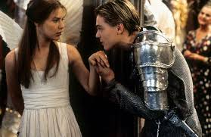
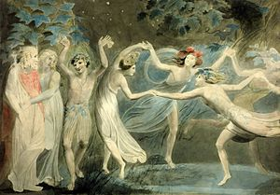
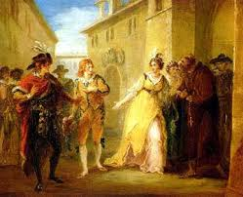
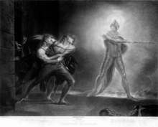
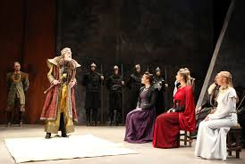
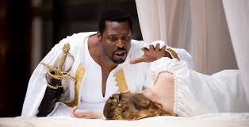
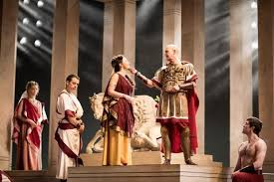
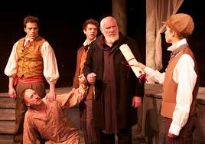
Shakespeare’s Plays.

Slide 2
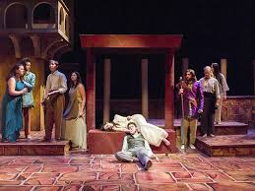
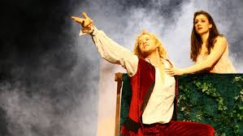
Romeo and Juliet.
An age-old vendetta between two powerful families erupts into bloodshed.
In a desperate attempt to be reunited with Romeo, Juliet fakes her own death.
The message fails to reach Romeo, and believing Juliet dead, he takes his life
in her tomb.
Juliet wakes to find Romeo’s corpse beside her and kills herself.
The grieving family agree to end their feud.

Slide 3
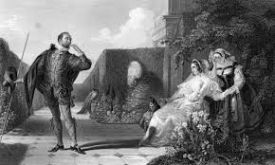
Twelfth Night.
It is a romantic comedy by William Shakespeare, believed to have
been written around 1601–1602 for the close of the Christmas
season. The play centres on the twins Viola and Sebastian,
who are separated in a shipwreck. Viola (who is disguised as Cesario)
falls in love with Duke Orsino, who in turn is in love
with Countess Olivia. Upon meeting Viola, Countess Olivia
falls in love with her thinking she is a man.

Slide 4
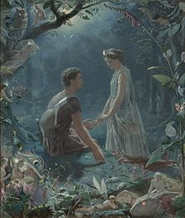
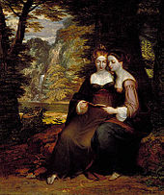
A Midsummer Night's Dream
It is a comedy written by William Shakespeare in 1595/96. It portrays the events
surrounding the marriage of Theseus, the Duke of Athens, to Hippolyta
(the former queen of the Amazons). These include the adventures of four young
Athenian lovers and a group of six amateur actors (the mechanicals) who are
controlled and manipulated by the fairies who inhabit the forest in which most
of the play is set. The play is one of Shakespeare's most popular works
for the stage and is widely performed across the world.

Slide 5
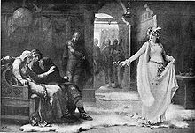
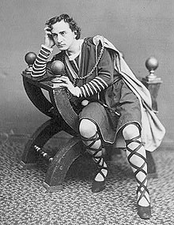
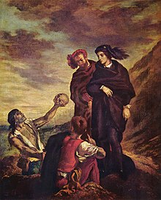
Hamlet
It is a tragedy written by William Shakespeare
sometime between 1599 and 1601.
It is Shakespeare's longest play with 30,557 words.
Set in Denmark, the play depicts Prince Hamlet
and his revenge against his uncle, Claudius,
who has murdered Hamlet's father in order
to seize his throne and marry Hamlet's mother.

Slide 6
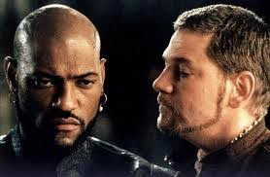
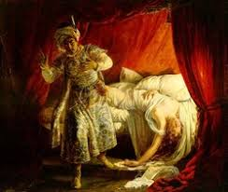
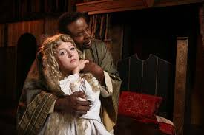
Othello
It is a tragedy by William Shakespeare, believed to have been written in 1603.
It is based on the story Un Capitano Moro ("A Moorish Captain") by Cinthio
(a disciple of Boccaccio's), first published in 1565.^{[2]} The story revolves around its
two central characters: Othello, a Moorish general in the Venetian army,
and his treacherous ensign, Iago. Given its varied and enduring themes of racism,
love, jealousy, betrayal, revenge, and repentance,
Othello is still often performed in professional and community theatre alike,
and has been the source for numerous operatic, film, and literary adaptations.

Slide 7
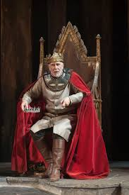
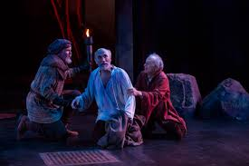
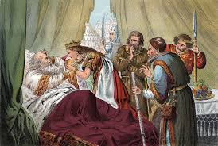
King Lear
It is a tragedy written by William Shakespeare. It tells
the tale of a king who bequeaths his power and land
to two of his three daughters, after they declare their
Love for him in an extremely fawning and obsequious
manner. His third daughter gets nothing, because
she will not flatter him as her sisters had done.
When he feels disrespected by the two daughters
who now have his wealth and power, he becomes
furious to the point of madness. He eventually
becomes tenderly reconciled to his third daughter,
just before tragedy strikes her and then the king.

Slide 8
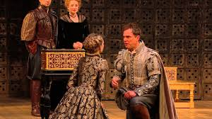
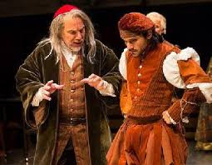
The Merchant of Venice
It is a 16th-century play written by William Shakespeare in which a merchant in
Venice named Antonio defaults on a large loan provided
by a Jewish moneylender, Shylock. It is believed to have been written
between 1596 and 1599. Although classified as a comedy in the First Folio
and sharing certain aspects with Shakespeare's other romantic comedies,
the play is most remembered for its dramatic scenes, and it is best known
for Shylock and his famous "Hath not a Jew eyes?" speech
on humanity. Also notable is Portia's speech about "the quality of mercy".
Critic Harold Bloom listed it among Shakespeare's great comedies.^{[1]}

Slide 9
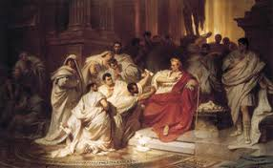
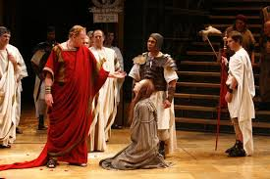
The Tragedy of Julius Caesar
It is a history play and tragedy by William Shakespeare,
believed to have been written and first performed
in 1599. It is one of several plays written by Shakespeare
based on true events from Roman history, such as
Coriolanus and Antony and Cleopatra.
Set in Rome in 44 BC, the play depicts the moral dilemma
of Brutus as he joins a conspiracy led by Cassius
to murder Julius Caesar to prevent him from becoming
dictator of Rome. Following Caesar's death, Rome is
thrust into a period of civil war, and the republic
the conspirators sought to preserve is lost forever.
Although the play is named Julius Caesar, Brutus speaks
more than four times as many lines as the title character;
and the central psychological drama of the play focuses
on Brutus' struggle between the conflicting demands
of honour, patriotism, and friendship.

Slide 10
Thank you for attention.

