Slide 1
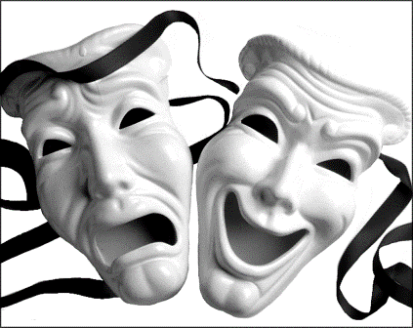
ГОКУ АО
«ОБЩЕОБРАЗОВАТЕЛЬНАЯ ШКОЛА ПРИ УЧРЕЖДЕНИЯХ ИСПОЛНЕНИЯ НАКАЗАНИЯ»
WHAT DO YOU KNOW ABOUT CINEMA?
Подготовила учитель английского языка Листратова О.В.

Slide 2
Союзные слова
who и which
который
одушевленный неодушевленный

Slide 3
For example:
1. Paramount pictures is a large corporation which consists of several studios
2. Mary Pickford is an American film star who took part in silent films in the 1920s

Slide 4
Глагол настоящего времени | Глагол прошедшего времени | Перевод
To be | was | был
To create | created | создал
Found | founded | основал
To shoot | shot | снял
To star | starred | сыграл
To win | won | выиграл

Slide 5
Warner brothers | L. Gaiday E. Ryazanov | Sergei Eisenstein
Titanic | Leonardo DiCaprio | Arrival of a Train
American producer | To be | WB company
Russian director | To create | The first film in the world
American actor | Found | Romeo and Juliet
American film | To shoot | 11 Oscars
Russian director | To shoot | The Battle Ship Potemkin
Russian director | To star | A lot of comedies
French film | To win | The Caucasian Prisoner

Slide 6
For example:
Arrival of a Train is a French film was the first film in the world

